Slide 1
Streamlining Deep Brain Stimulation
Julie G. Pilitsis MD, PhD
Chair - Department of Neuroscience and Experimental Therapeutics
Professor - Department of Neurosurgery
Albany Medical College, Albany, NY

Slide 2
Disclosures
Consultant for, Boston Scientific, Nevro, TerSera, and Abbott
Receives grant support from Medtronic, Boston Scientific, Abbott, Nevro, TerSera, NIH 2R01CA166379-06 and NIH U44NS115111
Medical advisor for Aim Medical Robotics and Karuna (stock equity)

Slide 3
Secrets to Success
Streamlining DBS surgery requires a consistent approach and a well-informed team
Prepare an algorithm, distribute to team members
Ensure everyone stays on message

Slide 4
Top 10 Steps to Success
Know the Target, Know the Patient
Know Your Guidelines
Plan and Review in Advance
Knowing the Steps… from 1-100
Assembling the Right Team
Frame Placement Protocol
Consistent OR Setup
Efficient Physiological Localization
Same Day Lead Confirmation
Effective Communication is Essential

Slide 5
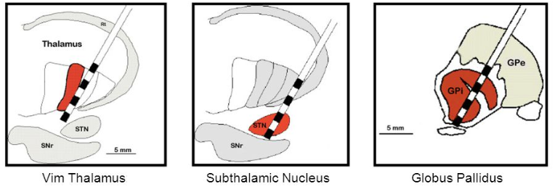
1. Know the Target, Know the Patient
Check patient labs, urinalysis, !coagulation factors!
ASA, NSAIDS, vitamins, etc. – stop 1 week before surgery
MAOI – work out plan with anesthesia if should be held
Carbidopa-Levodopa – patient to bring in all home meds; Bring IR to OR to be given once awake in OR or PACU.
Notes:
target determined in multidisciplinary conference
know why GPi is chosen over STN in PD, for example
consideration for medical and psychological comorbidities

Slide 6
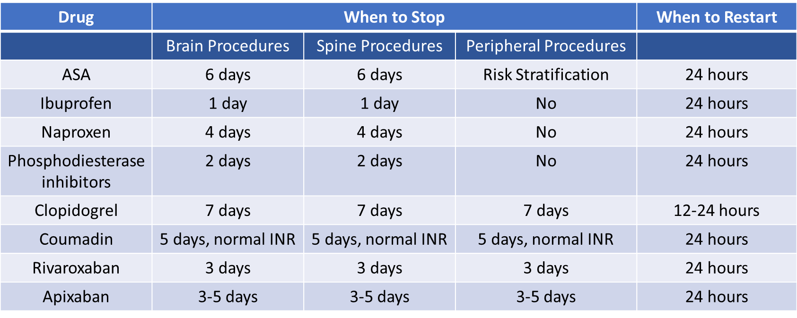
2. Know Your Guidelines
NACC Anticoagulation Recommendations
Deer TL et al. "The Neurostimulation Appropriateness Consensus Committee (NACC): Recommendations on Bleeding and Coagulation Management in Neurostimulation Devices." Neuromodulation. 2017 Jan;20(1):51-62.

Slide 7
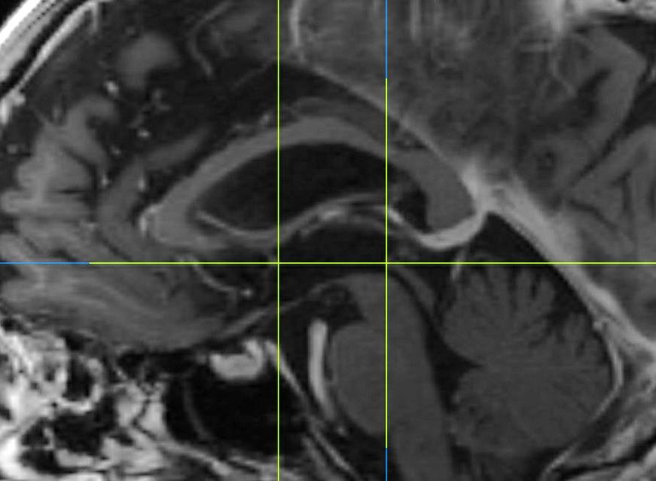
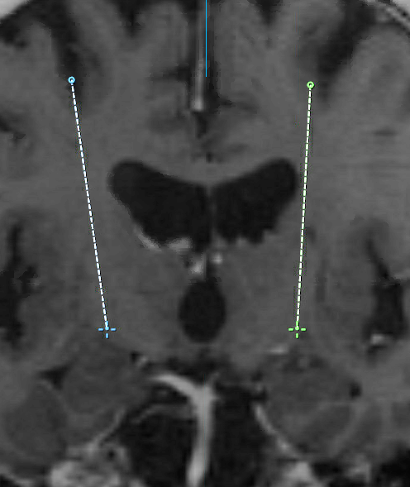
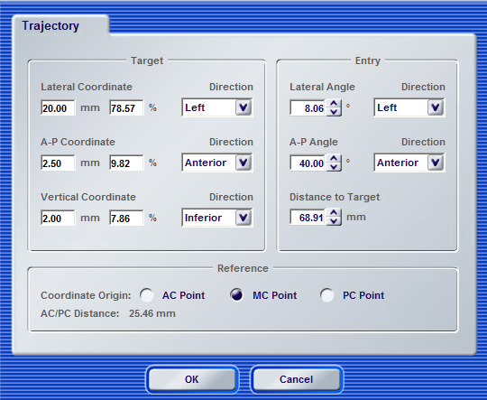
3. Plan and Review in Advance
Notes:
ensure MRI is appropriate (especially if not done under GA) well in advance
plan up to a week in advance
practice AC-PC line
use standard indirect target measurements

Slide 8
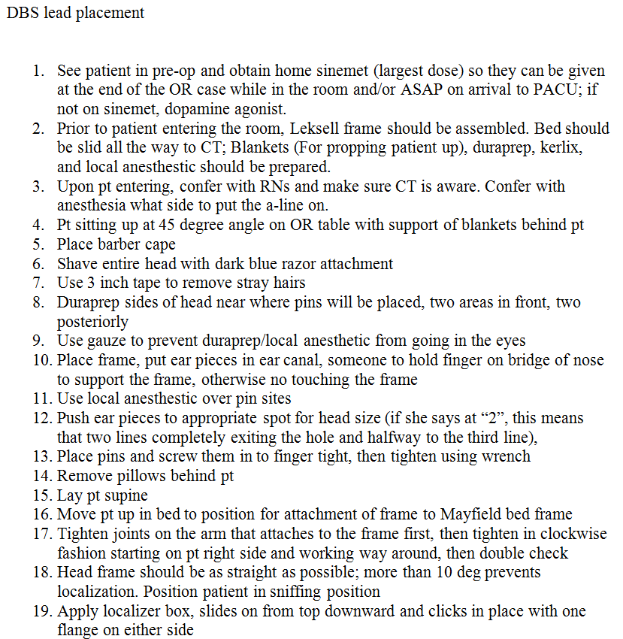
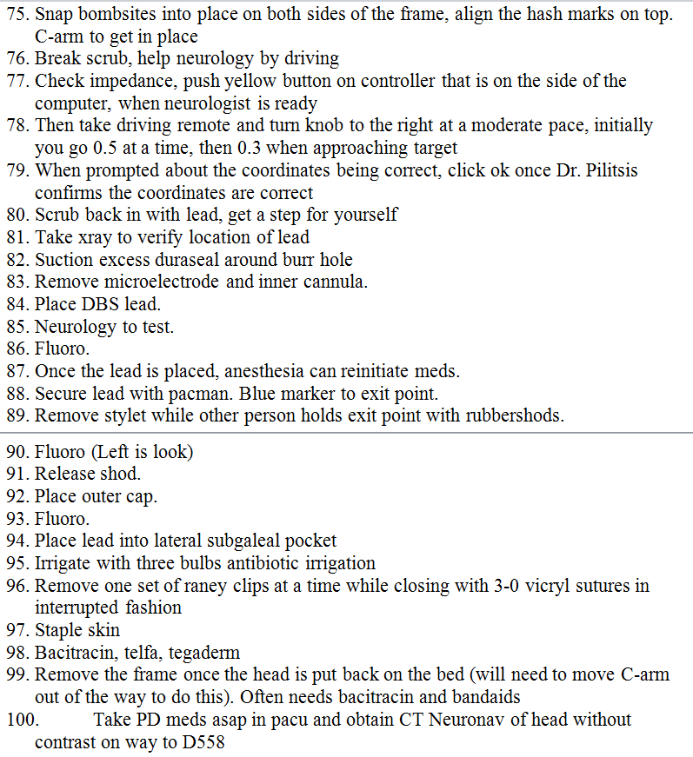
4.Knowing the Steps… from 1-100
Notes:
distribute algorithm to every team member

Slide 9
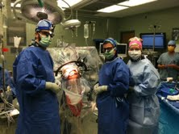
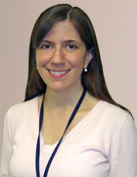
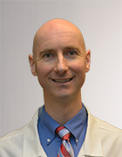
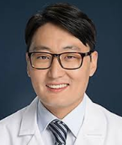
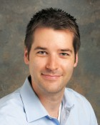
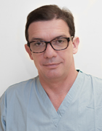
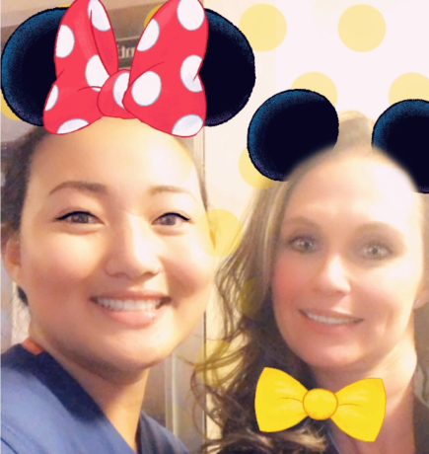
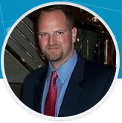
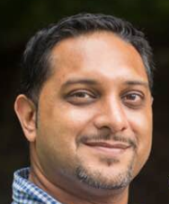
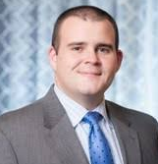
5. Assembling the Right Team
Neurology
Residents & Fellows
Anesthesia
Nursing
Industry
Notes:
not pictured: CT techs, fluoroscopy
everyone has a role, everyone knows their role

Slide 10
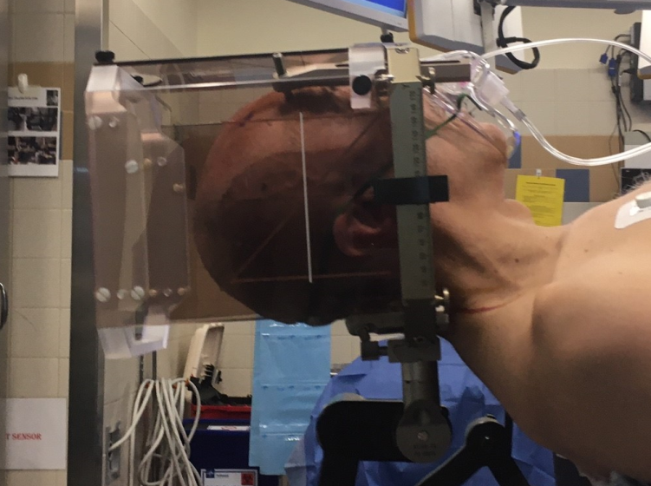
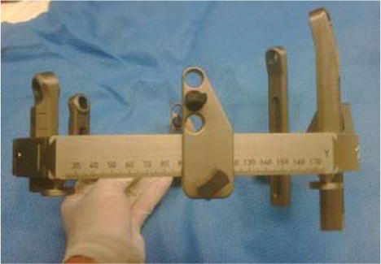
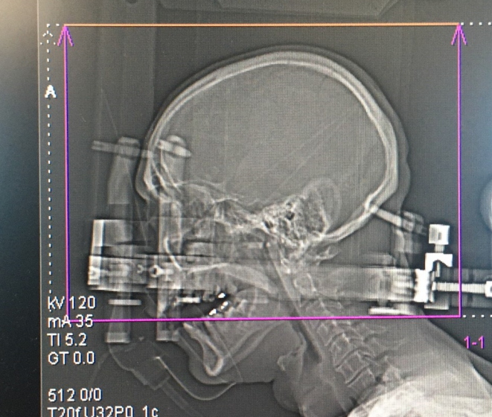
6. Frame Placement Protocol
Front bars: 4th line
Back bars: 1st line
Ear bars: 90 mm
Notes:
frame prepared prior to OR
always placed in same manner
plan for bilateral placement, want to ensure minimal-to-no adjustments are needed to stereotactic plan

Slide 11
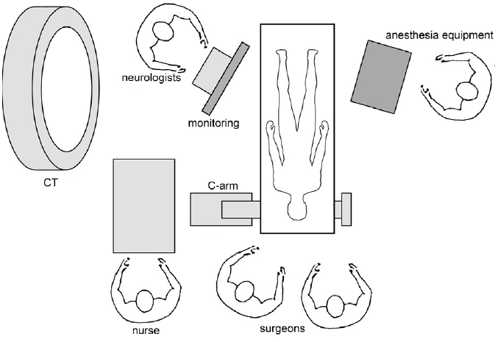
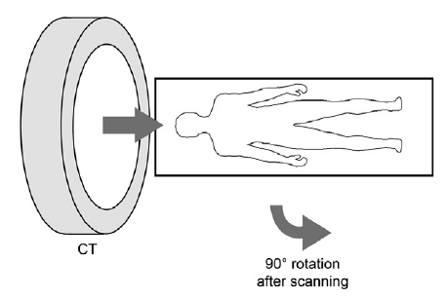
7. Consistent OR Setup
Notes:
OR always set up the same way
every OR attendee has a defined role, i.e. resident rotates bed, preps head; anesthesia inserts art line; plan simultaneously merged

Slide 12
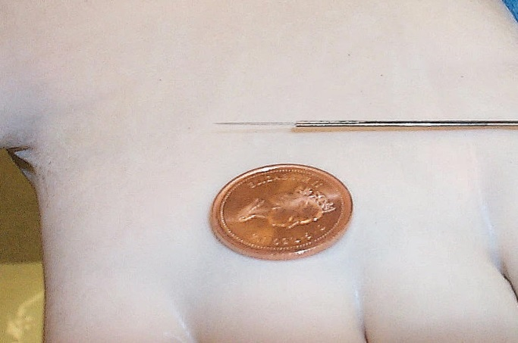
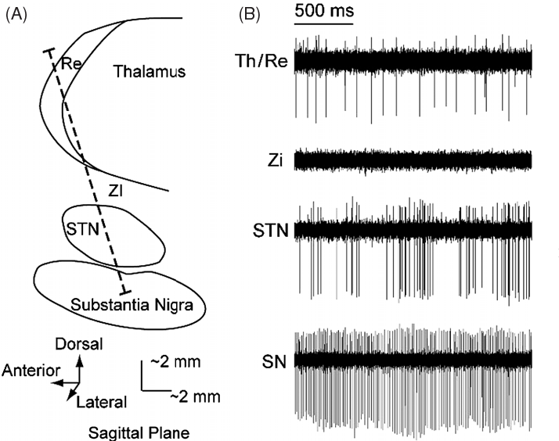
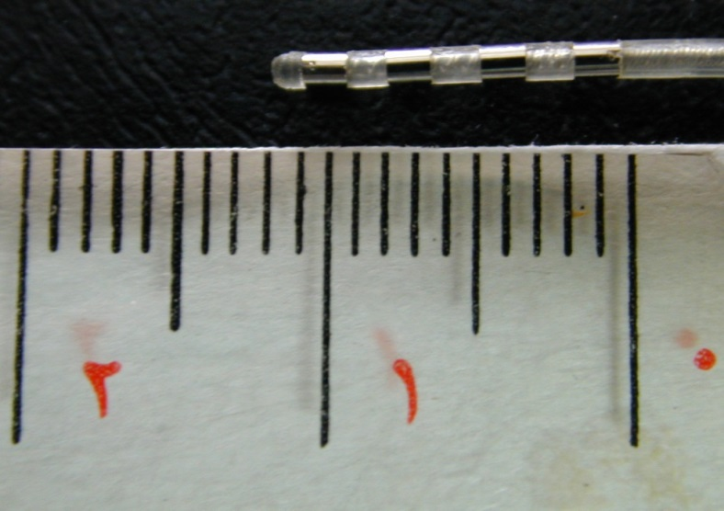
8. Efficient Physiological Localization
Wong S et al. "Functional localization and visualization of the subthalamic nucleus from microelectrode recordings acquired during DBS surgery with unsupervised machine learning." J Neural Eng. 2009 Apr;6(2):026006.
Microelectrode / Macroelectrode
Notes:
plan with neurology not to be in OR all day
minimize number of tracks performed
start 10 mm above target, descend by 0.5 mm
one person drives electrode, another tests patient
joint decision on optimal track and depth

Slide 13
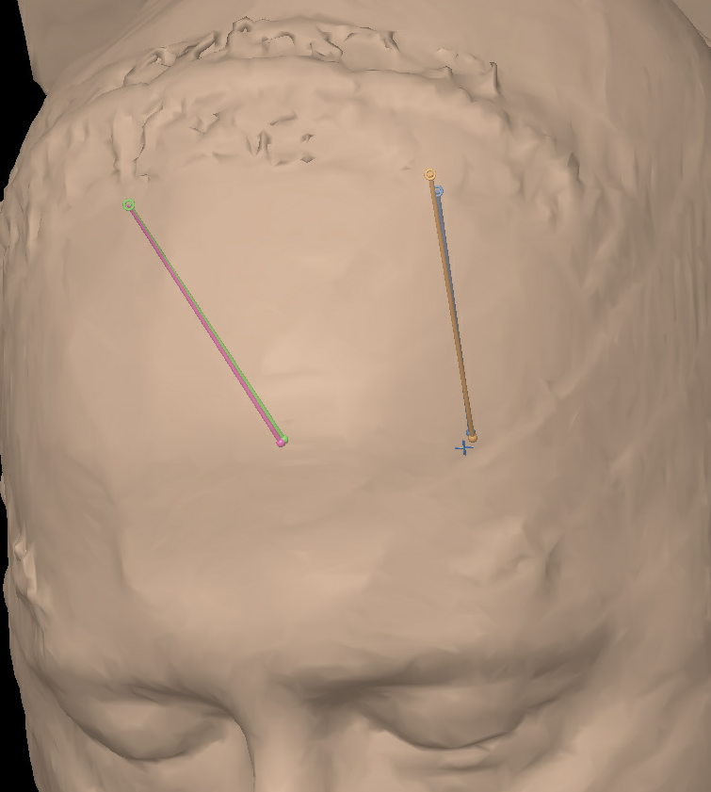
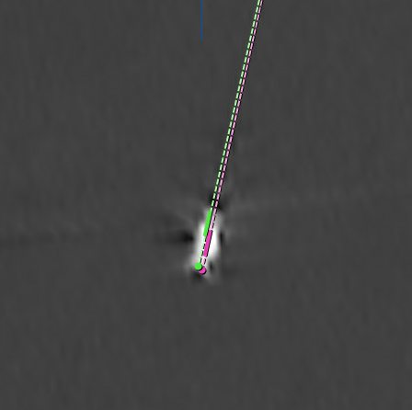
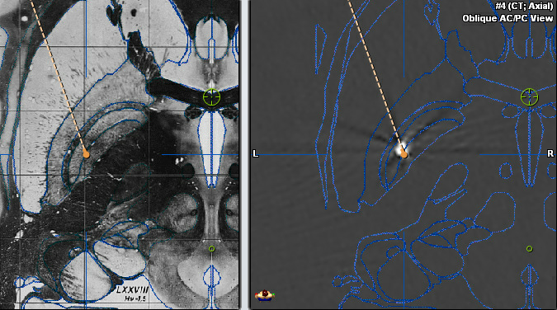
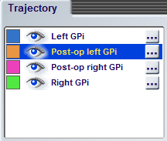
9.Same Day Lead Confirmation
Notes:
ensure post-op CT done within a few hours of surgery
tell PACU nurses that CT must be done en route to floor bed
inform MD if deviation >2 mm

Slide 14
10. Effective Communication is Essential!
MD
Device Rep
OR Team
Residents & Fellows
Patient

Slide 15
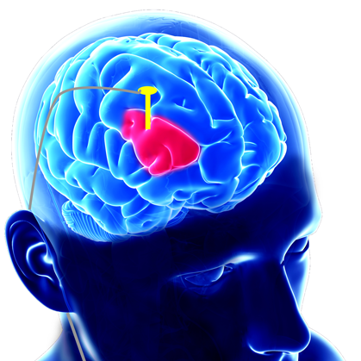
Conclusions
DBS surgery has a lot of moving parts, where a single error can lead to significant consequences
It’s important to define and understand the role of every participant
Having an algorithmic approach can streamline DBS planning and surgery

Slide 16
Thank you!
Clinical Team
Vishad Sukul, MD
Michael Staudt, MD
Laura Lambiase, PA
Jeffrey Foley, PA
Ellie Hobson, BS RN
Cheyanne Bridger, BS
Research Team
Damian Shin, PhD
Julia Nalwalk, M.Sc.
Michael Gillogly, BA/BS RN
Margaret Czerwinski, RN
Ilknur Telkes, PhD
Emilia Iannilli, PhD
Marisa DiMarzio, PhD
Olga Khazen, BS
Teresa Maietta, BS
Abigail Hellman, BA
Vraj Patel
Jonathan Bao
Zahabiya Campwala
Jackie MacDonnell
William Foland
Ellinor Grinde
Pya Seidner
Movement Disorders
Eric Molho, MD
Jennifer Durphy, MD
Era Hanspal, MD
Octavian Adam, MD
Anne Barba, PhD
Gia LaRuffa, PhD
Dzintra Celmins, MD
Pain Specialist
Charles Argoff, MD
Funding Sources:

Slide 17
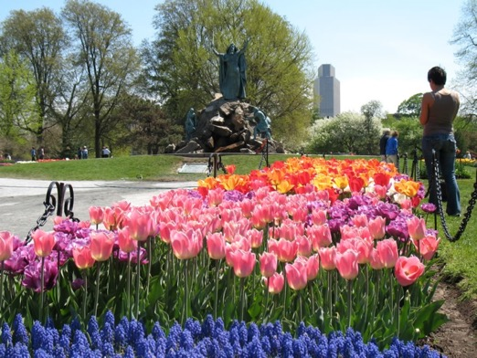
Thank you!
For questions, please feel free to contact me at jpilitsis@yahoo.com
Saratoga Horse Races
Tulip festival in Albany NY

