Slide 1
Asleep or Awake DBS:
Which Should You Do?
Jonathan Miller, MD
Professor of Neurological Surgery
Case Western Reserve University
University Hospitals Case Medical Center

Slide 2
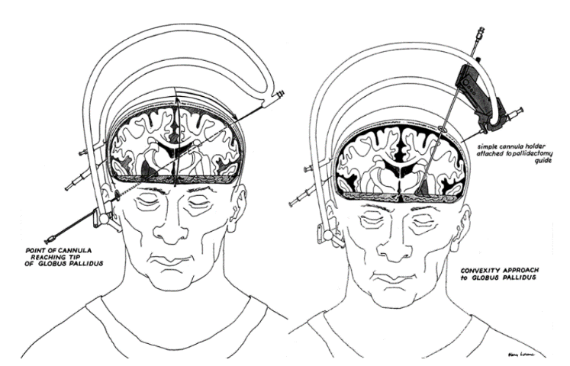
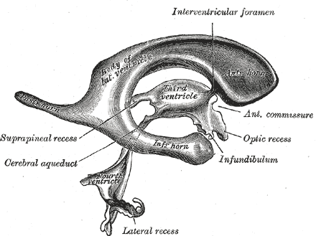
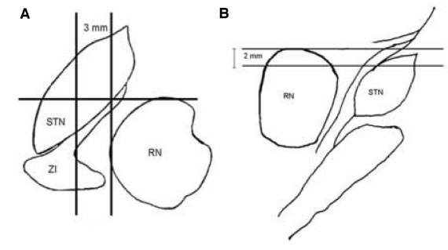
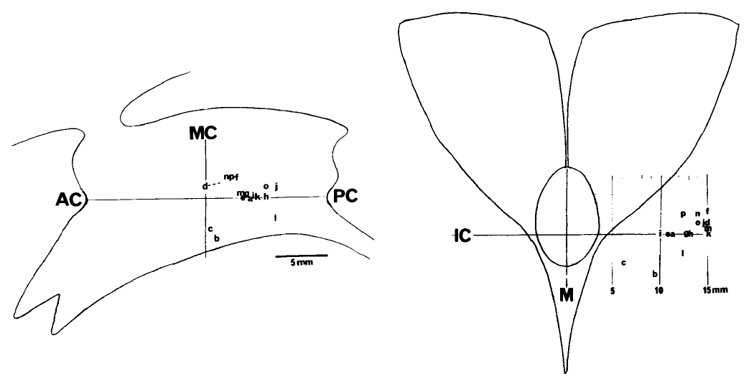
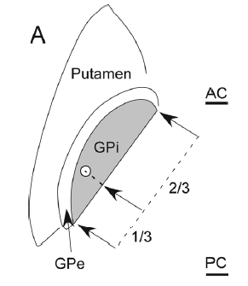
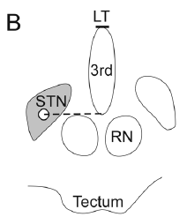
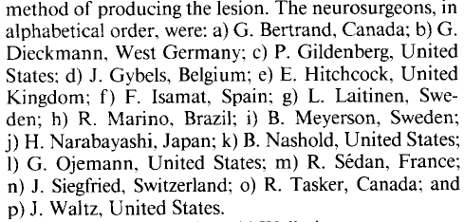
Background
Neuromodulation for movement disorders originated from therapeutic lesions, which were originally targeted using ventriculography
Modern MRI techniques allow direct visualization of targets of interest and intraoperative verification of lead placement
Survey of Ideal PD Tremor Target (1985)
Laitinen, J Neurosurg 1985 Mar;62(3):349-51.
Andrade-Souza et al., Neurosurgery 2008;62 Suppl 2:875-83.
Starr et al., J Neurosurg Pediatr. 2014 Oct;14(4):400-8.

Slide 3
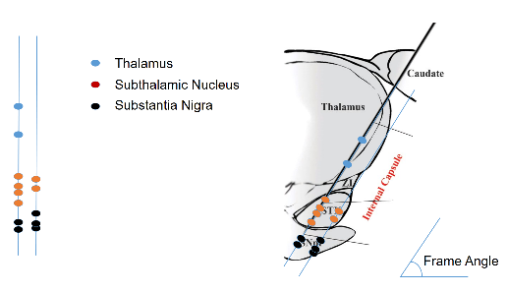
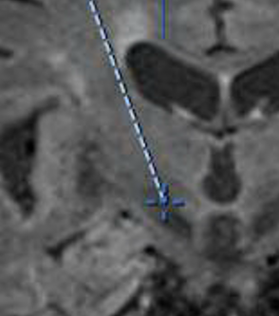
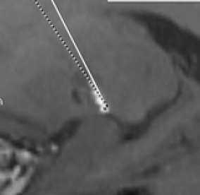
“Awake” vs. “Asleep” DBS: Advantages of Each
The controversy is not about anesthetic technique but about how accurate lead placement is verified
The goal is to correct for targeting error (spatial inaccuracy, distortion, brain shift, brain deflection)
“Awake” DBS = MER/Mapping
“Asleep” DBS = Intraoperative Imaging
Physiological (functional) target
Anatomic (structural) target
Extremely high spatial accuracy (<0.1 mm)
Lower risk (hemorrhage, edema, cognitive decline)
Works even when MRI not available (e.g., pacemaker) or suboptimal (artifact/movement)
Lower operative time, complexity, cost, CSF loss, pneumocephalus, discomfort (not awake off meds)
Allows intraoperative “test drive” to confirm stimulation therapeutic effects/side effects
Better speech outcome (phonemic/category fluency)
Targets least tolerant of misplacement are visible on MRI
Excellent research tool
Stim volume is large and defined empirically during programming, so 0.1 mm accuracy may be unnecessary
Fewer off-target effects, which may affect durability

Slide 4
Awake DBS (MER) Increases Surgical Risk
Study | Type | With MER | Without MER | Difference in Complications with MER | Difference in Outcome with MER
Alkhani and Lozano, J Neurosurg 2001;94(1):43-49. | Meta-analysis, pallidotomy | 903 | 1051 | MER associated with significantly higher rate of hemorrhage, postoperative weakness/dysphagia, and overall complications (p=0.003) | No difference in UPDRS
Palur et al., J Neurosurg 2002;96(6):1058-62. | Meta-analysis, pallodotomy | 302 | 184 | Significantly higher risk of hemorrhage with MER (1.3% vs. 0.25%, p=0.012) | No difference in UPDRS or dyskinesia
De Bie et al., Neurology 2002;58(7):1008-12. | Meta-analysis, pallidotomy | 198 | 136 | Adverse effects 14.4% higher, stroke 4.9% higher with MER | N/A
Hariz et al., Stereotact Funct Neurosurg 2002;78(3-4):146-57. | Meta-analysis, thalamotomy and pallidotomy |  |  | 5-fold increase in risk of complications | No difference
Higuchi and Iacono, Neurosurgery 2003;52(3):558-71. | Retrospective single-institution, pallidotomy | 73 | 723 | Risk of hemorrhage 3.82x higher, risk of postoperative hemiparesis without hemorrhage 6.1x higher with MER (p=0.001) | N/A
Gorgulho et al., J Neurosurg 2005;102(5):888-96. | Retrospective single-institution, pallidotomy and DBS | 104 | 144 | Hemorrhage increased from 1.4% to 2.9% when MER used, correlated with number of passes | N/A
DBS for PD study group, NEJM 2001;345(13):956-63. | Prospective double blind study, DBS | 134 | 0 | Number of passes strongly correlated with hemorrhage (4.1 passes in cases with hemorrhage vs. 2.9 passes in cases without hemorrhage) | N/A
Binder et al., Neurosurgery 2005;56(4):722-32. | Retrospective single-institution, DBS | 280 | 0 | Hemorrhage rate 3.3%; correlated with number of passes and target (GPi worse) | N/A
Zrinzo et al., J Neurosurg 2012;116(1):84-94. | Retrospective single-institution, DBS | 0 | 214 | MER not used; hemorrhage rate 0.9% compared with up to 5.0% in prior studies | N/A

Slide 5
Clinical Results are Similar Using Either Technique
Study | Technique | Patients | Results
Starr et al., J Neurosurg 2010;112(3):479-90. | MRI (NexFrame) | 29 | Single electrode passed in 87%, no complications; UPDRS decreased 60%; faster, greater comfort
Larson et al., Neurosurgery 2012;70(1 Suppl):95-103. | MRI (Clearpoint) | 18 | Error 0.2 +/- 0.1 mm, 88 min procedure time
Ostrom et al., Clin Neurol Neurosurg 2013;115:708-12. | MRI (NexFrame) | 17 | UPDRS decreased from 44.5 to 22.5 (49.4%), which is similar to MER-guided awake DBS; no complications
Burchiel et al., J Neurosurg 2013;119(2):301-6. | CT (NexFrame) | 60 | Mean deviation off trajectory only 1.59 +/- 1.11 mm, one infection, no hemorrhage; also no pneumocephalus (seen in every case previously)
Starr et al., J Neurosurg Peds 2014;14(4):400-8. | MRI (Clearpoint) | 6 | Error 0.6 +/- 0.5 mm, BFMDRS decreased 87.6% +/- 19.2%, similar to MER-guided; no complications
Jiminez-Shahed et al., Mov Disord 2014;29(Suppl 1):1202. | MRI (Clearpoint) | 3 MRI, 5 MER (randomized) | MER more likely than MRI to have microlesion (80% vs. 33%), greater targeting error (0.6 vs. 1.1 mm), and postoperative confusion
Saleh et al., Stereotact Funct Neurosurg 2015;93(6):419-26. | MRI (Clearpoint) | 14 MER, 23 MRI | Levodopa dosage decreased 38% for MER, 49% for MRI
Chen et al., J Neurosurg 2015;27:1-8. | CT (NexFrame or Leksell) | 40 awake, 17 asleep (no MER in either) | No difference in BFTADL (-32.1 awake, -27.0 asleep, n.s.); error higher in awake patients (1.7 vs 0.8 mm)
Ostrem et al., J Neurosurg 2016;124(4):908-16. | MRI (Clearpoint) | 26 | Single electrode passed in all cases, significant improvement in UPDRS (40.75 to 24.35, p=0.001) and levodopa dosage, one infection, no hemorrhage or cognitive/mood decline
Mirzadeh et al., J Neurosurg 2016;124(4):902-7. | CT (Leksell) | 35 | Error 0.8 mm, significant improvement in UPDRS (48.4 to 28.9, p<0.001), PDQ-39 and levodopa dosage, no complications
Jacob et al., J Neurosurg 2016;124(5):1517-23. | CT (NexFrame) | 53 MER, 158 asleep | Asleep has less variable costs; overall cost is half national average
Lefranc et al., World Neurosurg 2017;106:602-8. | CT (Robot) | 10 MER, 13 asleep | Therapeutic window and UPDRS scores identical
Brodsky et al., Neurology 2017;89(19):1944-50. | CT (NexFrame) | 39 MER, 30 asleep | Asleep has better motor outcome (UPDRS-III “on” time without dyskinesia), better speech outcome, better quality of life compared with MER

Slide 6
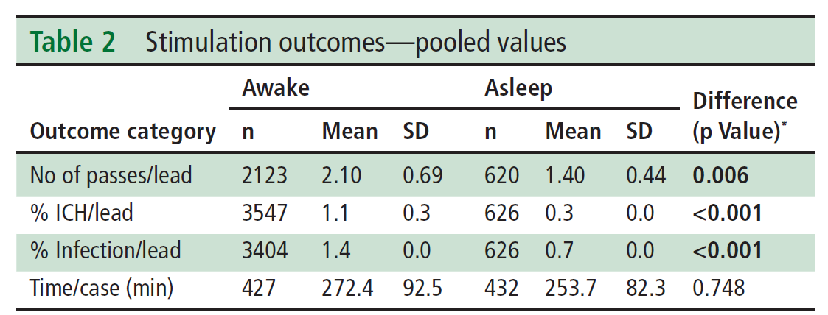
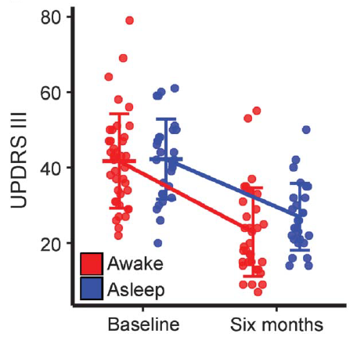
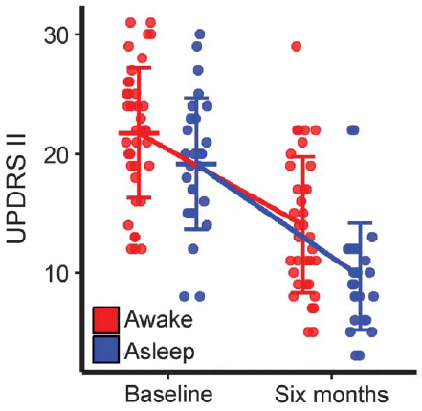
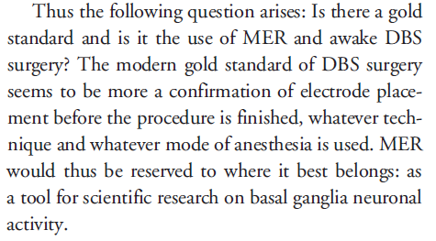
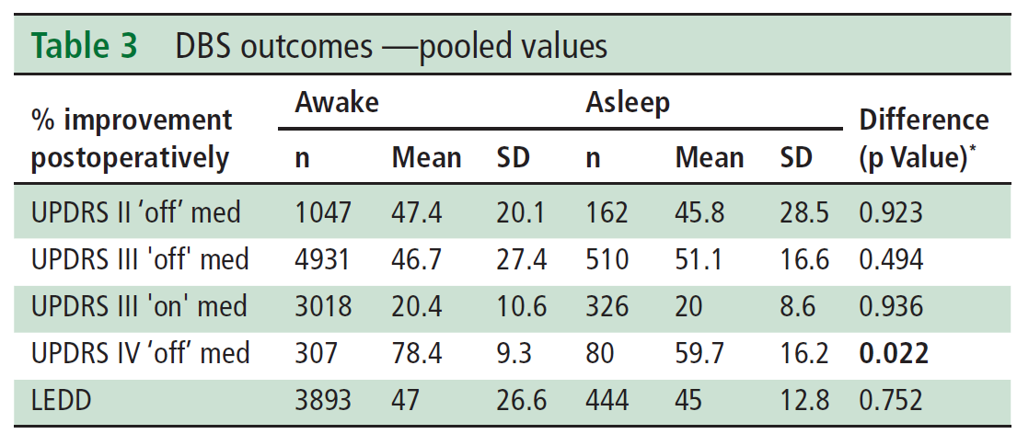
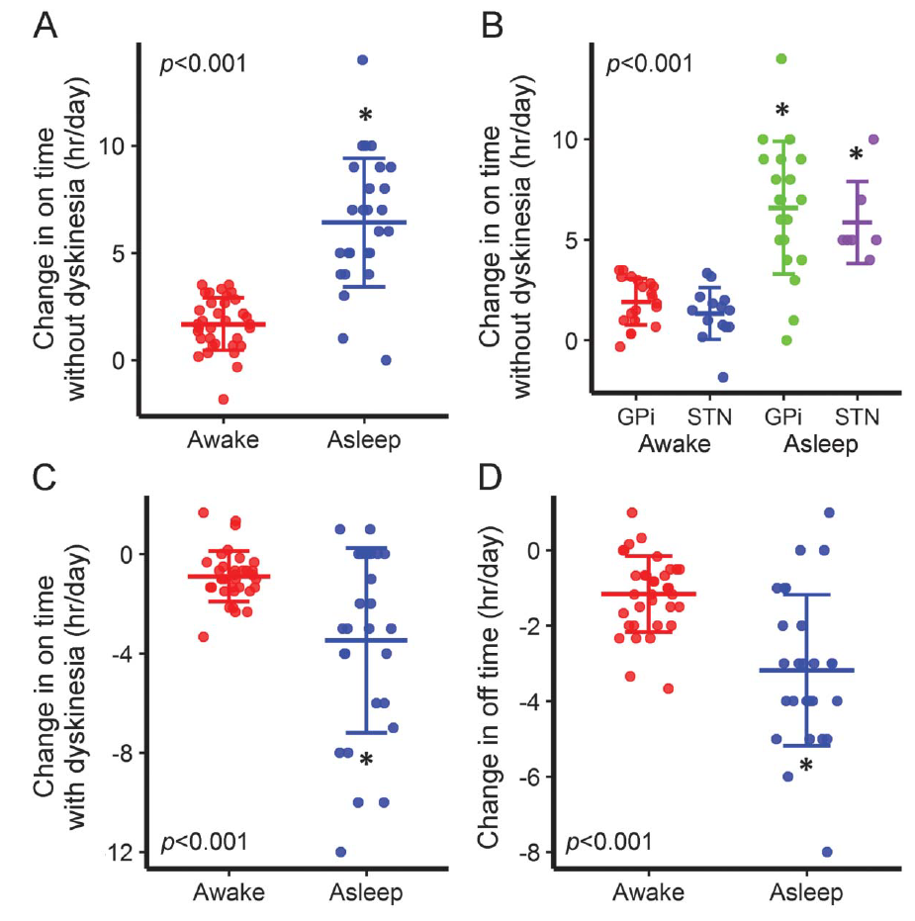
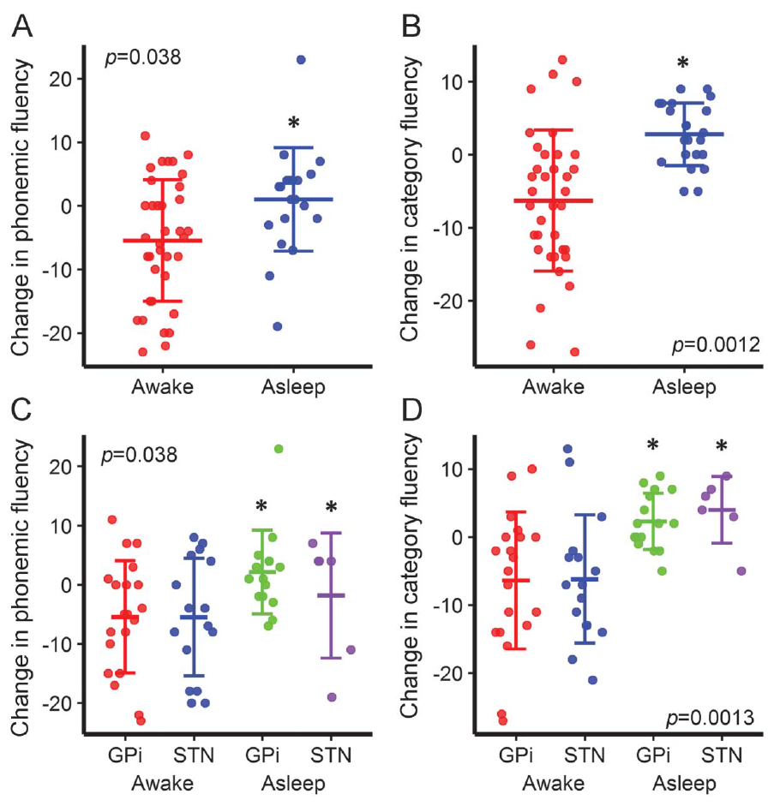
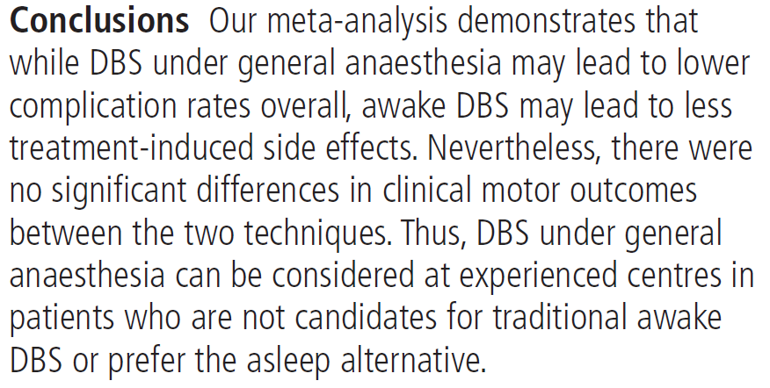
Comparison: Awake vs. Asleep
145 studies, 8382 patients
Similar UPDRS-II/III Outcome
Editorial:
Aziz and Hariz, Neurology 2017;89:1938-1939.
Asleep Better Motor Outcome
Asleep Better Speech Outcome
Brodsky et al, Neurology 2017;89:1944-1950.
Ho et al, J Neurol Neurosurg Psychiatry 2017;1:1-5.

Slide 7
Which Should You Do?
Physiology
Intraoperative Imaging
Experience/equipment?
No
MRI available/
Target visible?
Yes
Yes
Patient able to handle awake anesthesia?
No
Yes
No
Research
application?
Awake
Asleep

Slide 8
Conclusions
Both awake and asleep DBS are associated with excellent outcomes
Awake DBS is associated with greater accuracy and ability to test efficacy/side effects; fewer off-target effects (may increase durability)
Asleep DBS is associated with less hemorrhage, edema, pneumocephalus, discomfort, time, complexity, and cost; lower operative risk
There are advantages and disadvantages to each technique but no evidence that either is superior to the other

