Slide 1
Obsessive Compulsive Disorder:
To Ablate or Neuromodulate?
Brian Harris Kopell MD
Departments of Neurosurgery, Neurology, Psychiatry and Neuroscience
The Icahn School of Medicine at Mount Sinai

Slide 2
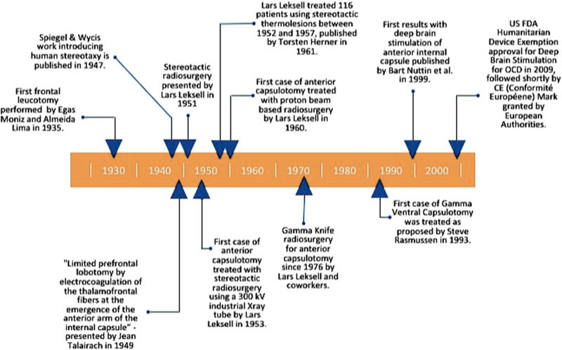
Miguel E et al 2019

Slide 3
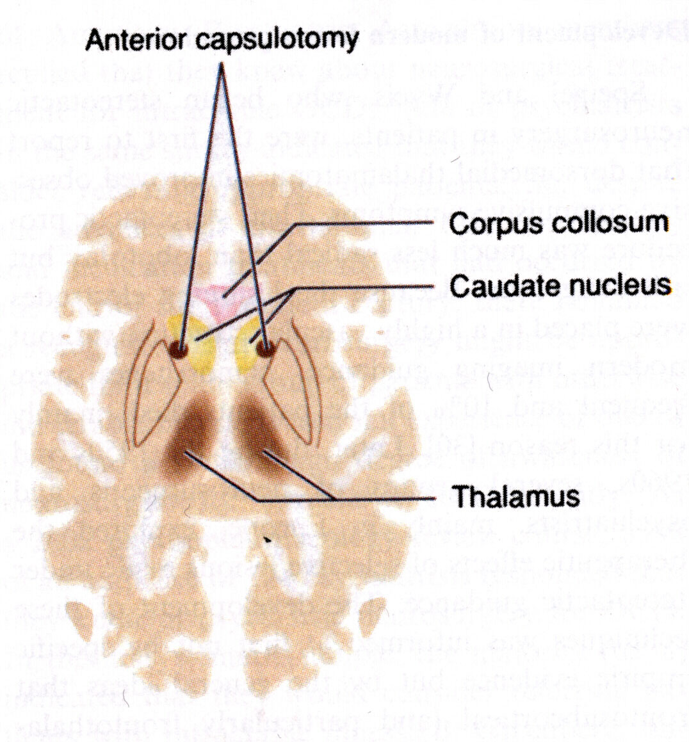
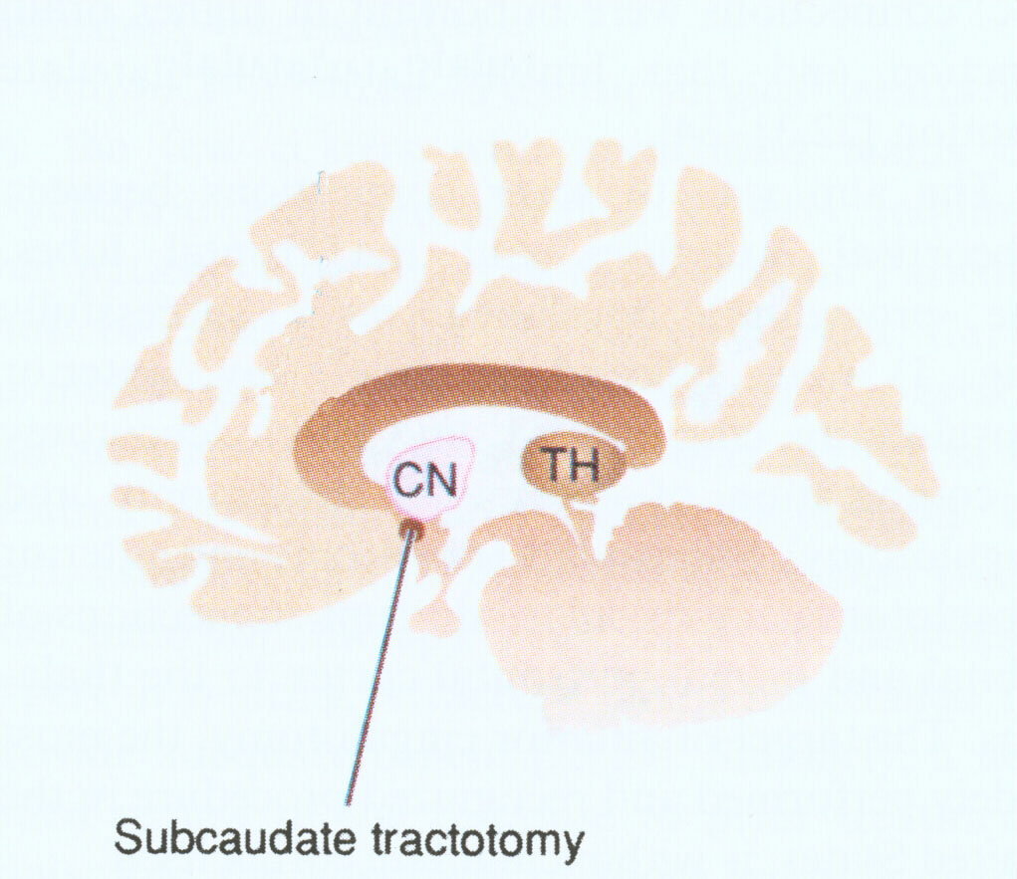
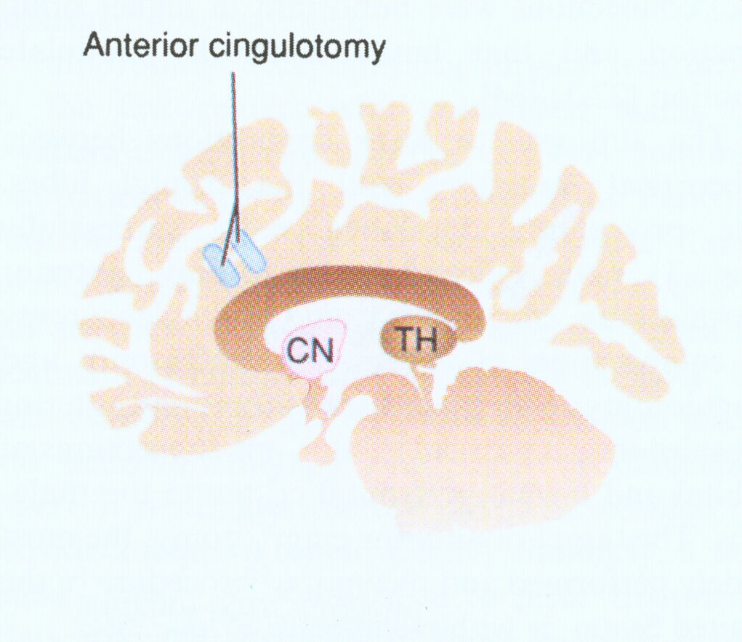
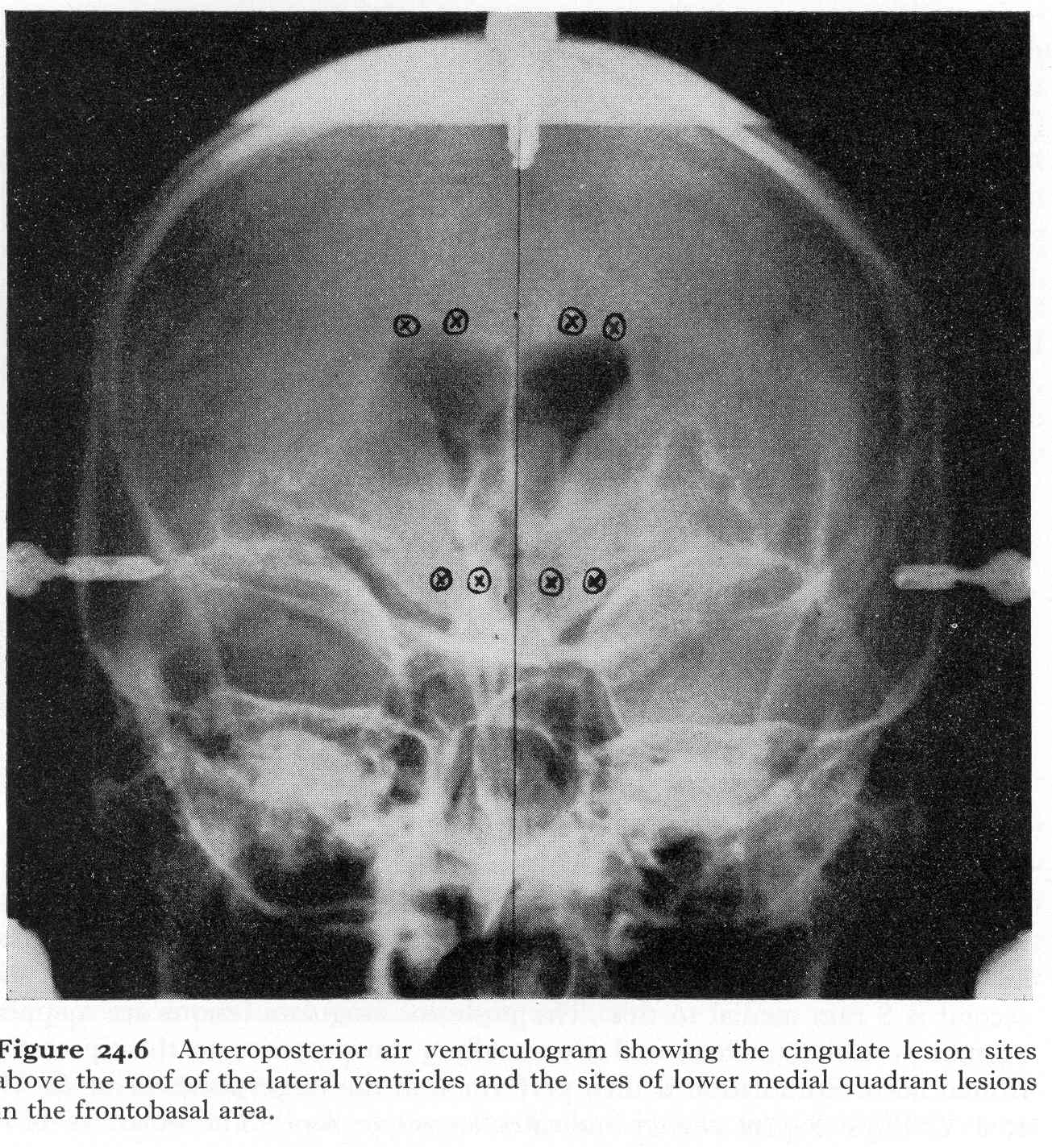
Stereotactic Lesions: Modern Psychiatric Neurosurgery
Anterior Capsulotomy
  1949: Lars Leksell in Sweden and Jean Talairach in France
Subcaudate Tractotomy
  1965: Geoffrey Knight in London
Cingulotomy
  1967: H. Thomas Ballantine of MGH
Limbic Leucotomy
  1973: Desmond Kelly (psychiatrist) and Alan Richardson (neurosurgeon), England

Slide 4
The Ablative Targets: Clustering around the Midline
Doshi 2009

Slide 5
Anterior Capsulotomy History
1949- French neurosurgeon Jean Talairach (Saint-Anne Hospital, Paris), was first to lesion the ALIC with stereotactic RF thermocoagulation for psychiatric disorders
  Yielded poor results in patients with psychosis but found to be more effective in OCD and anxiety
1949- Lars Leksell, in Sweden, separately and in parallel, develops stereotactic system for creating radiofrequency ablative lesions
1951- Lars Leksell modernized the anterior capsulotomy, with the development of stereotactic radiosurgery

Slide 6
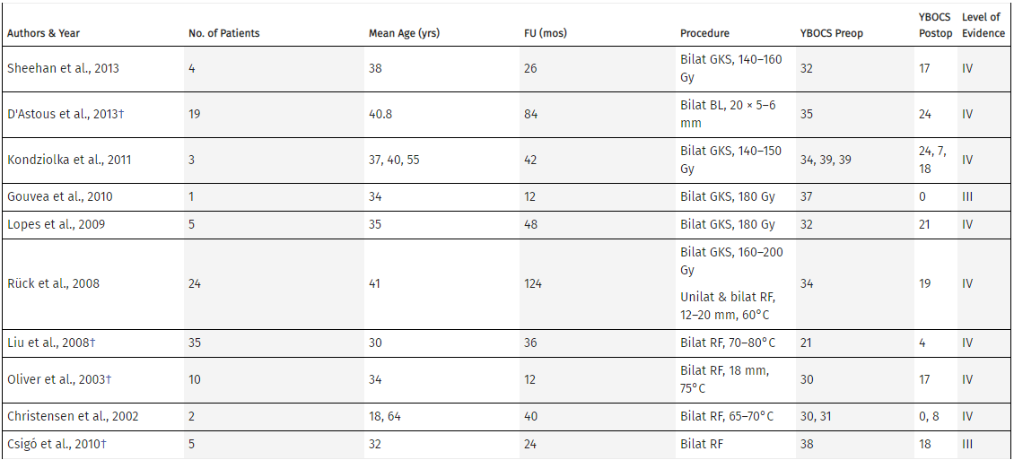
Efficacy of Anterior Capsulotomy
Herner (1961) published series of 116 OCD patients with 51% response rate to anterior capsulotomy with stereotactic thermocoagulation
2015 Review (Pepper et al)
Capsulotomy:
  Has mostly level III or IV evidence
  However, consistently demonstrated clinically significant benefit

Slide 7
Efficacy of Cingulotomy
Sheth et al (2013)
64 patients (retrospective, un-blinded)
  35% “full response” rate at 11 months (>=35% Y-BOCS reduction)
  47% full responder rate at 65 months (>=35% Y-BOCS reduction)
  47% of the patients also required re-operation- cingulotomy or subcaudate tractotomy

Slide 8
Cingulotomy vs Capsulotomy
Sheth et al (2016)
  Systematic review of cingulotomy (2 studies with 81 patients) or anterior capsulotomy (8 studies with 112 patients)
    12 month follow-up average Y-BOCS reduction of 37% for cingulotomy and 55% for capsulotomy
    Average full response rate of 41% for cingulotomy and 54% for capsulotomy

Slide 9
Enter Neuromodulation…
Modern DBS for OCD was pioneered by
Bart Nuttin in 1999 targeting ALIC
  4 patients underwent bilateral implantation of ALIC DBS, with 3 patients getting benefit (>=35% Y-BOCS reduction)

Slide 10
What are the DBS Targets?
Fitzgerald 2015

Slide 11
DBS Efficacy
Alonso et al 2015 - Meta-analysis of 31 studies (with 116 patients) identified, with DBS to ALIC, VC/VS, NAc, ventral caudate, and STN
Overall 45% reduction in Y-BOCS
60% of patients responding to treatment (“response” = >35% Y-BOCS reductions)
No significant efficacy difference detected between targets

Slide 12
DBS vs Ablation Efficacy
2015 review by Pepper reporting on 20 studies and 170 patients
  DBS (ALIC-VC/VS):
    40% reduction in Y-BOCS
    50% response rate
  Capsulotomy:
    51% reduction in Y-BOCS
    67% response rate
  Caveat: patients undergoing DBS had higher pre-op Y-BOCS
Only 1 study to date (8 patients) has given class I evidence for efficacy of bilateral DBS to the STN for OCD (Mallet et al 2008), with 68% reduction in Y-BOCS
Notes:
Clinical response= (>35% Y-BOCS reduction)

Slide 13
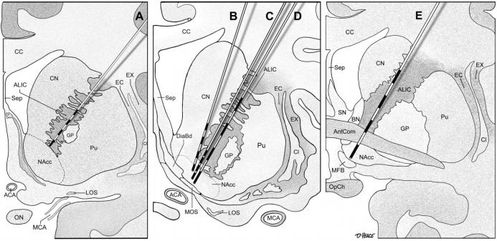
ALIC/VC/VS/NAc all variations on similar theme…
…Leading to possible heterogeneity of targets/tissue stimulated
Morishita et al 2014

Slide 14
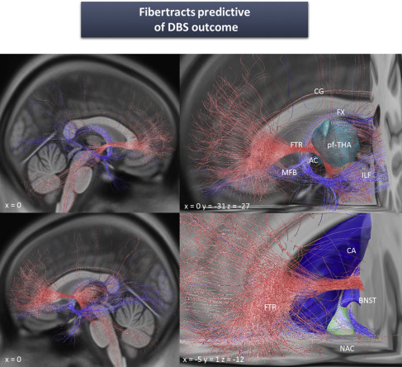
Refining DBS Target with Tractography
Recent work (Balderman 2019) demonstrates a frontothalamic fiber bundle common between STN vs ALIC treated DBS patients that may represent a common pathway resulting in OCD treatment efficacy

Slide 15

Drawbacks
DBS Ablation
hardware implant with possibility for infection, malfunction/lead breakage, hardware erosion though skin, and need for periodic battery replacement
Can’t program a hole
If off target with lesion, no salvage options
Advantages
DBS Ablation
Able to adjust stimulation to patient specific need
Removable
More finely targeted modulation
No hardware or associated hardware failure risks
Cheaper

Slide 16
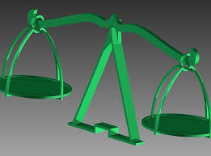


Conclusion

Slide 17
Bibliography
Talairach J, Hecaen H, David M. Lobotomies prefrontal limitee par electrocoagulation des fibres thalamo-frontales a leur emergence dubras anterieur de la capsule interne. Revue Neurologique, IV Congres Neurologique International 83, 1949.
Herner T: Treatment of mental disorders with frontal stereotactic thermo-lesions: A follow-up of 116 cases. Acta Psychiatr Scand Suppl 158:36, 1961
Deep brain stimulation for obsessive-compulsive disorder: systematic review and evidence-based guideline sponsored by the American Society for Stereotactic and Functional Neurosurgery and the Congress of Neurological Surgeons (CNS) and endorsed by the CNS and American Association of Neurological Surgeons. neurosurgery. 2014 Oct;75(4):327-33
Nuttin B, Cosyns P, Demeulemeester H, Gybel, J, and Meyerson B. (1999). Electrical stimulation in anterior limbs of internal capsules in patients with obsessive-compulsive disorder. Lancet 354:1526
Baldermann, J. C. et al. Connectivity profile predictive of effective deep brain stimulation in obsessive compulsive disorder. Biol. Psychiatry (2019).
Miguel EC, Lopes AC, McLaughlin NCR, et al. Evolution of gamma knife capsulotomy for intractable obsessive-compulsive disorder. Mol Psychiatry. 2019;24(2):218–240. doi:10.1038/s41380-018-0054-0
Mallet L, Polosan M, Jaafari N, et al. Subthalamic nucleus stimulation in severe obsessive-compulsive disorder. N Engl J Med . 2008;359(20):2121–2134
Fitzgerald P, Rebecca S. (2015). Deep brain stimulation in mental health: Review of evidence for clinical efficacy. The Australian and New Zealand journal of psychiatry. 49. 10.1177/0004867415598011.
Travis S. Tierney, Muhammad M. Abd-El-Barr, Arielle D. Stanford, Kelly D. Foote & Michael S. Okun (2014) Deep brain stimulation and ablation for obsessive compulsive disorder: evolution of contemporary indications, targets and techniques, International Journal of Neuroscience, 124:6, 394-402, DOI:
Morishita T, Fayad SM, Goodman WK, et al. Surgical neuroanatomy and programming in deep brain stimulation for obsessive compulsive disorder. Neuromodulation. 2014;17(4):312–319. doi:10.1111/ner.12141
Doshi PK. Surgical treatment of obsessive compulsive disorders: Current status. Indian J Psychiatry. 2009;51(3):216–221. doi:10.4103/0019-5545.55095
Sheth, S. A., Neal, J., Tangherlini, F., Mian, M. K., Gentil, A., Cosgrove, G., Eskandar, E. N., & Dougherty, D. D. (2013). Limbic system surgery for treatment-refractory obsessive-compulsive disorder: a prospective long-term follow-up of 64 patients, Journal of Neurosurgery JNS, 118(3), 491-497.
Brown, L. T., Mikell, C. B., Youngerman, B. E., Zhang, Y., McKhann, G. M., & Sheth, S. A. (2016). Dorsal anterior cingulotomy and anterior capsulotomy for severe, refractory obsessive-compulsive disorder: a systematic review of observational studies, Journal of Neurosurgery JNS, 124(1), 77-89.
Alonso P, Cuadras D, Gabriëls L, et al. Deep Brain Stimulation for Obsessive-Compulsive Disorder: A Meta-Analysis of Treatment Outcome and Predictors of Response. PLoS One. 2015;10(7):e0133591. Published 2015 Jul 24. doi:10.1371/journal.pone.0133591

