Slide 1
Percs vs. Paddles: Pearls and Pitfalls
Alon Y. Mogilner, MD, PhD
Director, Center for Neuromodulation
Associate professor of Neurosurgery and Anesthesiology
NYU Langone Medical Center
New York, NY

Slide 2
Disclosures
Consultant, Honorarium:
Medtronic
Abbott/St. Jude
Alpha-Omega Engineering
Gammacore - Equity Share

Slide 3
Overview
Both percutaneous and paddle leads can be appropriate and viable options for spinal cord stimulator implantation
We will review:
Hardware fundamentals
Basic surgical technique
Literature
Complications and outcomes via representative cases

Slide 4
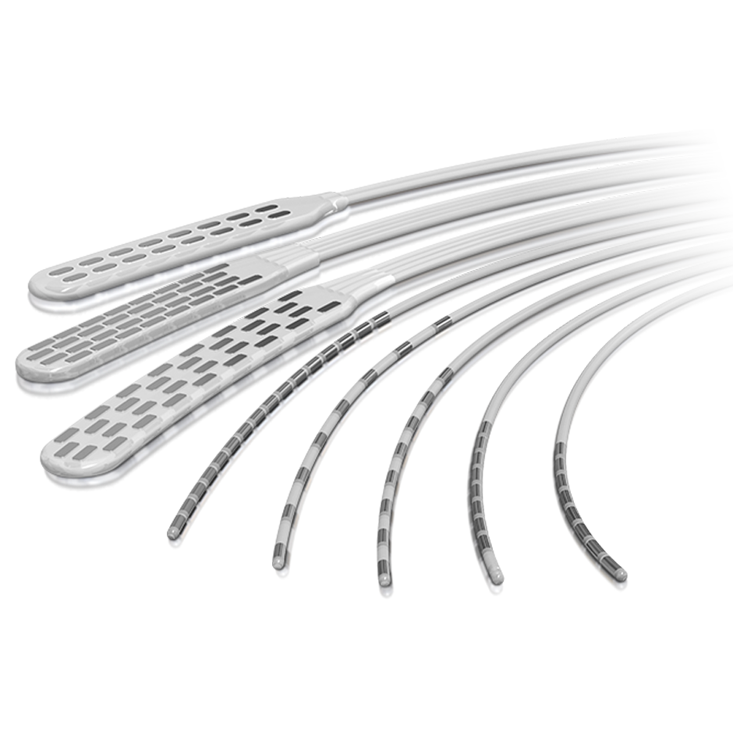
SCS leads
Percutaneous:
Thin, cylindrical leads placed via a needle
Can be placed by non-surgeons
Non-insulated (stimulation spreads 360º)
Paddle:
Wider, rectangular leads
Must be placed surgically via laminotomy
Insulated
NOTE: DRG leads are only percutaneous at this time

Slide 5
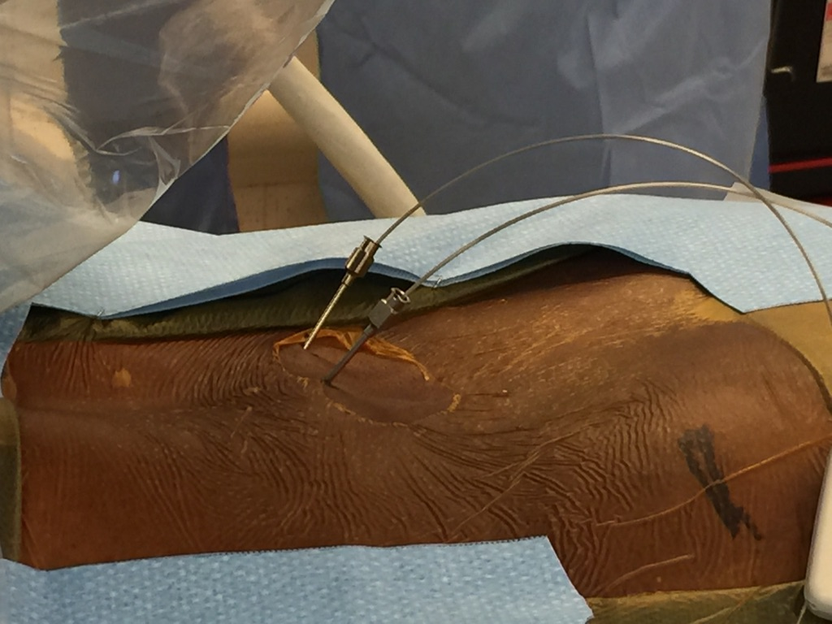
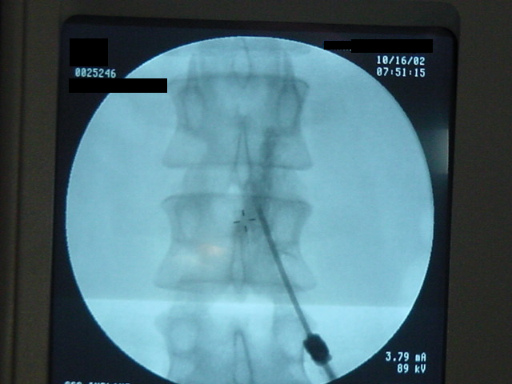
SCS Trials
Percutaneous, unless the epidural space cannot be accessed via a needle (i.e. prior decompression, fusion, etc.)
Epidural space accessed below levels of final contact locations (i.e. L2-3 access for T8-9 lead placement)

Slide 6
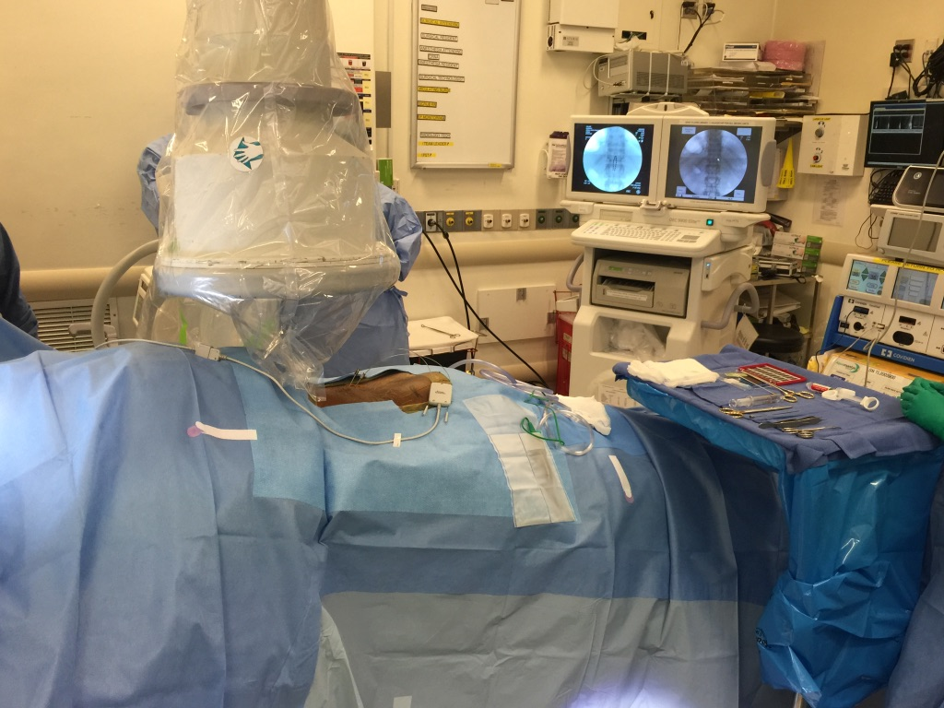

Slide 8
Trust, but verify…
Review all preoperative imaging carefully and correlate with operative notes
If you cannot see the T12-L1 junction clearly, make the referring physician and patient aware…

Slide 9
Permanent Implant: Percutaneous vs. Paddle
Determined on a patient-by-patient basis
Percutaneous:
Advantages:
Less incisional pain
Same day discharge in all cases (barring complications)
Disadvantages:
Lead migration
Less efficient energy use
Paddle:
Advantages:
Minimal risk of migration
More efficient energy delivery
Disadvantages:
More painful
May not be safe in cases of canal stenosis

Slide 10
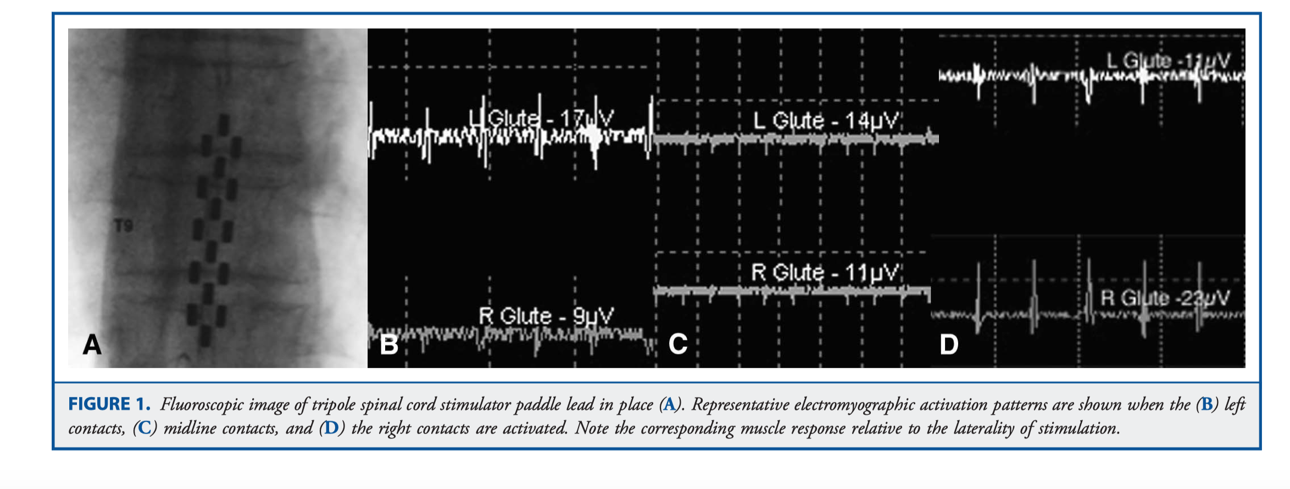
SCS Paddle Electrodes

Slide 11
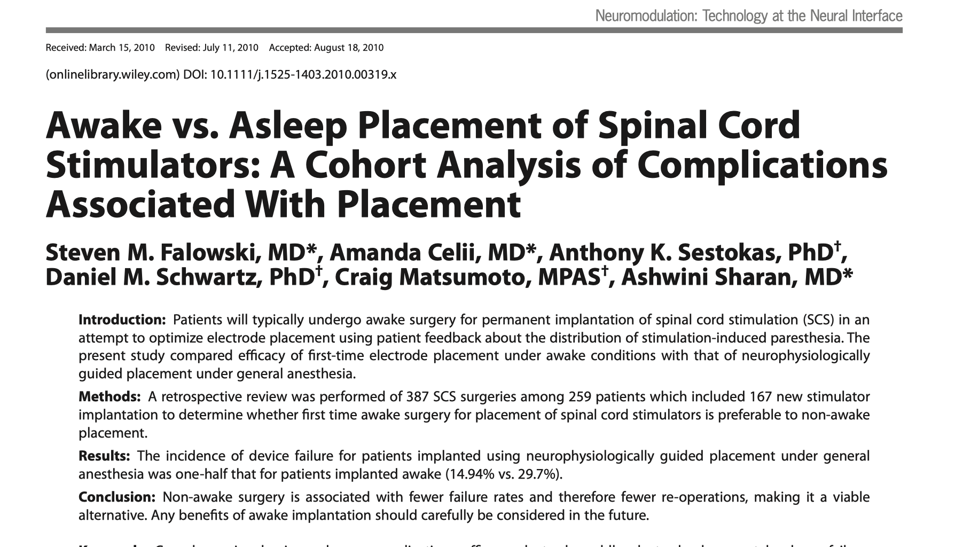

Slide 12
SCS Paddle Electrode Placement with Monitoring
Allows for physiologic assessment of lead location
Presumably provides a measure of safety to minimize neurologic deficit secondary to spinal cord injury
No evidence that awake with feedback is any safer than asleep placement, with or without monitoring

Slide 13
Paddle leads: Pitfalls
60 YO male referred to me 4 months after paddle lead placement for FBSS by another surgeon
Soon after lead placement, developed severe left-sided chest wall pain
In and out of ER, ruled out for PE and MI
Pain was noted to be positional, worsening with extension
Presents to me three months postop

Slide 14
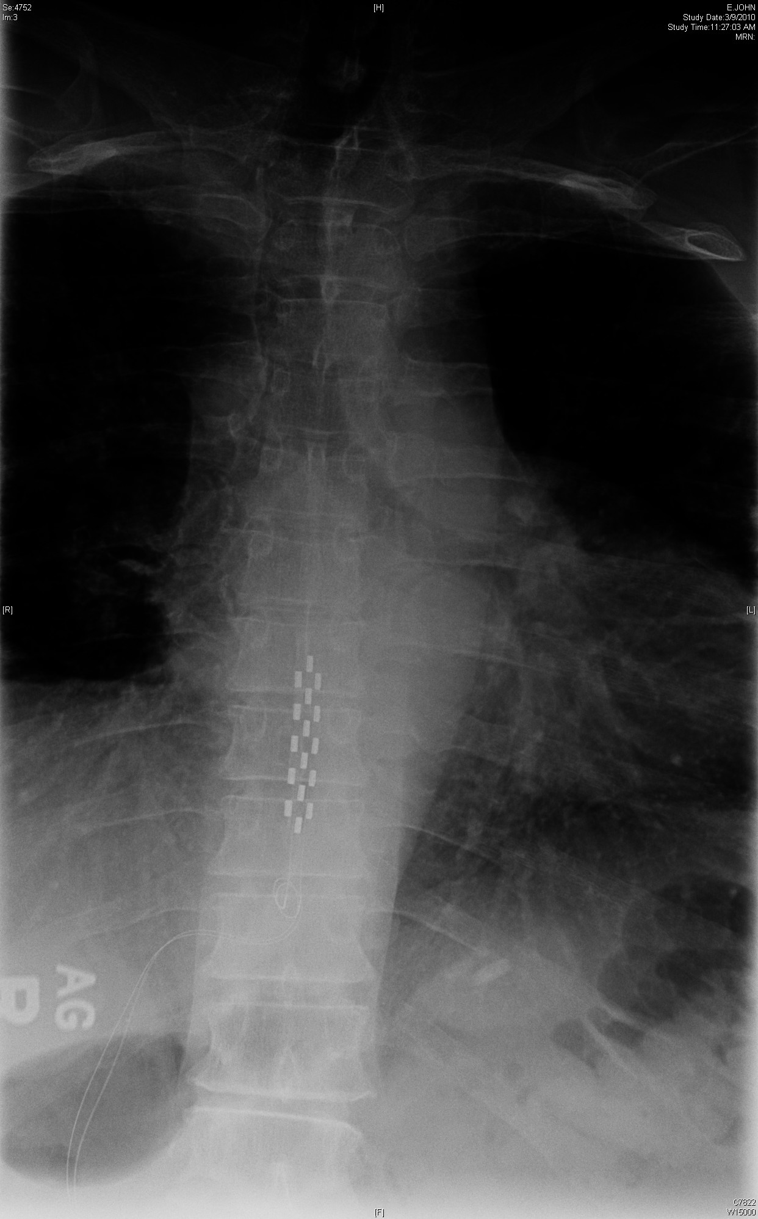
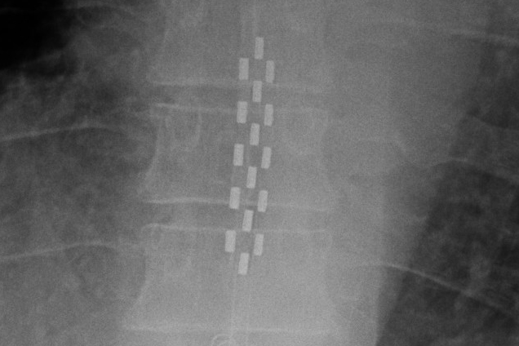
Case 3

Slide 15
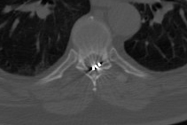
Neural Compression

Slide 16
Paddle leads and compression
Paddle leads placed eccentrically, or even placed in the midline in patients with stenosis, can cause severe radicular pain.
If the pain does not resolve, either removal of the lead or a further decompression is the only way to treat these symptoms •Spinal MRI recommended prior to all paddle placements (CT myelo if MRI not possible)

Slide 17
Lead Placement: Not always straightforward

Slide 18
Paddle Placement
Epidural scar tissue, scoliosis, or other factors can prevent appropriate midline electrode placement…
This can be a particular problem with revisions from percutaneous to paddle, and with longer paddles
Surgical strategies…
First do no harm…

Slide 19
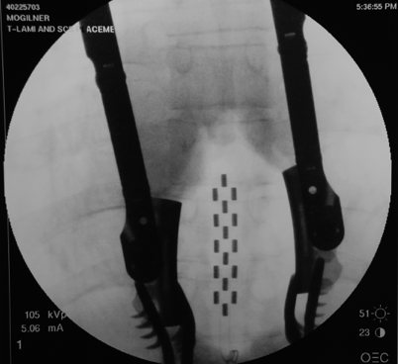
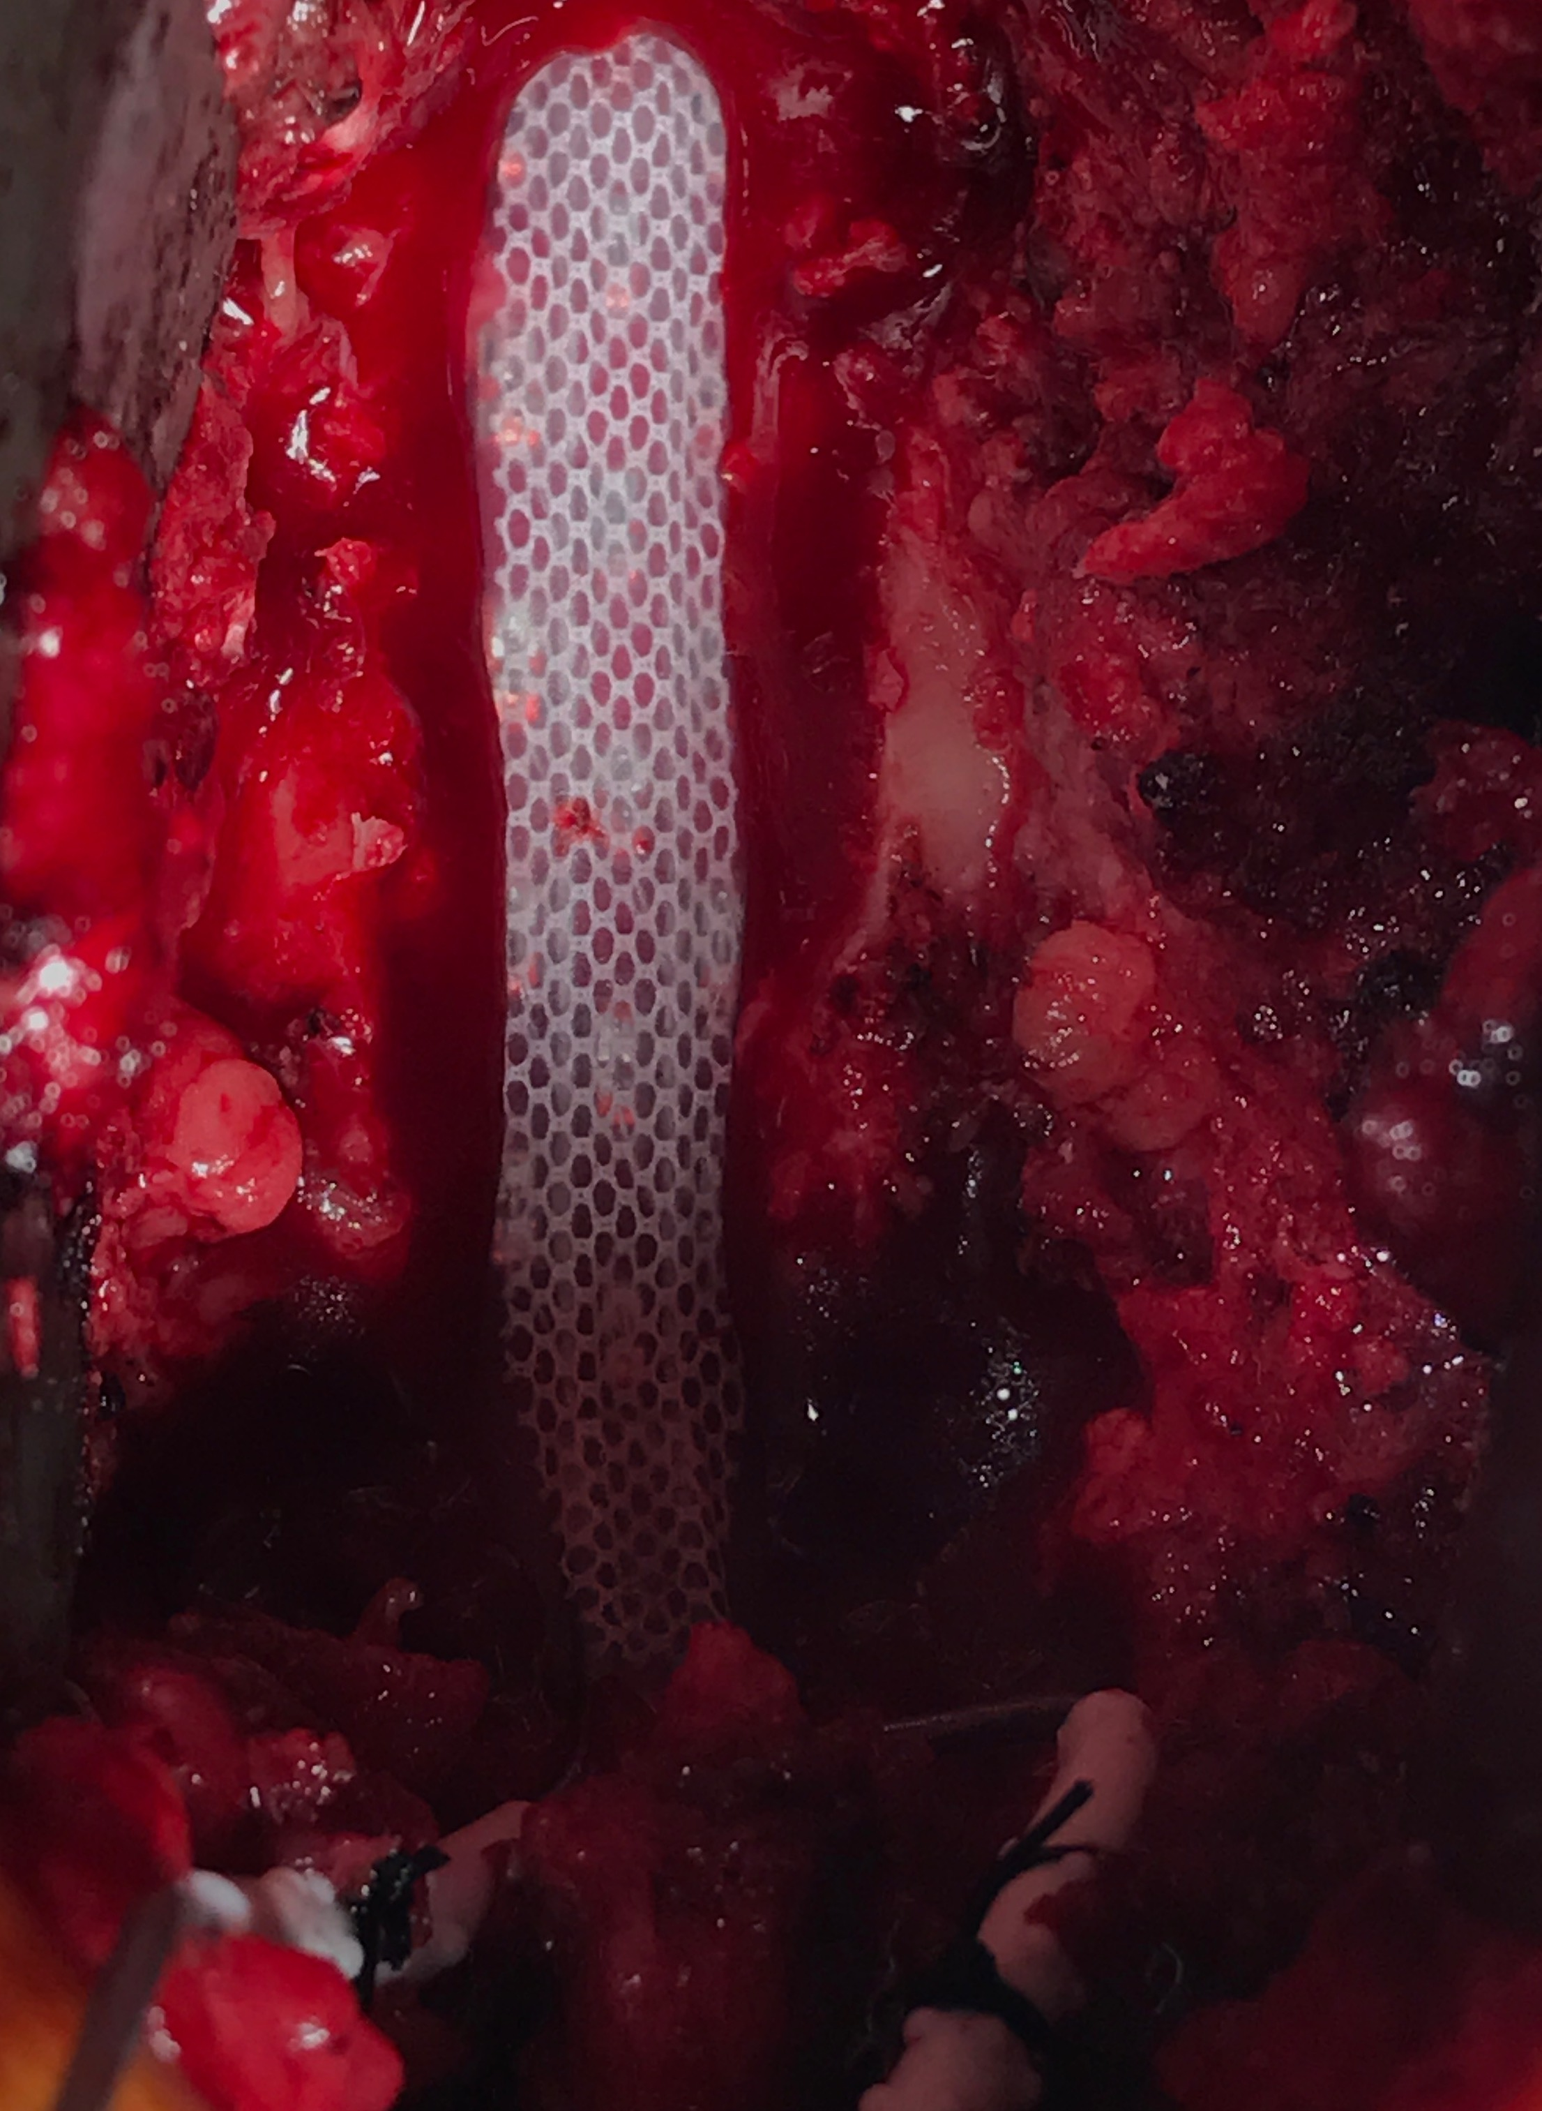
Complete Decompression…

Slide 20
Complete Decompression…
A full laminectomy over the paddle may be necessary at times
Anchoring technique:
lead edges tucked under bone
Tisseel fibrin glue placed over lead

Slide 21
Partial Decompressions
Based on the anatomy and the location of the obstructions, partial decompressions can facilitate appropriate lead placement…
Why is the lead not passing?
Where is/are the obstructions?

Slide 22
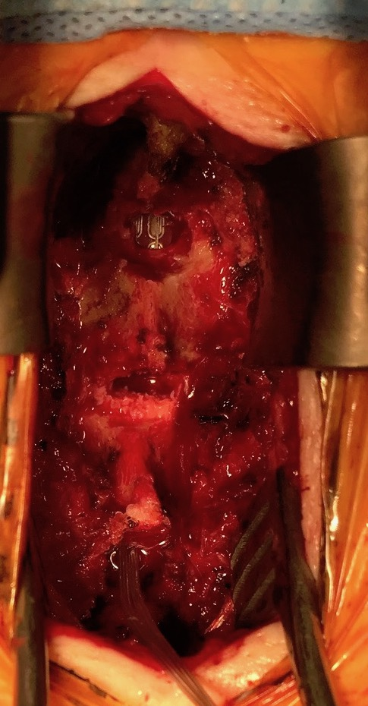
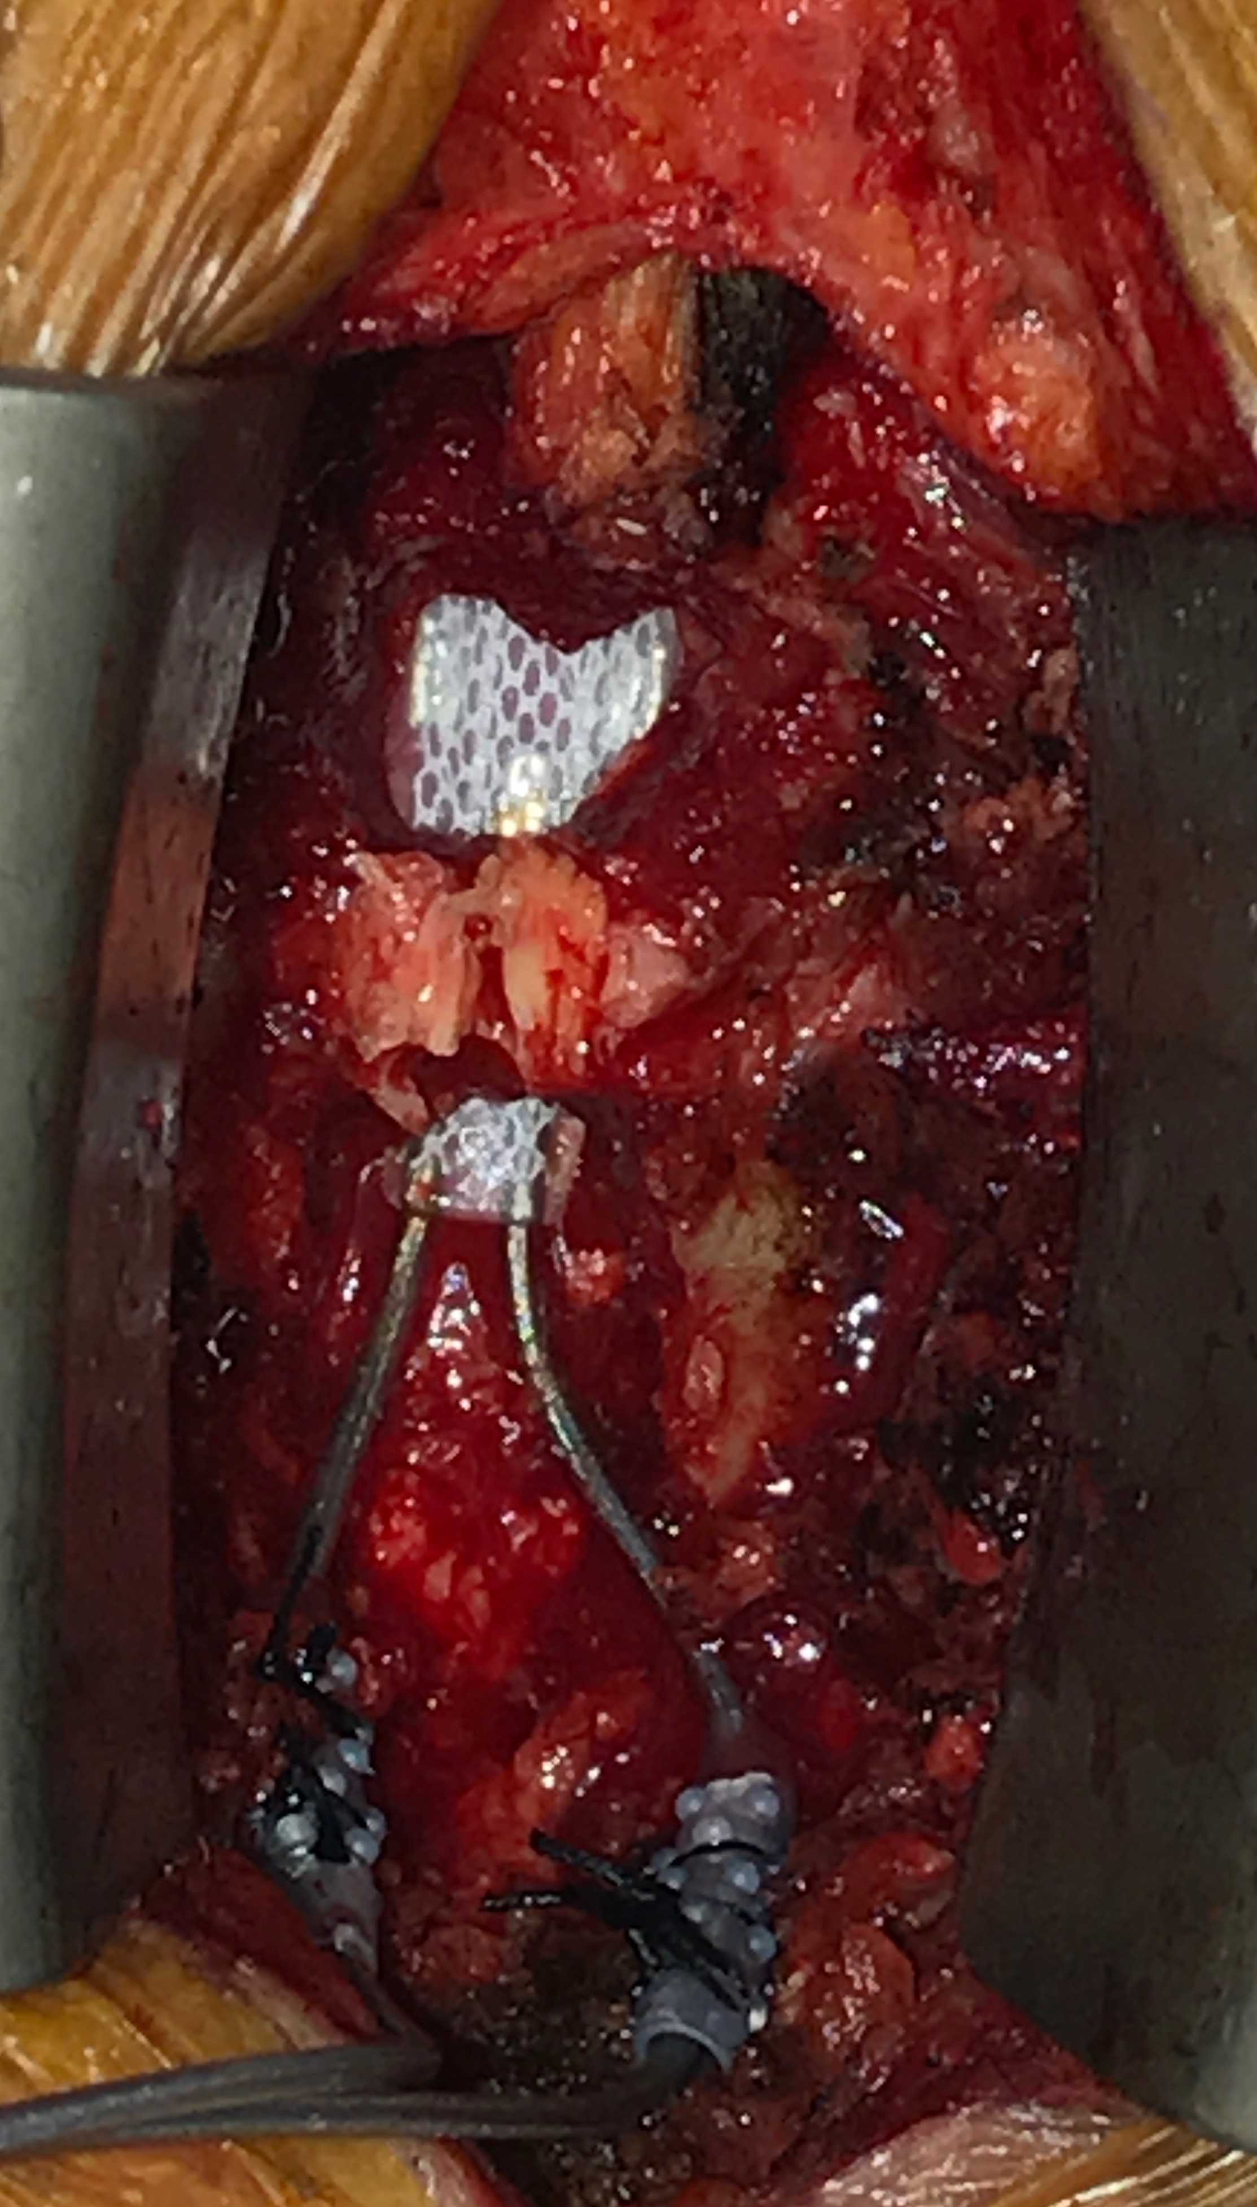

Slide 23
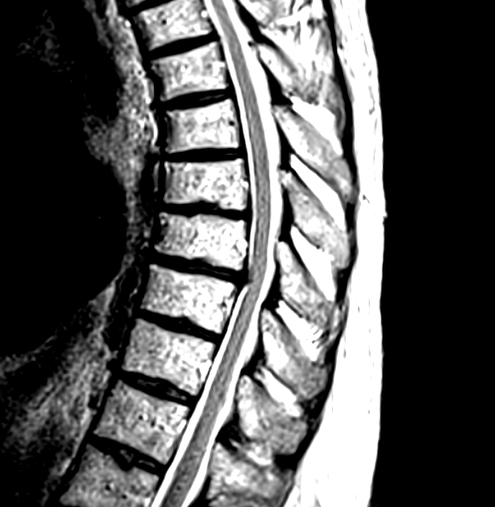
What not to do
50 YO male referred to a neurosurgeon for a permanent implant s/p successful percutaneous trial
Trial lead spanned T8-T10
T8
T9

Slide 24
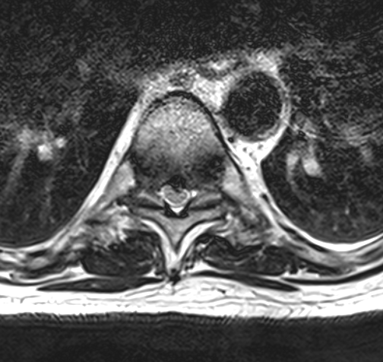
T8-9 Disc space

Slide 25
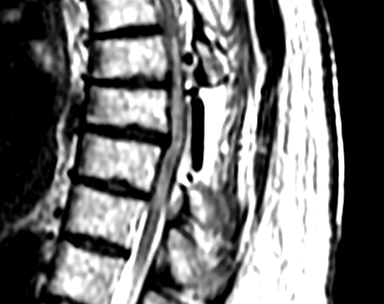

Slide 26
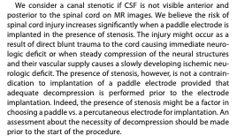

Slide 27
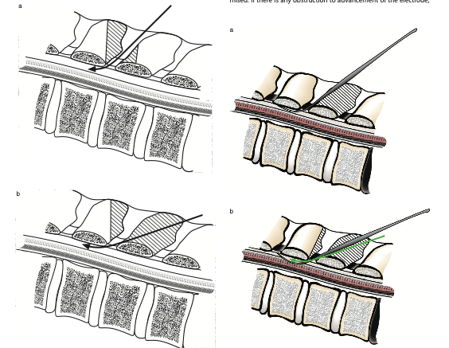

Slide 28
Cervical SCS placement
I have moved away from cervical paddle placement
Exceptions:
Inability to access the cervical epidural space percutaneously
Multiple (>2) lead migrations

Slide 29
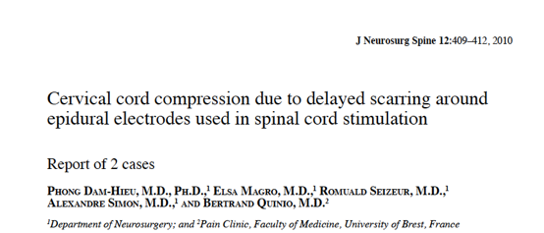
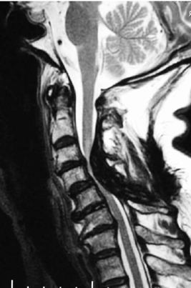

Slide 30
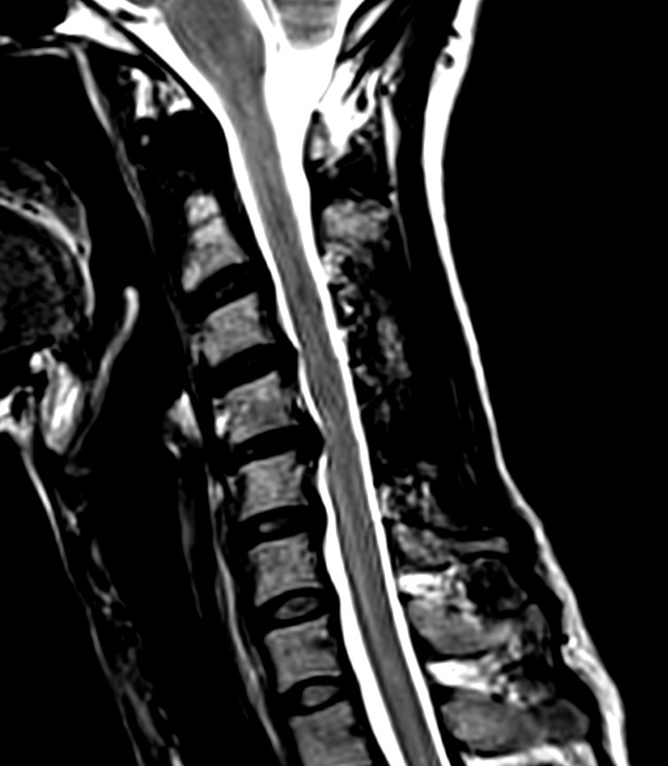
Cervical SCS
47 YO female with unilateral UE CRPS
Had successful percutaneous SCS trial
Referred for permanent implant
How would you implant?
•Non-myelopathic

Slide 31
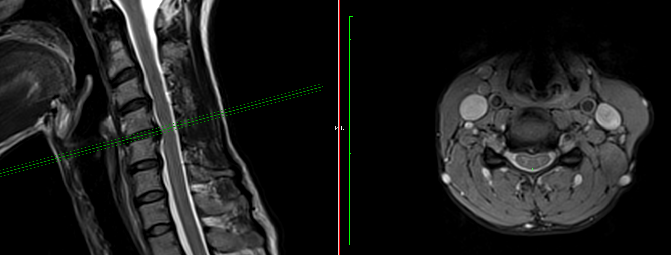
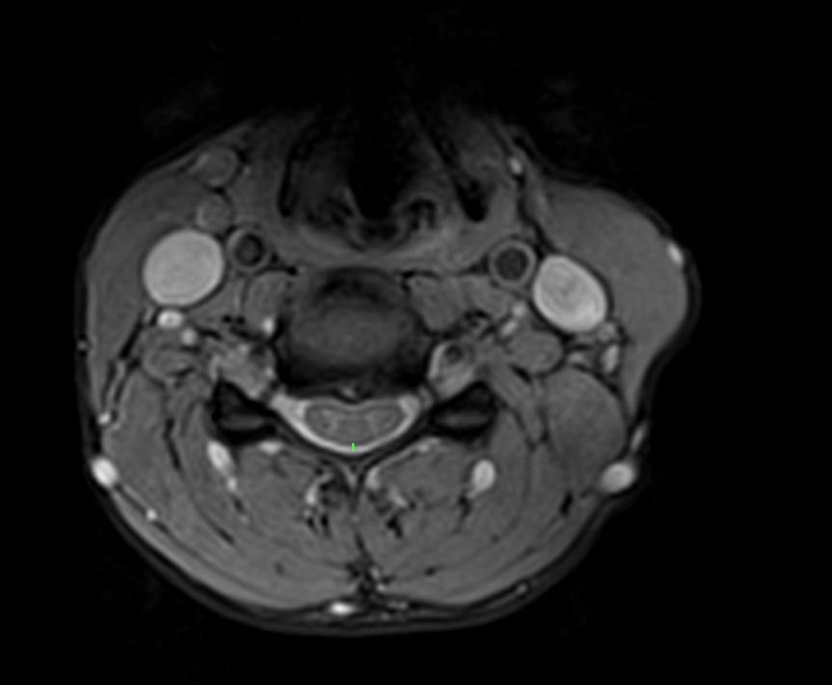

Slide 32
Implant
Patient undergoes cervical laminectomy and anterograde lead placement
Wakes up with severe pain and weakness in the arm
Told it is an exacerbation of her CRPS and sent home
Eventually, strength recovers but remains with new neuropathic pain qualitatively different than her preop pain

Slide 33
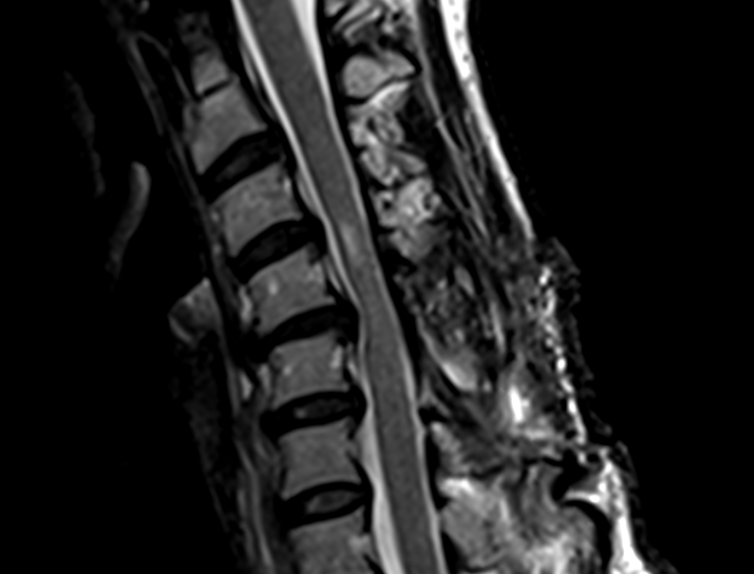

Slide 34
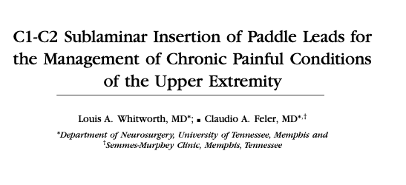
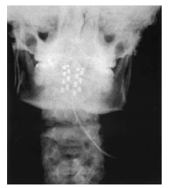
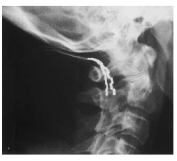
Options for cervical paddle placement
Retrograde C1-C2 placement

Slide 35
Cervical SCS
51 Y/O male with brachial plexus injury
Unilateral RUE pain
•Percutaneous trial attempted but aborted due to severe radiculopathy and pain while passing lead
Referred to me

Slide 36
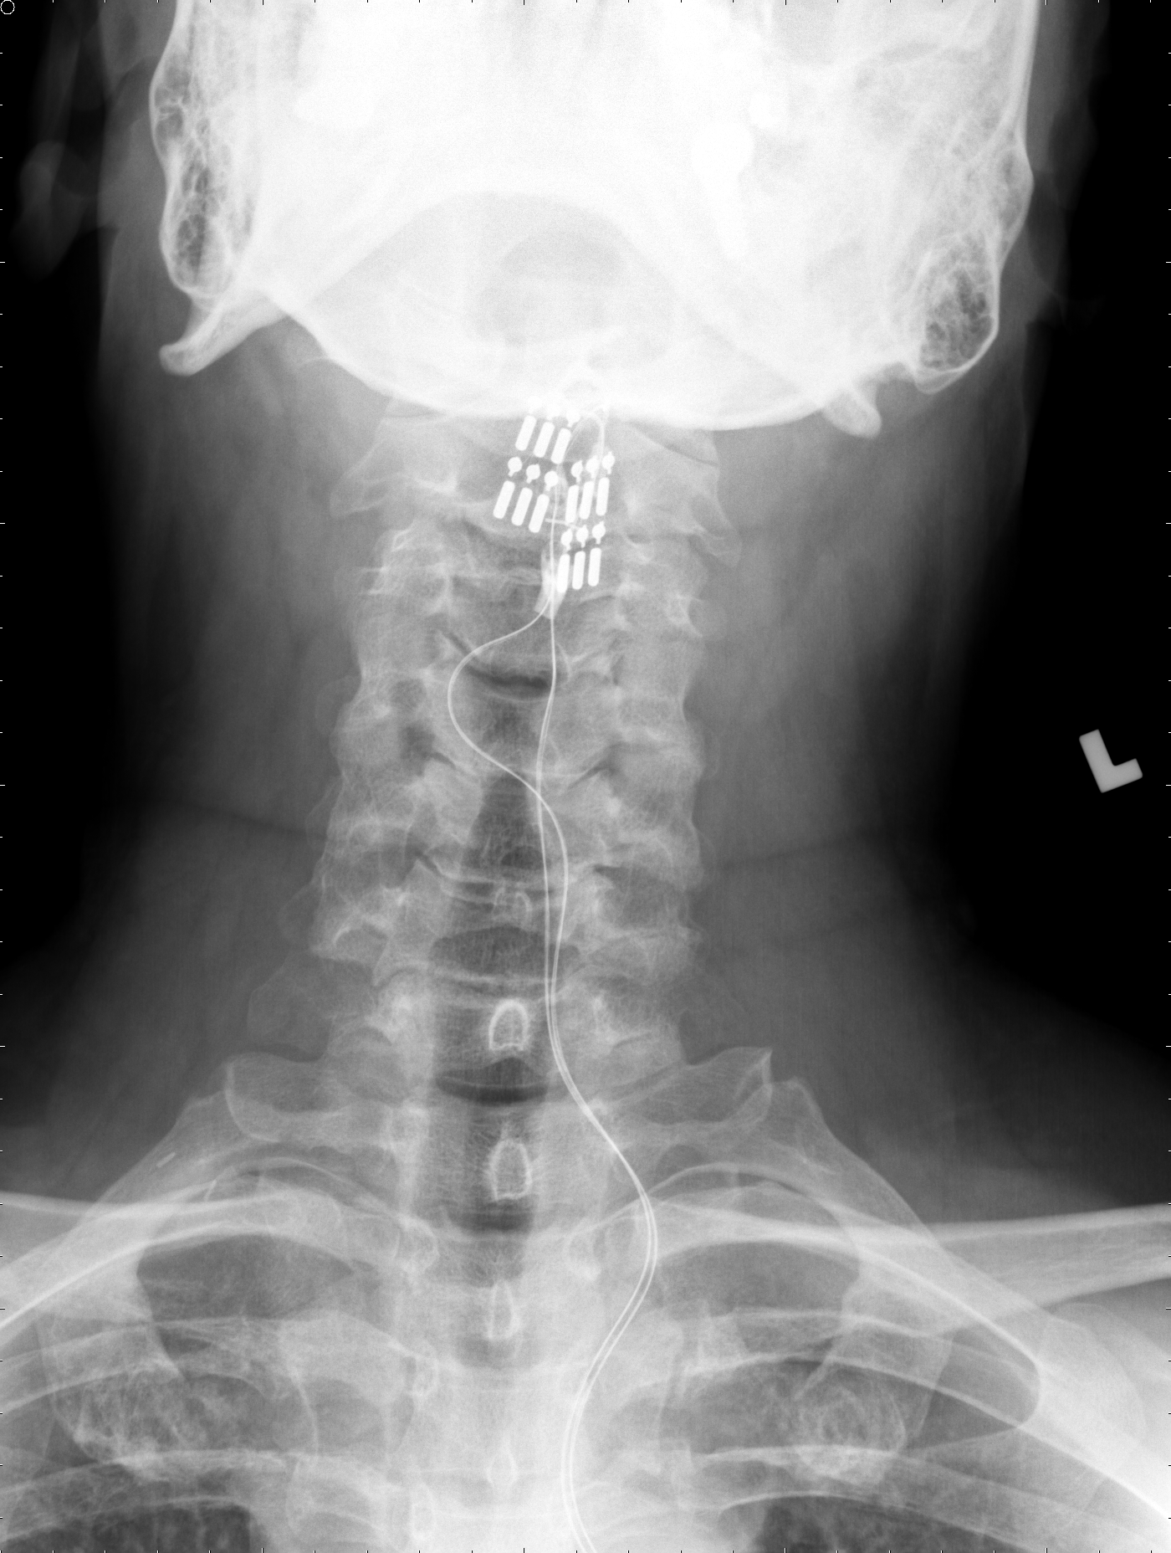
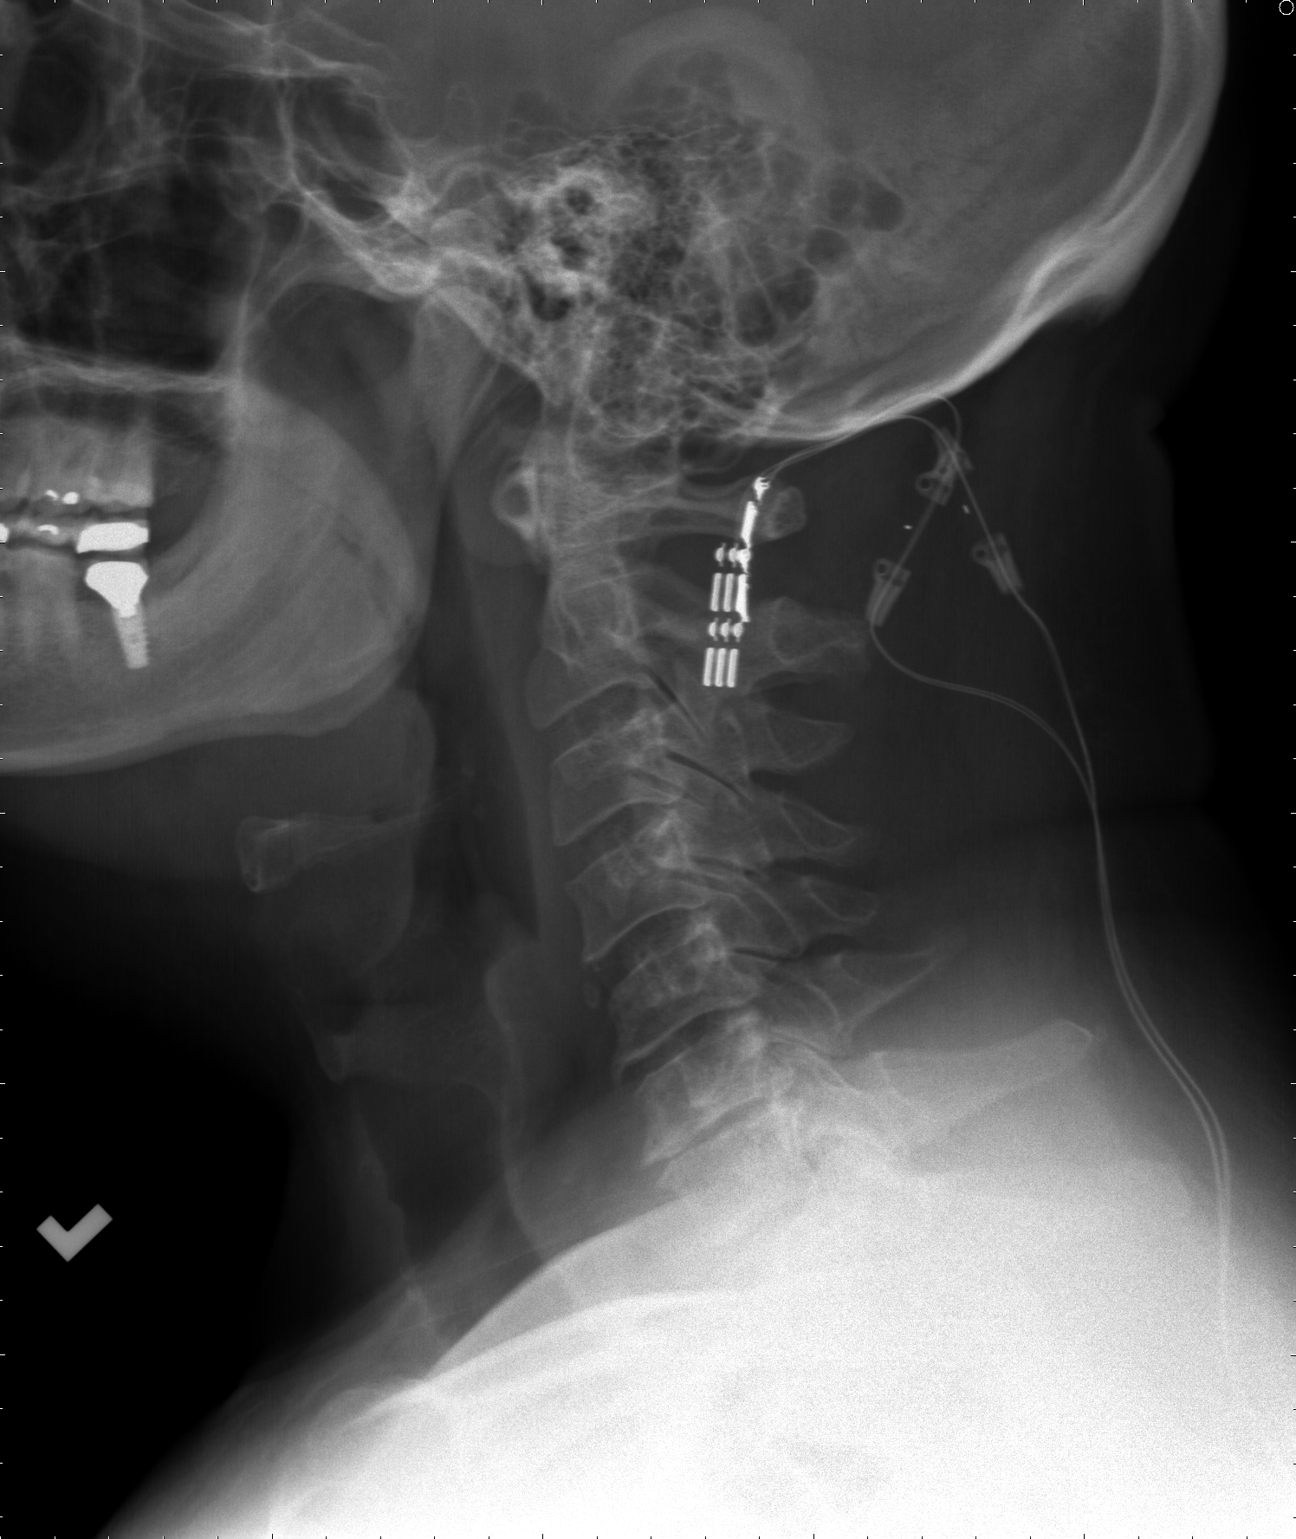
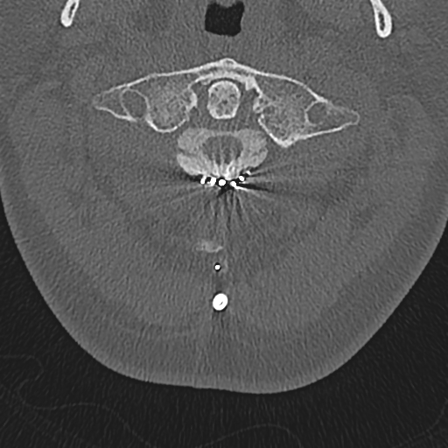

Slide 37
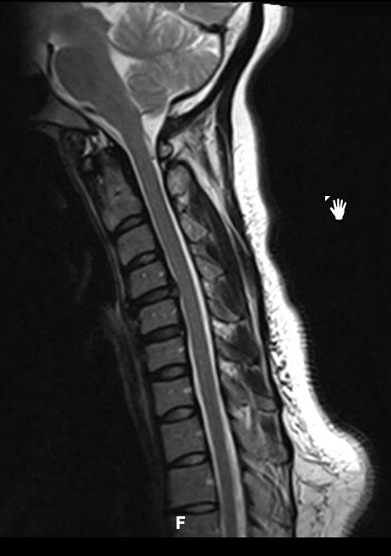
Cervical SCS case 2
36 YO female with bilateral UE neuropathic pain
Had successful percutaneous SCS trial
•Had a percutaneous system placed by another physician (anesthesia pain assisted by spinal neurosurgeon)
•Lead migration 6 months later
Referred for revision implant
How would you implant?

Slide 38
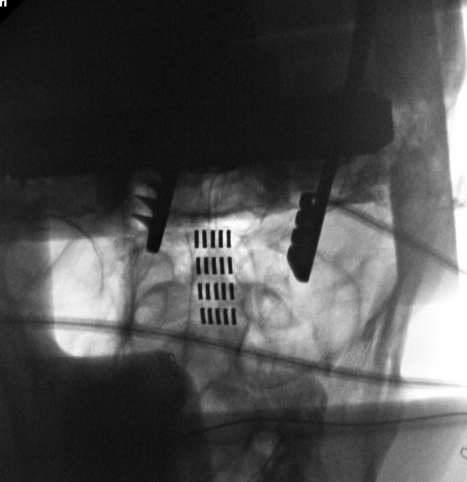
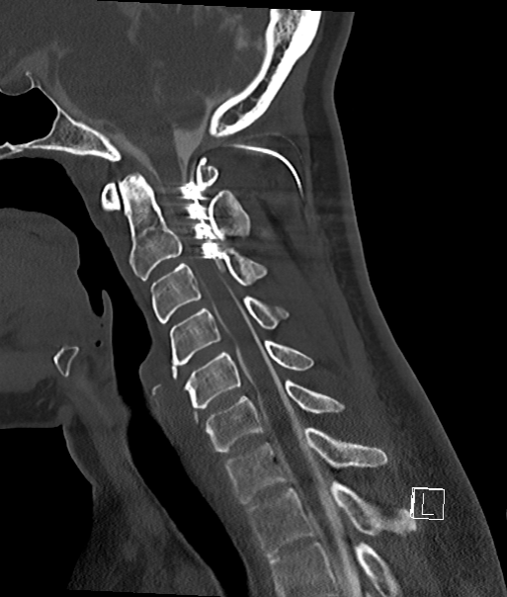
Cervical SCS Case 2
Underwent retrograde C1-2 lead placement by another physician

Slide 39
Implant
Patient undergoes retrograde C1-2 lead placement
Wakes up with severe pain, spasms and weakness in the right arm
Told it is an exacerbation of her condition and sent home

Slide 40
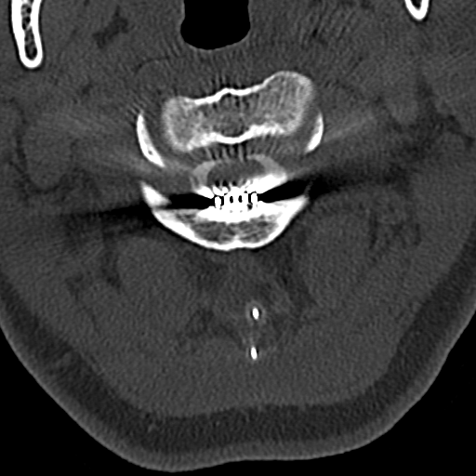
Case 2, continued
Case “run by me” by the pain physician
System not MRI compatible
Myelo CT…

Slide 41
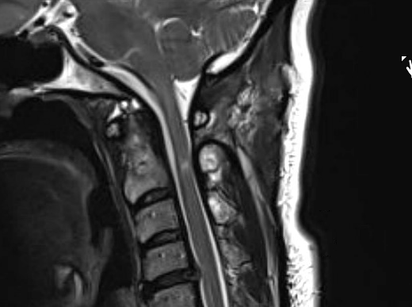
Underwent device removal, followed by C-Spine MRI
Referred to me…
Original preoperative pain has returned (bilateral)
Superimposed on this is new right arm “spasms”

Slide 42
• No area is truly safe in the cervical spine, although it seems some are safer than others

Slide 43
Summary
Trials: percutaneous unless epidural space cannot be accessed
Permanent:
Cervical: percutaneous unless not possible
Thoracic:
Canal diameter
Age
Body Habitus
Activity level
Comorbidities

Slide 44
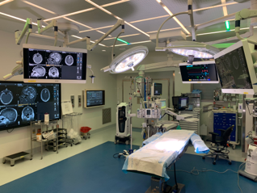
Thank you

