Slide 1
Resection vs. LITT vs. RNS
Guy M. McKhann, M.D.
Columbia University
ASSFN Webinar 09/25/19

Slide 2
Epilepsy Surgery: Rates of Seizure Freedom
TLE: Epilepsy Surgery is Effective, but UNDERUTILIZED.
Temporal lobectomy (MTS)
Lesionectomy
Nonlesional resection
(temporal)
Nonlesional resection
(extratemporal)
ETLE: Epilepsy Surgery is Invasive, and Not That Effective!
Adapted from Tellez-Zentano et al, 2010
Notes:
Unfortunately, our current methods of seizure localization doesn’t seem to be serving us well. If we look at outcomes of different types of surgical procedures, we see that procedures that are guided by brain anatomy or structural abnormalities have very good outcomes. However, most of the cases we deal with are nonlesional and neocortical, meaning that they don’t involve the mesial temporal lobe, and there are no structural lesions to use as a guide. But when we have to rely on EEG, the outcomes are not so good – which just reinforces the point that we really don’t know how to localize seizures using EEG recordings.

Slide 3
Why are We Not Treating More Refractory Epilepsy Patients?
REFERRAL GAP
~80% not referred
“Too invasive/too dangerous”
TREATMENT GAP
98% are not surgical candidates/ refuse surgery
“Too invasive/Too dangerous”
Are ablation and neuromodulation better options?
Source: Gumnit RJ, Labiner DM, Fountain NB, et al.; Prepared by the National Association of Epilepsy Centers. Data on Specialized Epilepsy Centers: Report to the Institute of Medicine's Committee on the Public Health Dimensions of the Epilepsies.
Notes:
About 1 million persons in the United States have medically uncontrolled seizures but only 220,000 are evaluated at Level 4 Comprehensive Epilepsy Centers each year. That means that 78% are not referred. Once referred, only about 3000 patients have an epilepsy surgery, either because they are not candidates for an epilepsy surgery or because they decline. The other 98% of patients are in need of a new treatment option. For many of these patients, neuromodulation could be a good option.

Slide 4
Epilepsy Surgery Goals: Balancing Risk and Benefit
To remove, ablate, or stimulate the “epileptogenic zone”, maximizing the chance of seizure freedom, while minimizing risk to the patient.
How do we improve epilepsy surgery for patients?
TLE: Make it less invasive and safer
ETLE: Make it less invasive, safer, and more effective.

Slide 5
Indications for surgical resection
Lesional epilepsy: LEAT, FCD, CM, MTS MTLE
Temporal lobe epilepsy
MTS MTLE, if laser not available or patient wants best sz outcome
Non-MTS TLE, particularly if SEEG/subdural not localizing to mesial or not done
Extratemporal epilepsy
Non-lesional onset, even if SEEG localized, unless very focal on invasive monitoring.
Hemispheric epilepsy or need for large topectomy or lobectomy
Indications are changing; ablation will only increase.

Slide 6
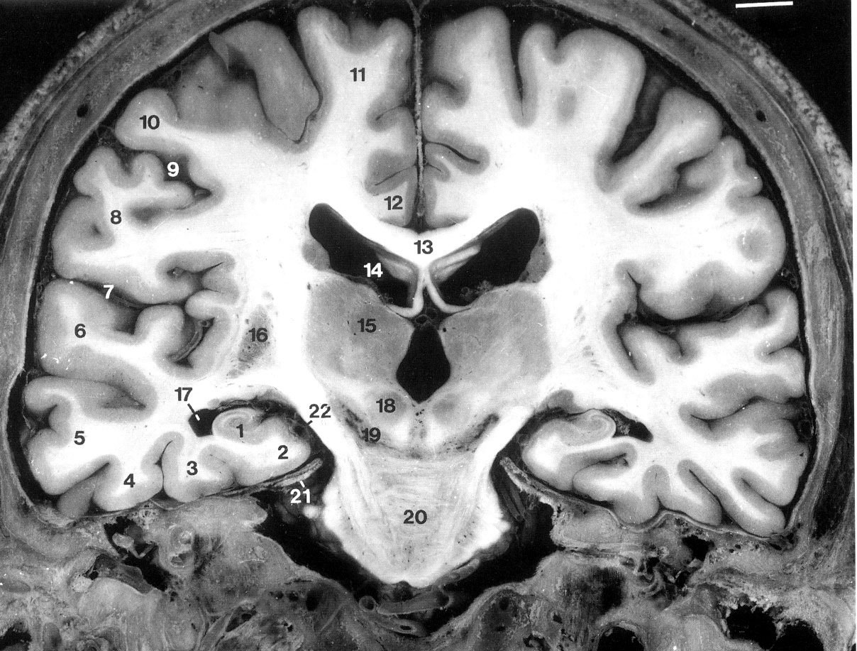
Selective Amygdalohippocampectomy (SAH)
Trans-Sylvian
Trans-sulcal
Subtemporal

Slide 7
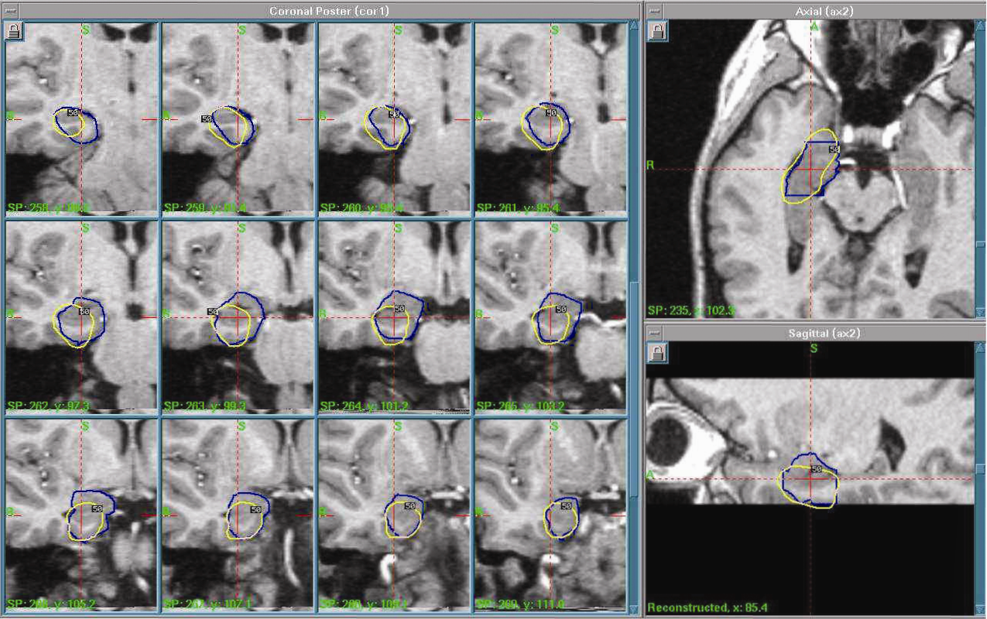
“Superselective” AH: Gamma Knife Radiosurgery

Slide 8
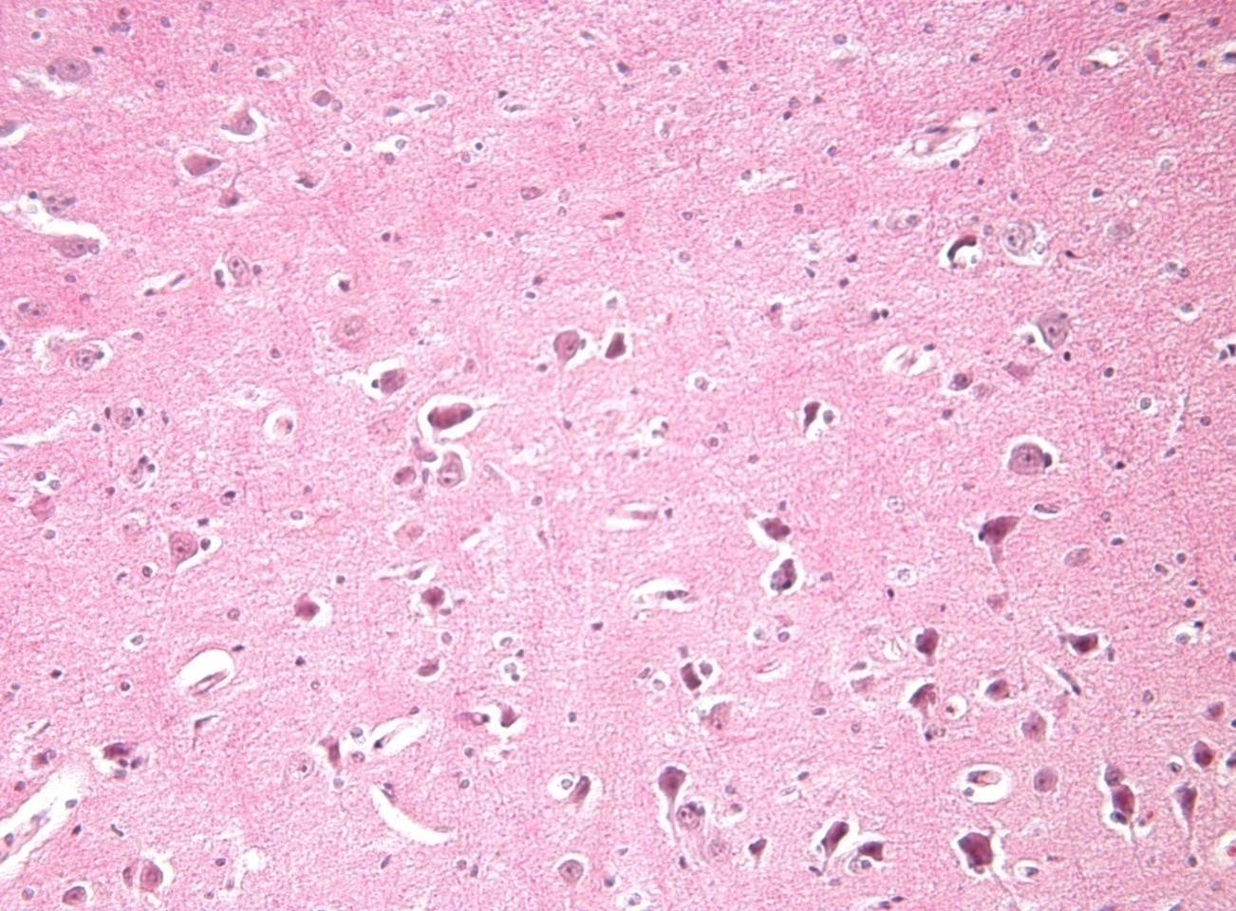
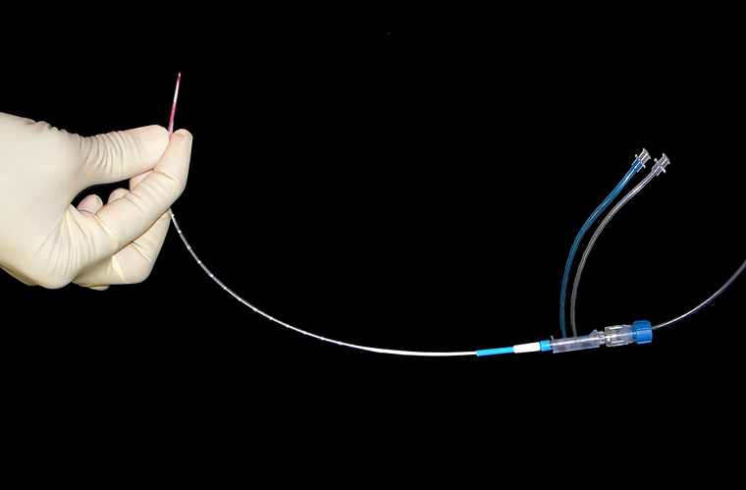
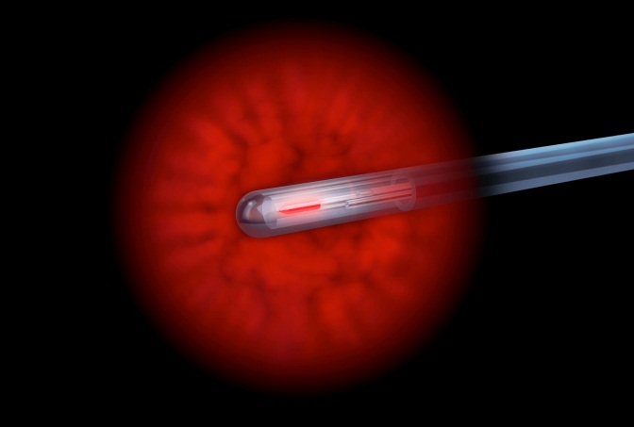
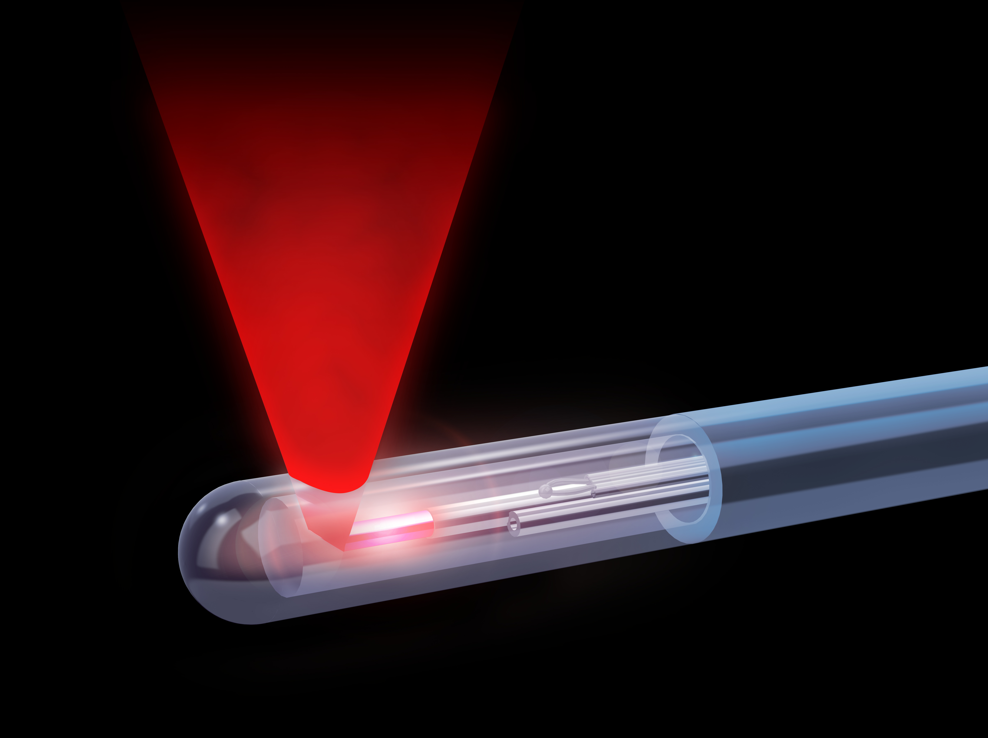
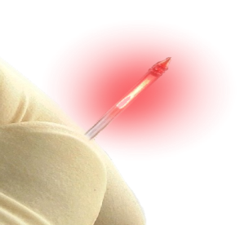
“Superselective” AH: LITT
Stereotactic implantation of an optical fiber for delivery of laser energy
Laser fiber enclosed in a cooling catheter
Thermal destruction of tissue
MRI-thermometry and irreversible damage zone prediction
Abnormal
Coagulated
Tissue
0.2 - 0.7 mm boundary
Normal
Tissue

Slide 9
ATL/SAH
Stereotactic
Ablation (LITT)
~70-90% 1 year sz free
“Collateral damage” from approach to mesial temporal lobe
Transtemporal craniotomy
Health care utilization
4-6 hr surgery
ICU stay
LOS 2-3 days
~50-60% 1 year sz free
Minimize “collateral damage”: neurocognitive benefit?
3mm twist drill
Health care utilization
Shorter procedure time
No ICU stay
Shorter LOS (0-1 day)
Earlier return to work
Figure courtesy Chen Wu

Slide 10
LITT works for SAH surgery, but not as well as open surgery.
LITT for SAH is safe; ? cost effective.
For patients unwilling to undergo open surgery.
First line treatment option, with repeat ablations or open resection still viable for patients who fail to achieve seizure freedom.
Works well in MRI normal MTLE if seizures localized by SEEG (Youngerman et al, Epilepsia, 2018)
Prospective trial ongoing (SLATE) to further optimize ablation volume/targets and patient selection.
Also effective for HH, FCD, LGG/LEAT, CM,TSC, p-SEEG,CC, …
(Obviously)...needs more data and follow up!!!
Notes:
To conclude … while seizure freedom rates with laser ablation appear to be lower than the seizure freedom rates achieved with an open resection, laser ablation can be considered a less invasive option with a shorter length of stay for patients with refractory MTLE.
Laser ablation may be a reasonable first-line treatment option for drug-resistant mesial temporal lobe epilepsy with repeat ablations and/or open resection as a viable option for patients who fail to achieve seizure freedom.
Prospective trials and larger studies – such as the SLATE trial which we are participating in – are warranted to further optimize ablation volumes and targets as well as patient selection.

Slide 11
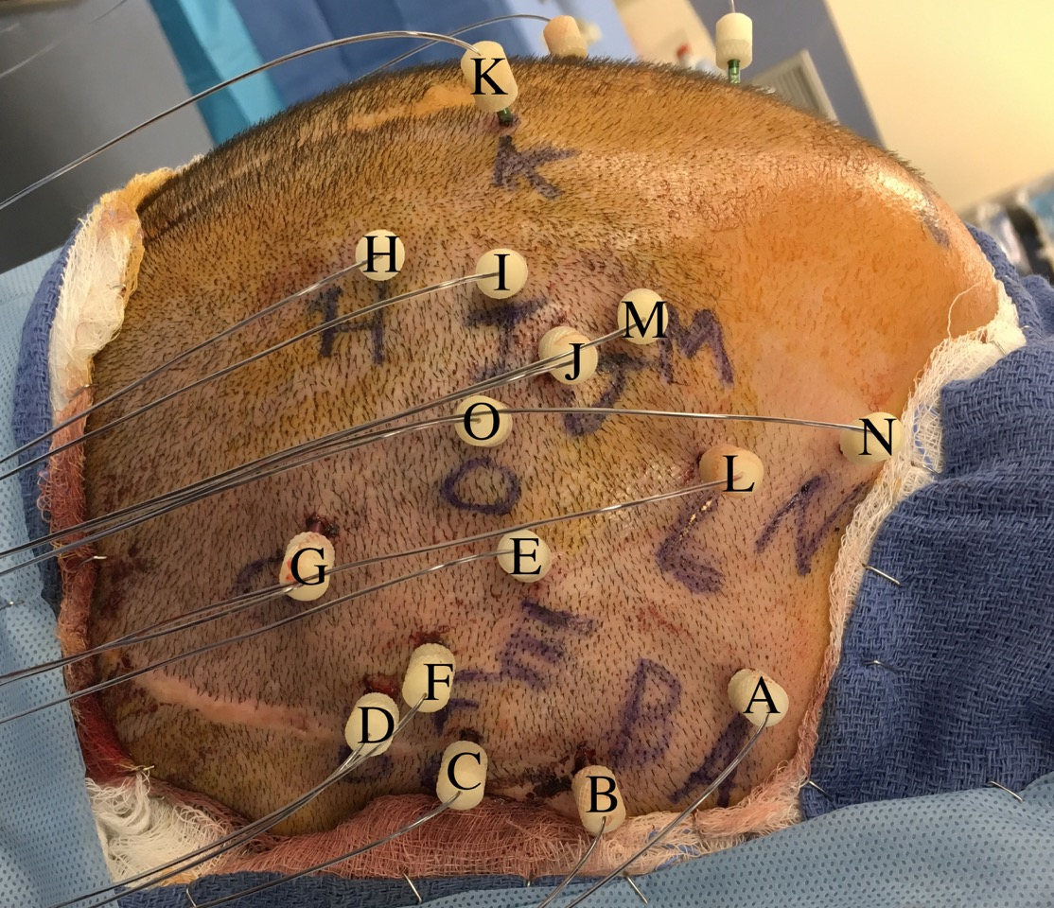
Patients want minimally invasive surgery.
LITT over ATL/SAH
SEEG over SD grid/strips
Expanding LITT indications
Notes:
To conclude … while seizure freedom rates with laser ablation appear to be lower than the seizure freedom rates achieved with an open resection, laser ablation can be considered a less invasive option with a shorter length of stay for patients with refractory MTLE.
Laser ablation may be a reasonable first-line treatment option for drug-resistant mesial temporal lobe epilepsy with repeat ablations and/or open resection as a viable option for patients who fail to achieve seizure freedom.
Prospective trials and larger studies – such as the SLATE trial which we are participating in – are warranted to further optimize ablation volumes and targets as well as patient selection.

Slide 12
Improving the Treatment Gap: Nonlesional Neuromodulation
Low
Neuromodulation
- RNS
- VNS
- DBS
COGNITIVE RISK
Additional
Medications
Epilepsy Surgery
- Laser Ablation
- Resection
High
Low
CHANCE OF SEIZURE FREEDOM
High

Slide 13
Neuromodulation: DBS vs. RNS?
DBS: Open loop stimulation of a node or pathway in a network.
RNS: Closed loop stimulation of a focal epileptogenic zone.
BUT: DBS is becoming closed loop, while RNS is being applied to network pathways and nodes.
Semantic debate, as the two technologies approach one another in practical use.

Slide 14
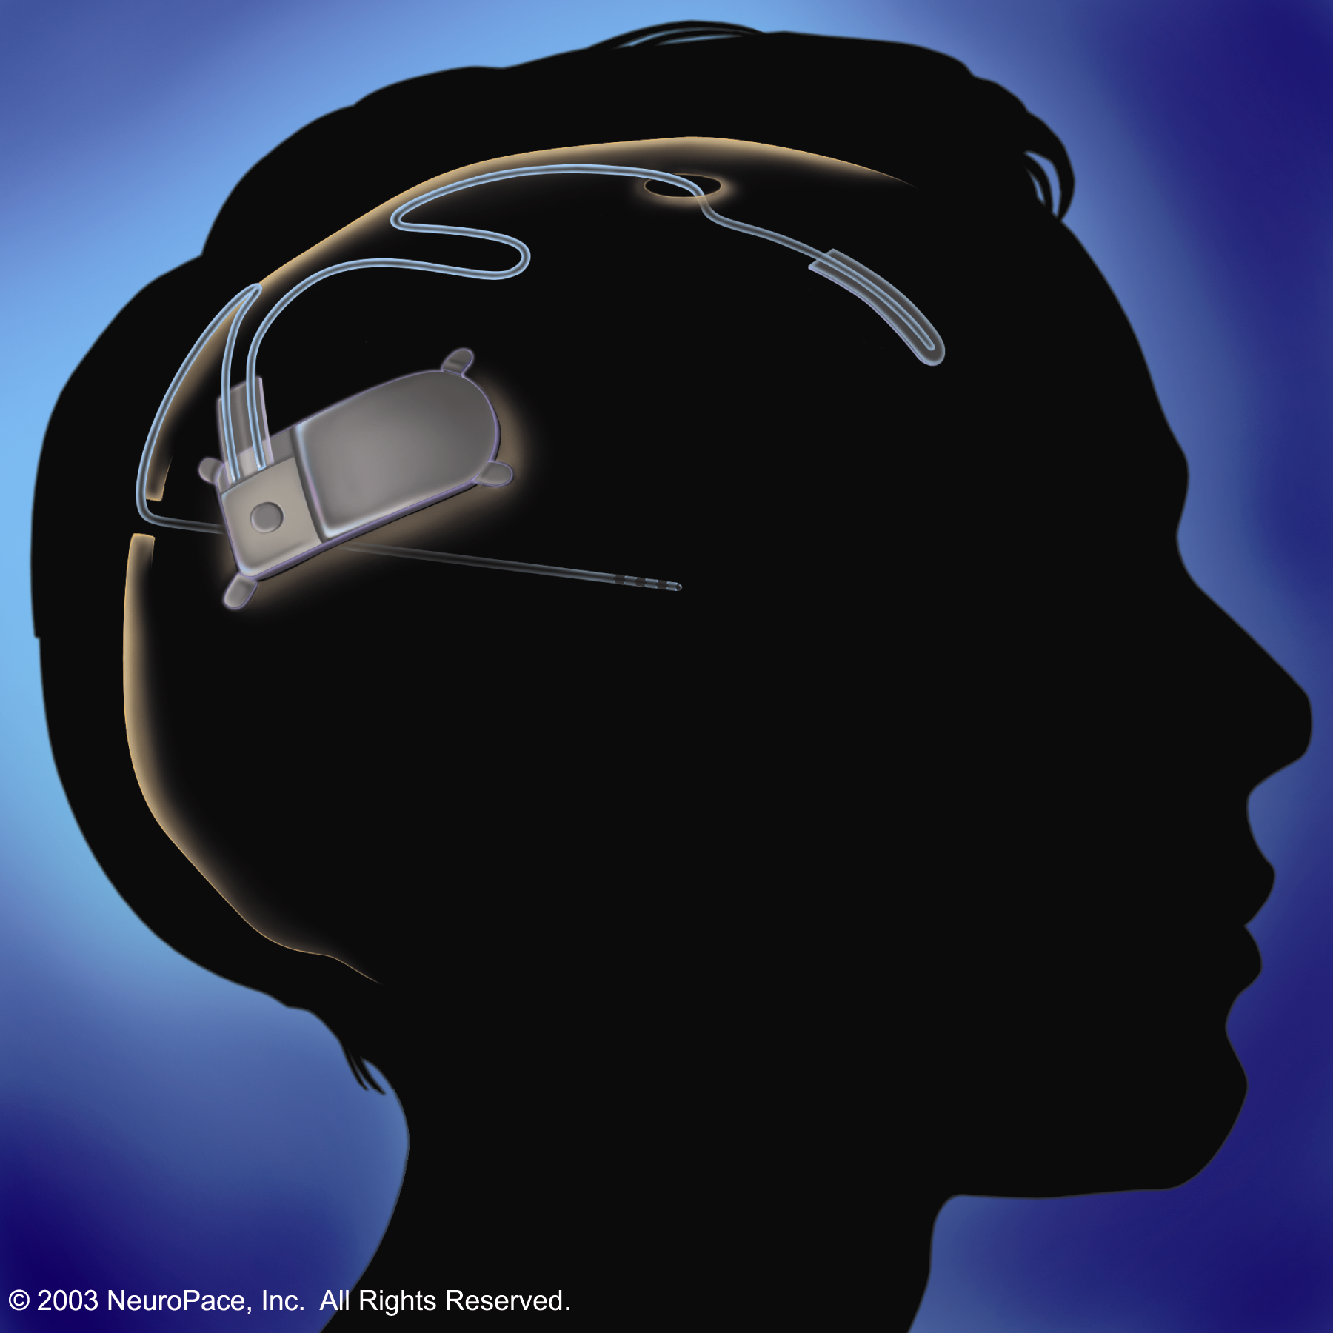
Responsive Neurostimulator (RNS™)
Goal: To disrupt abnormal neuronal synchrony before a seizure occurs by delivering desynchronizing electrical stimulation near the onset zone in response to detected epileptiform activity. (NeuroPace)
NeuroPace
RNS Study Results
Well tolerated and safe
~10-15% seizure free
Increasing seizure reduction with prolonged application
Notes:
Device and stimulation well tolerated
Chronic responsive stimulation therapy safe
Stimulation should occur early in the electrographic event
Electrodes should be placed to capture the earliest electrographic onset
Multiple electrodes in the vicinity of the seizure onset should be used for delivery of responsive stimulation
Frequent responsive stimulation may be necessary to suppress clinical seizures

Slide 15
(Current) RNS System Candidates
Patients >18 years of age or older
Refractory to two or more medications
Partial onset seizures with 1-2 seizure foci
----------------------------------------------------------
Patients commonly treated with the RNS System:
Mesial Temporal Lobe:
Bilateral
Unilateral
Eloquent Cortex
Deep lesions (PVNH)
Difficult to resect:
Interhemispheric
Regional focal onsets
Insula
Partial resection with RNS
Suboptimal response to a previous resection and/or VNS
Notes:
The RNS System is approved to treat patients who are 18 years of age or older, have not responded adequately to two or more antiepileptic medications and have disabling partial onset seizures that arise from one or two foci.
Patients commonly treated with the RNS System include those with:
--Bilateral mesial temporal seizure onsets or unilateral mesial temporal onsets with risks to language or to memory with resection.
--Patients whose seizure arise in eloquent (functional) cortex and who would be at risk for neurological deficits
--Suboptimal response to VNS or epilepsy surgery– about 30 percent of the patients in the RNS System clinical trials had already been treated with a VNS and a similar percentage had already been treated by an epilepsy resective surgery. These patients did as well as those who had not been treated with VNS or surgery

Slide 16
Epilepsy Surgery Goals: Balancing Risk and Benefit
To remove, ablate or stimulate the “epileptogenic zone”, maximizing the chance of seizure freedom, while minimizing risk to the patient.
How do we use closed loop stimulation to increase seizure freedom in our epilepsy patient population?

Slide 17
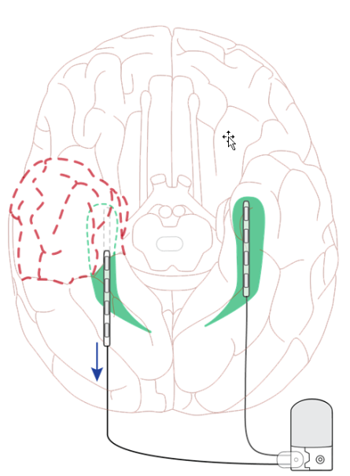
MTL Resection Following Bilateral RNS
Retrospective chart review of patients that had bilateral MTL RNS Systems implanted
Patients underwent a resective or ablative procedure after monitoring with the RNS System
Hirsch, et al. Presented at AES 2018

Slide 18
Results
21 patients at 17 centers underwent an AMTL or SAH following bitemporal RNS
RNS monitoring time: Avg: 42 months (median: 22 mo, range: 8- 117 mo)
At last follow-up, 15 of 21 patients (71%) were free of clinically-reported disabling seizures
Seizure freedom timeframe for these patients was an average of 20 months (median: 13 mo, range: 6-48 mo)
Hirsch, et al. Presented at AES 2018

Slide 19
Neuromodulation: currently used when surgical resection or ablation not a primary option.
Neuromodulation: primary choice over lesioning, particularly in high functioning areas of brain?
Non-MTS mesial temporal lobe
“MRI negative” epilepsy: ? Subtle FCD
Goal: seizure freedom, not palliation, when possible.

Slide 20
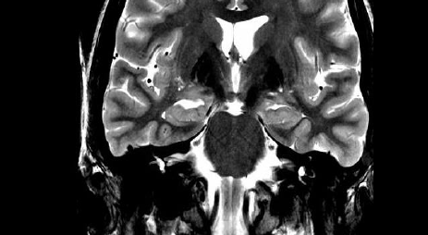
Case: MRI normal TLE
35 yo high functioning female with several years of right TLE. SPS, CPSz, and 2nd generalization, often in clusters.
Semiology: Feeling of “unreality”/”dream like state”
MRI: choroidal fissure cyst; otherwise normal.

Slide 21
PET: R temporal hypometabolism

Slide 22
Neuropsych testing: nonlateralizing Scalp vEEG: Right temporal, broad fMRI: Left language dominant
Options:
Subdural implant?
Generous anterior temporal lobectomy (ATL)?
SEEG?

Slide 23
SEEG implant

Slide 24
SEEG implant Hair Sparing

Slide 25
Onsets in Hippocampus

Slide 26
HC Body onsets

Slide 27
Seizure free at 4 years; no neuropsychological change.
What about if the seizures were arising from dominant HC?

Slide 28
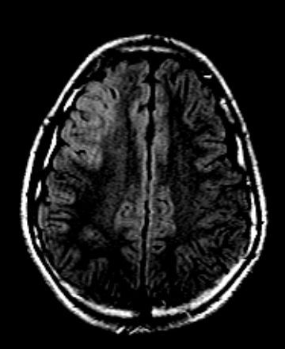
Improving FCD Detection: Voxel Based Morphometry (MAP)
Slide: Dr Irene Wang, CCF
Notes:
28

Slide 29
Summary
Epilepsy Surgery is rapidly changing.
Advanced imaging combined with minimally invasive techniques are decreasing morbidity and mortality.
Long term benefit of newer approaches needs to be demonstrated.
Laser ablation and RNS in their infancy.
Many challenges remain: e.g. interictal, noninvasive detection of epileptogenic zone (EZ).
New techniques are coming: machine learning MRI EZ detection (VBM, rs fMRI) +/- robotic ablation (laser, RF, focused ultrasound); less invasive RNS

