Slide 1
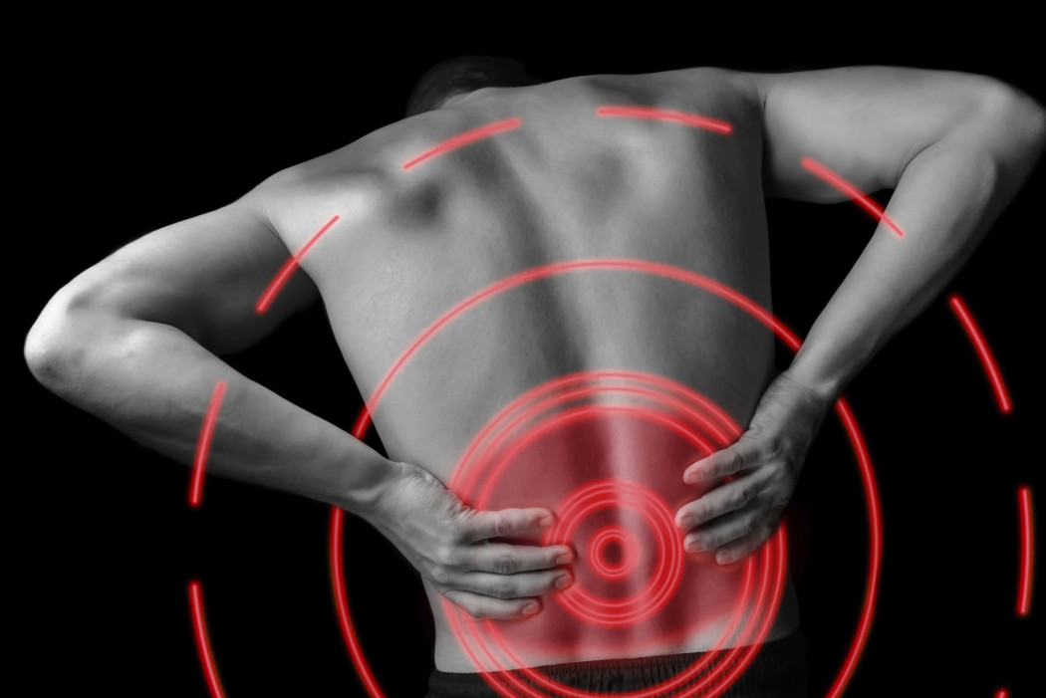
Spinal Cord and DRG Stimulation
January 30 2019
Ausaf A. Bari MD PhD
Assistant Professor
UCLA Department of Neurosurgery

Slide 2
Broad Categories of Surgical Pain Procedures
Remove the offending agent
  Microdiscectomy for radicular pain
  Fusion for instability
  Release entrapment (carpal tunnel release)
  MVD for TN
Lesional
  Cordotomy
  Cingulotomy
  Myelotomy
  DREZ
  Neurectomies, percutaneous rhizotomy for TN
Implantable Pain Pumps
  Intrathecal morphine pump
Stimulation
  Deep brain stimulation (PAG/PVG, Vc Thalamus)
  Peripheral nerve stimulation (ONS)
  Spinal Cord Stimulation
  Dorsal Root Ganglion (DRG) Stimulation
Notes:
Functional Neurosurgery has its roots in ablative procedures such as frontal lobotomy for psych, ….

Slide 3
The Burden of Chronic Pain
Affects at least 23.5 million adults in the U.S.
$635 billion in cost to society
Prevalence of 31%
The most common reason people see a physician.
Increase in long-term opioid use in the U.S.
Back Pain is the most common subtype of chronic pain.
Notes:
Functional Neurosurgery has its roots in ablative procedures such as frontal lobotomy for psych, ….

Slide 4
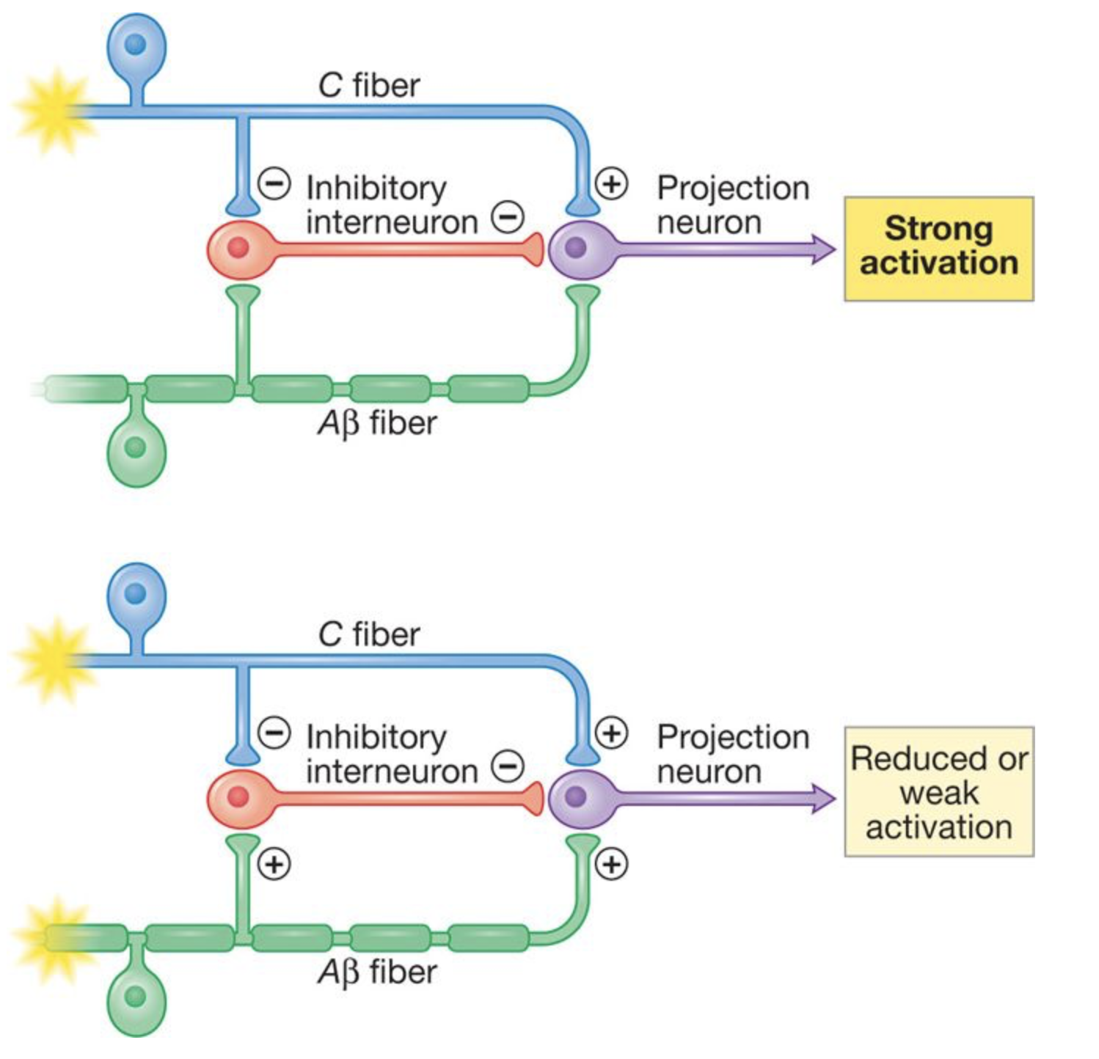

Gate Control Theory of Pain
Notes:
This is neurophysiological theory behind SCS.

Slide 5
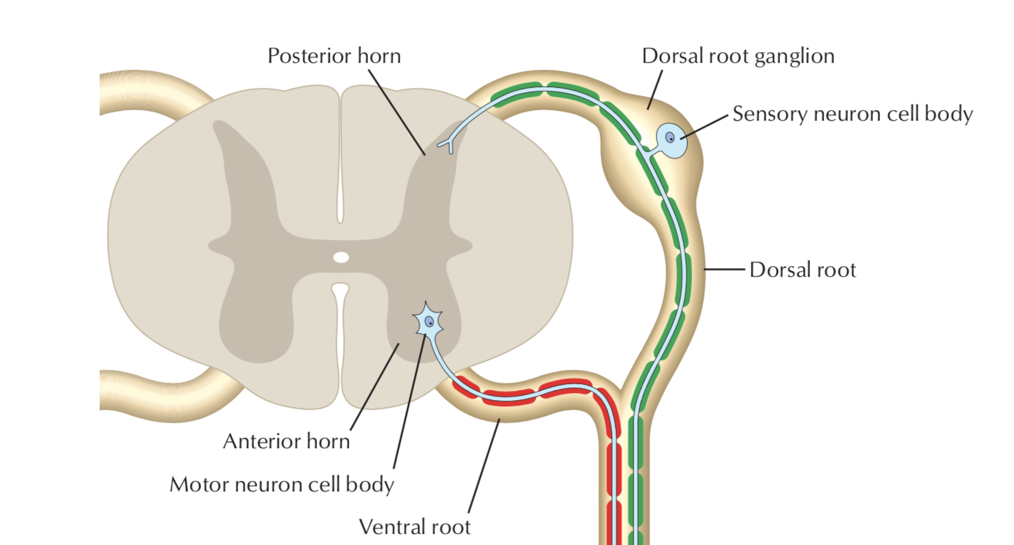
Stimulation for Chronic Pain
Spinal Cord Stimulation
DRG Stimulation

Slide 6

Traditional Low Frequency SCS
Dorsal Column Stimulation at 40-60 Hz Frequency
Indications: chronic intractable pain of the trunk and/or limbs, including unilateral or bilateral pain associated with the following: failed back surgery syndrome (FBSS), intractable low back pain, and leg pain
Replaces pain with paresthesias
Better for extremity pain than for back pain
Can develop tolerance to stimulation over time
Paresthesias can be affected by postural changes
SCS Paddle

Slide 7

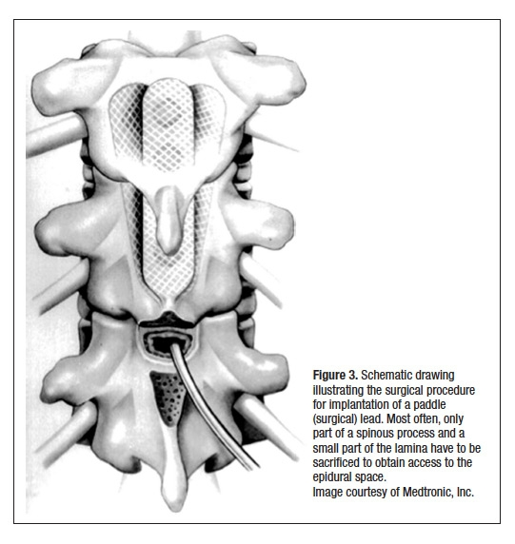
SCS Placement
Percutaneous or through an open laminotomy
Use of fluoroscopy
Epidural electrode placement between T8-T11
Externalize leads for trial
Internalization and placement of pulse generator

Slide 8
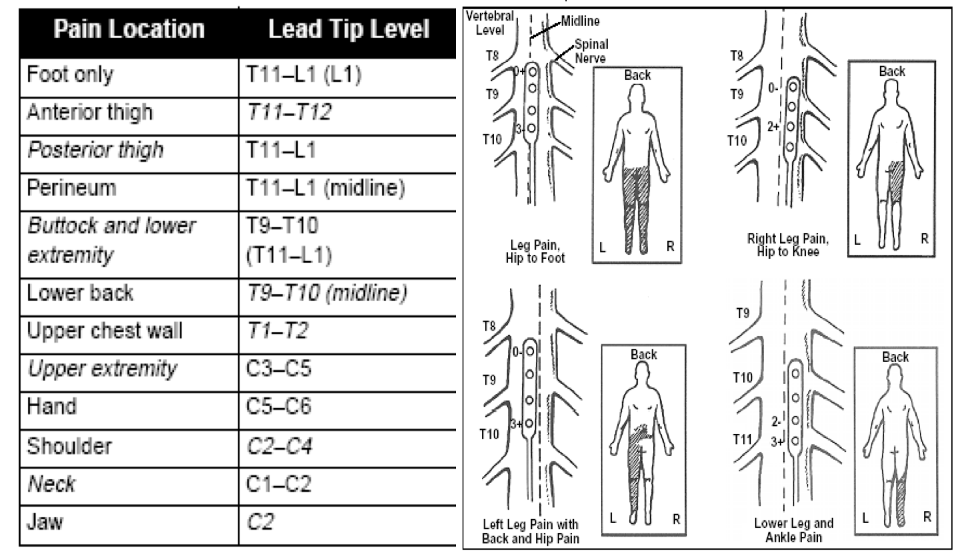

Slide 9
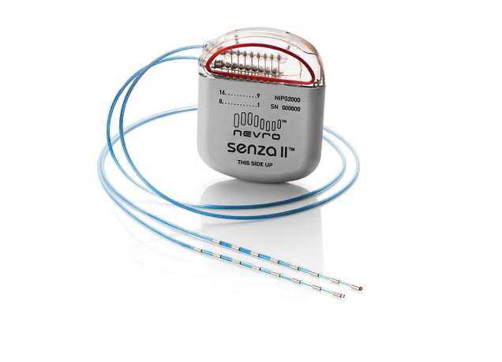
High Frequency SCS
Newer technique
10,000 Hz (vs. 40-60 Hz for regular SCS)
No paresthesias - no mapping
Some evidence for better outcomes compared to traditional SCS
Better outcomes for BACK PAIN
Less tolerance to stimulation

Slide 10
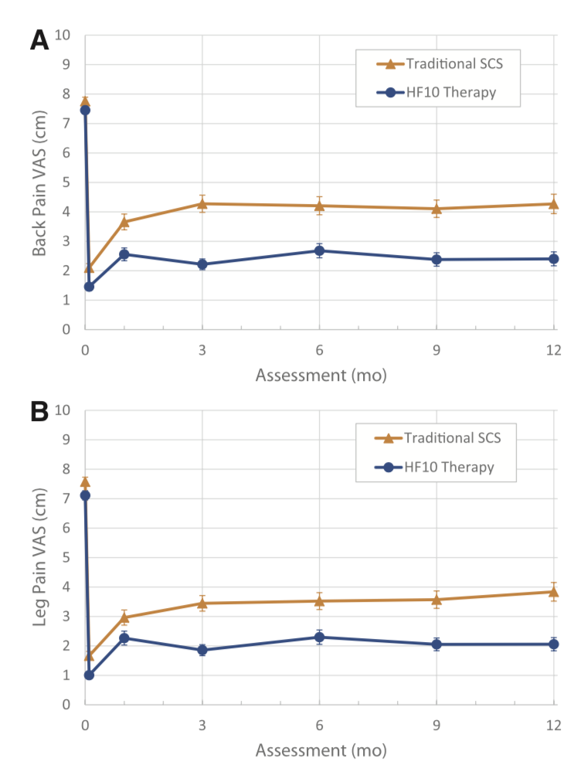
HF10 Outcomes RCT
HF10 > SCS for Back and Leg Pain
At 12 months (50% reduction in pain): 78% (HF10) vs. 53% traditional SCS
Notes:
The primary endpoint of >50% back pain reduction at 3 months was achieved in 80.9% of the HF10 SCS group versus 42.5% of the traditional SCS group.37 This met the cri- teria for noninferiority and statistical superiority (P<0.001). Furthermore, at 12 months, this primary endpoint was met in 78.7% versus 51.3% of the patients.

Slide 11
HF10 Outcomes RCT
Lack of paresthesias:
May allow patients to use stimulation throughout the day including while sleeping (24hrs).
Potential disadvantage of HF10?
Increase in power consumption.
Need for more frequent recharging of pulse generator.
Mechanism: Unlike traditional SCS, unknown - possible inhibition of wide dynamic range (WDR) dorsal horn neurons.
Notes:
The primary endpoint of >50% back pain reduction at 3 months was achieved in 80.9% of the HF10 SCS group versus 42.5% of the traditional SCS group.37 This met the cri- teria for noninferiority and statistical superiority (P<0.001). Furthermore, at 12 months, this primary endpoint was met in 78.7% versus 51.3% of the patients.

Slide 12
Stimulation for Chronic Pain
Spinal Cord Stimulation
DRG Stimulation

Slide 13
DRG Stimulation

Slide 14
DRG Stimulation
More localized dermatomal distribution
May be better for more causalgia/CRPS of the lower limb
Can be used with or without paresthesias
Targets certain anatomical areas that are difficult to treat with SCS:
  pelvis
  groin
  foot
  buttocks
  abdominal pain
Notes:
ACCURATE study 2015
Target outcome >50% reduction in VAS

Slide 15
DRG vs SCS
ACCURATE trial: RCT of DRGS vs SCS for CRPS of the lower extremities.
Primary outcome: ≥ 50% reduction in VAS
At 12 months: DRG: 74% vs SCS: 53%
Less positional variation in perceived paresthesias. (Due to decreased CSF space between DRG and dura).
95% stimulation specificity vs. SCS
Reduced power requirements
Reduced lead migration
Notes:
ACCURATE study 2015
Target outcome >50% reduction in VAS

Slide 16
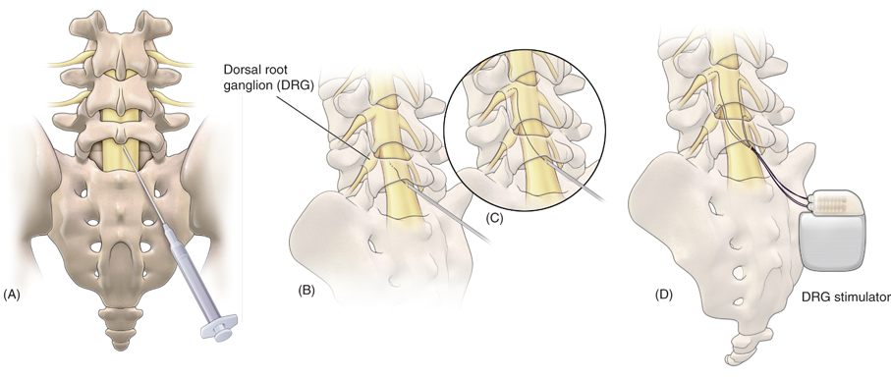
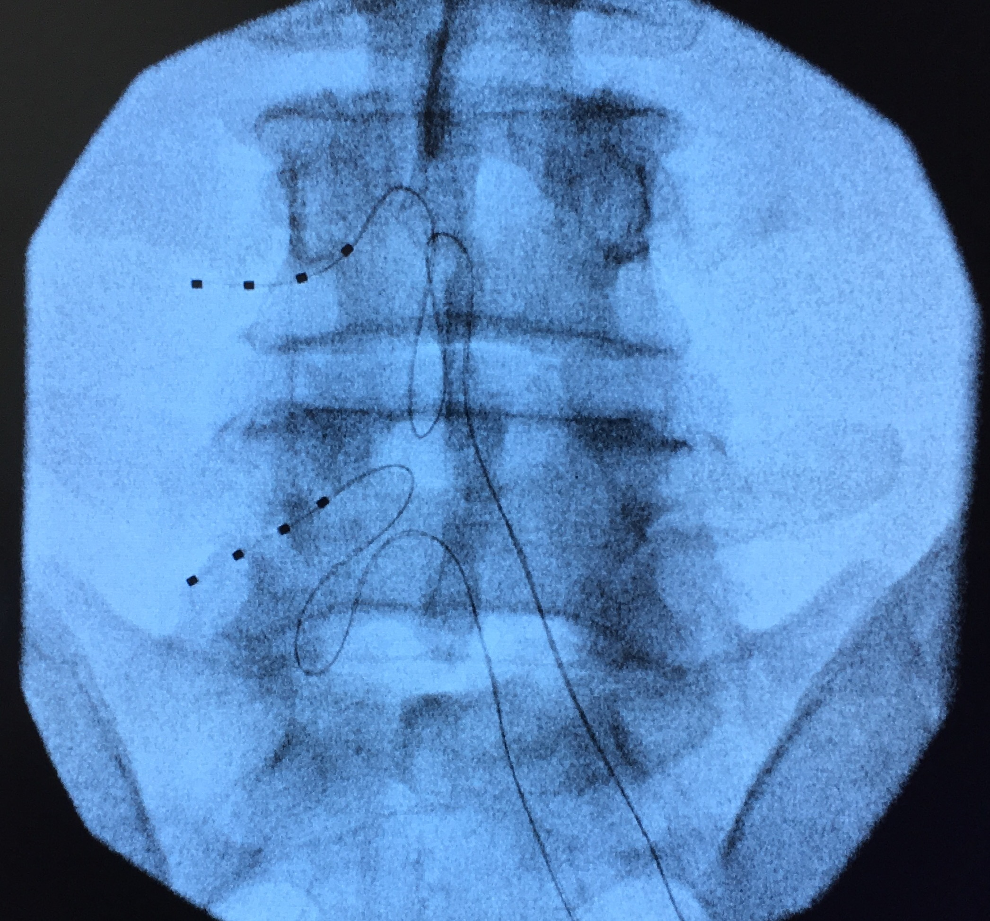
DRG Lead Placement
Percutaneous placement
Hairpin strain relief loop
Externalized trial period
Permanent implant with IPG
Up to 4 separate leads possible

Slide 17
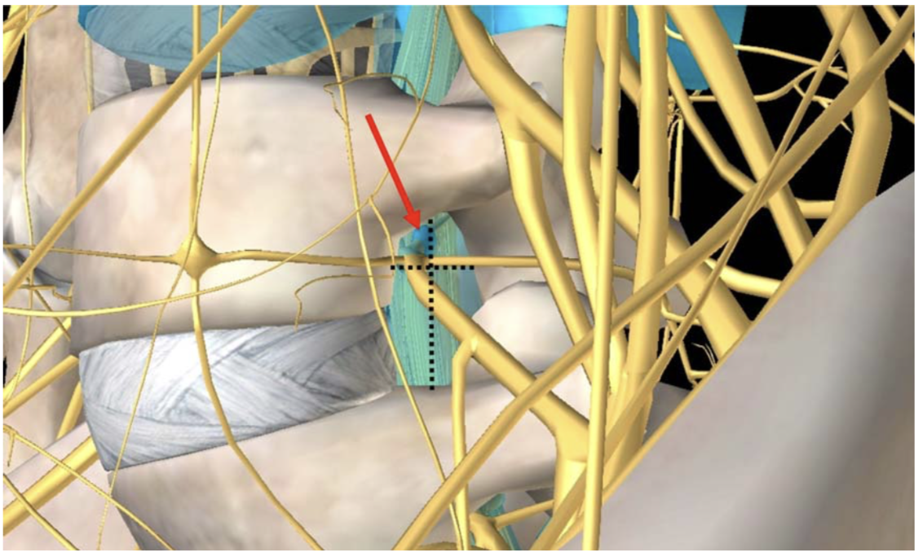
Pearls for DRG Stimulation
Steeper learning curve
Limitation due to foraminal stenosis
Look for neuroforaminal fat on MRI. If no fat - can still proceed but inform patient that it will be more challenging.
For patients with good response to trial can consider removing trial within 3 days to prevent epidural fibrosis for permanent placement.
DRG may alleviate nociceptive pain unlike SCS
Notes:
“Alternate Intraspinal Targets for Spinal Cord Stimulation: A systematic review.” 2016 Chien, Mekhail

Slide 18
Peripheral Nerve Stimulation
Pain isolated to the distribution of a single peripheral nerve.
Examples:
  Occipital Neuralgia
  Entrapment (carpal tunnel syndrome)
  Post-amputation pain
  CRPS
  Post-stroke shoulder pain
  Post-surgical pain (knee, back, inguinal hernia repair)
Notes:
“Alternate Intraspinal Targets for Spinal Cord Stimulation: A systematic review.” 2016 Chien, Mekhail

Slide 19
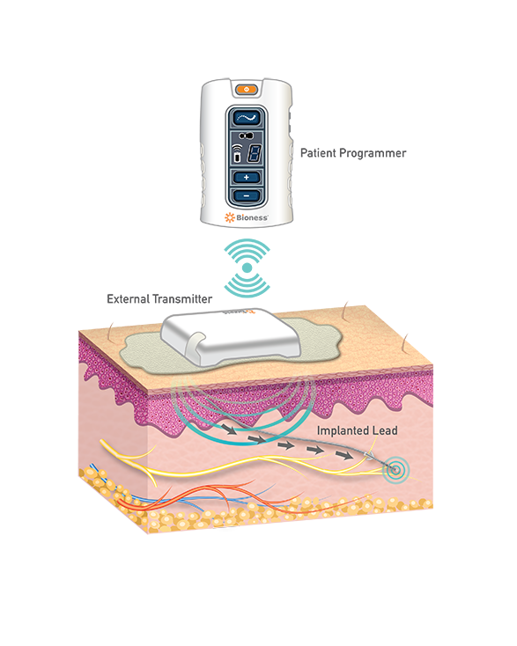
Percutaneous vs. open placement
Wired or wireless options
Trial period followed by permanent placement
Evolving technology
Notes:
“Alternate Intraspinal Targets for Spinal Cord Stimulation: A systematic review.” 2016 Chien, Mekhail

Slide 20
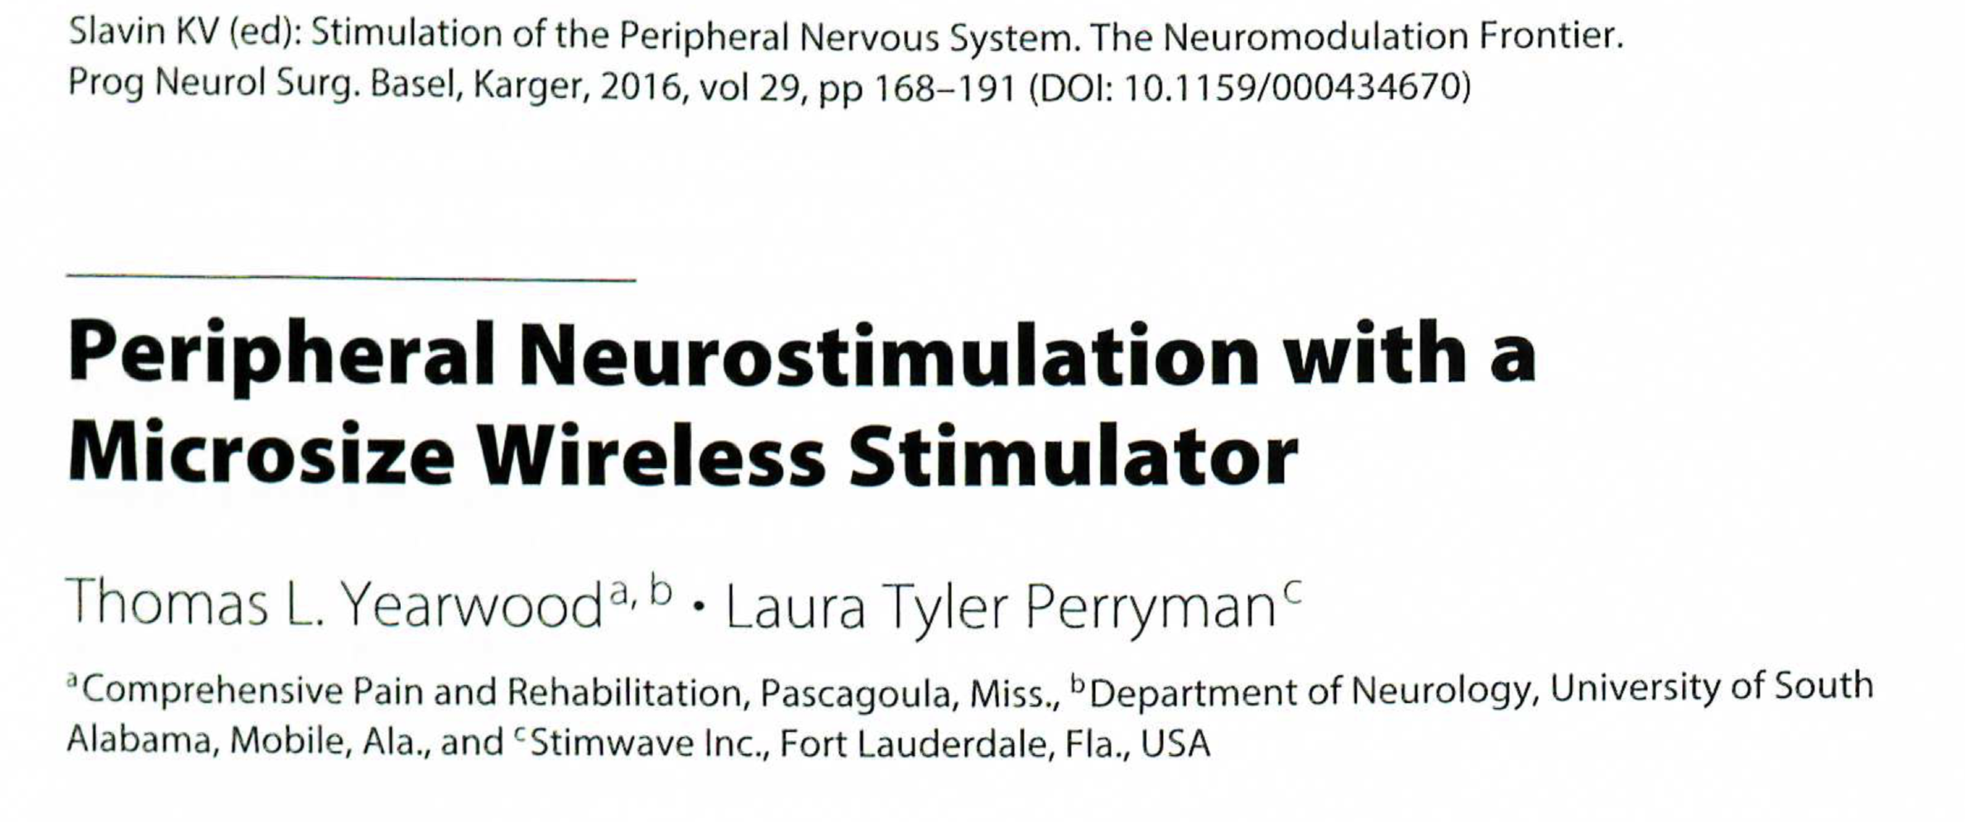
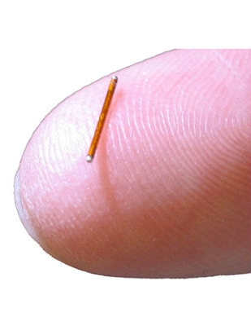
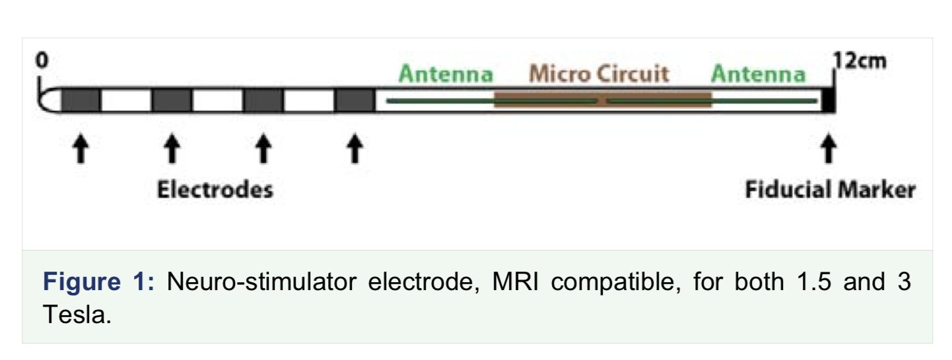
Notes:
“Alternate Intraspinal Targets for Spinal Cord Stimulation: A systematic review.” 2016 Chien, Mekhail

Slide 21
Take Home Points
Try to get patient down to at least 90 morphine equivalents before implanting.
Leave pharmacotherapy to the pain management specialists.
For radicular pain – DRG would be off label. Better to use SCS.
For CRPS involving multiple dermatomes (CRPS) - target the level where the injury initially began.
Don’t necessarily document “spinal CORD stimulation” in H&P/Consult Note. Dictate “SPINAL stimulation” to allow for flexibility to use either DRG or SCS.
Wireless techniques are available now for patients that do not want an IPG.
Patient selection is still key:
  Remove the offending pathology if possible
  Externalized trial period
  Psychiatric pre-evaluation

