Slide 1



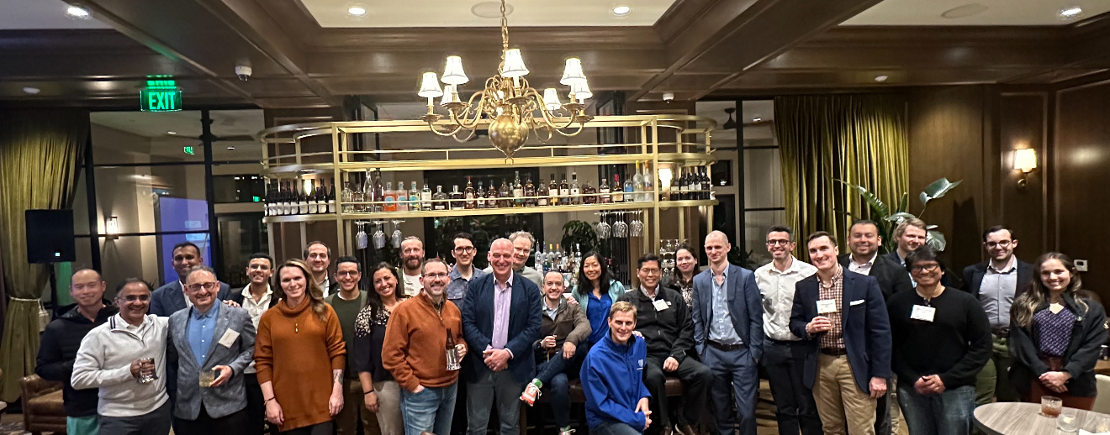
13th Annual Hands-On Practical Course in Stereotactic and Functional Neurosurgery
Center for Surgical Innovation, University of Colorado Anschutz School of Medicine, Aurora, CO
October 23-25, 2026

Slide 2
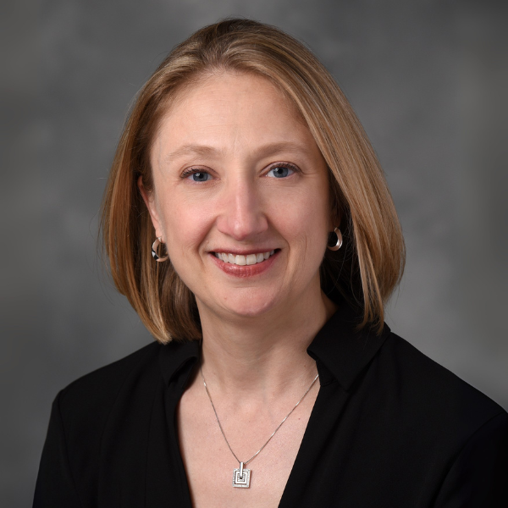
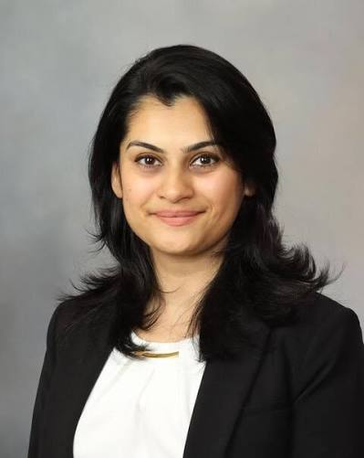
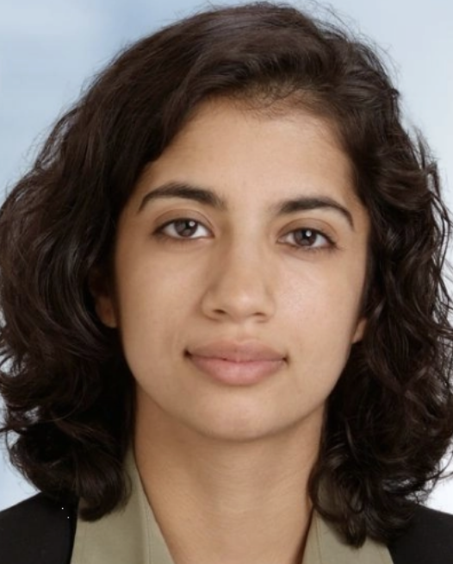
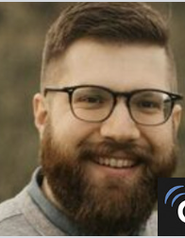
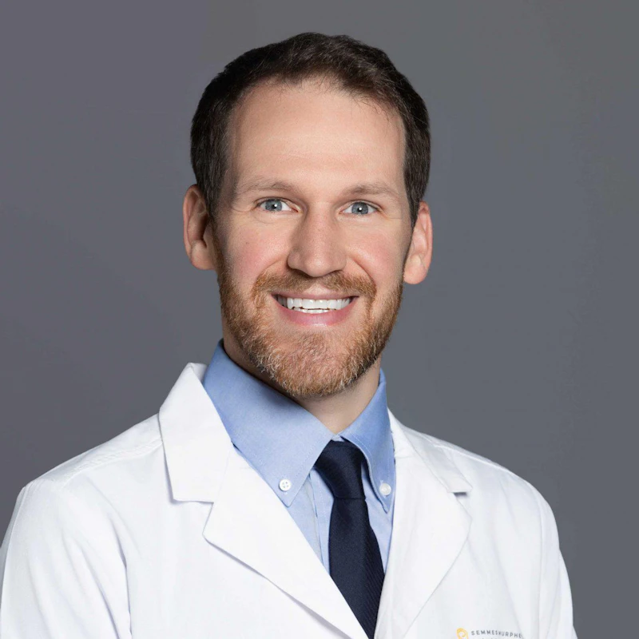
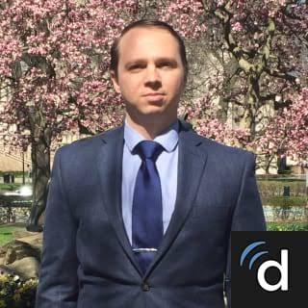
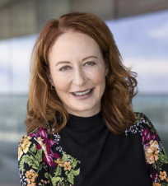
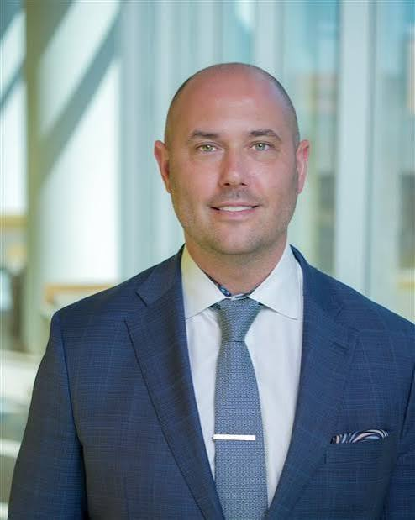
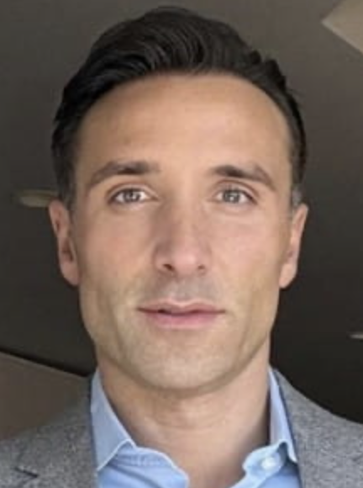
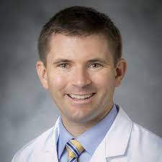
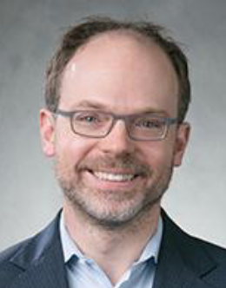
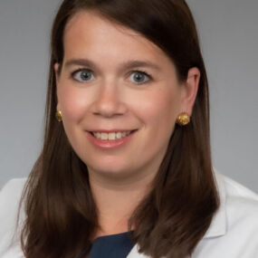
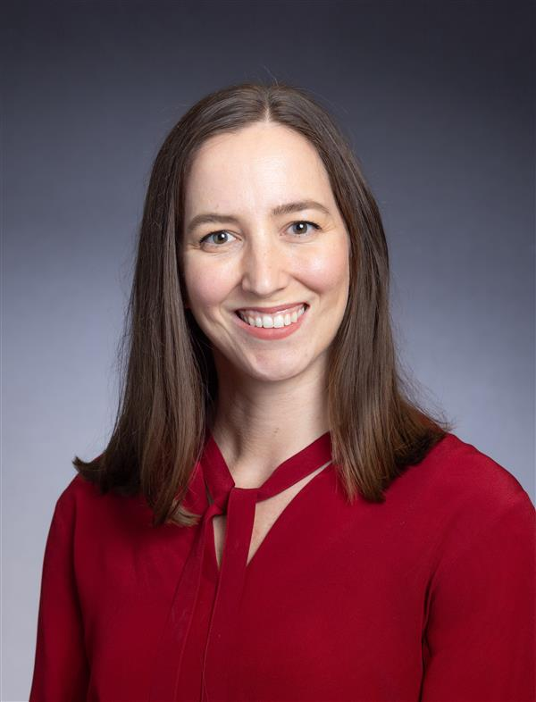
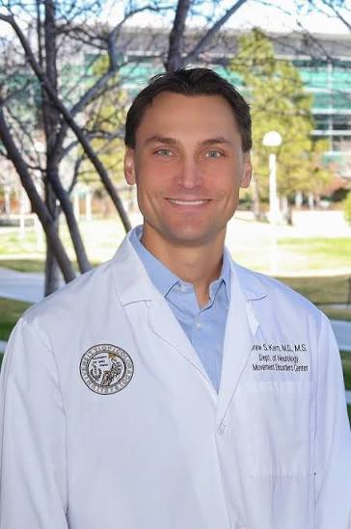
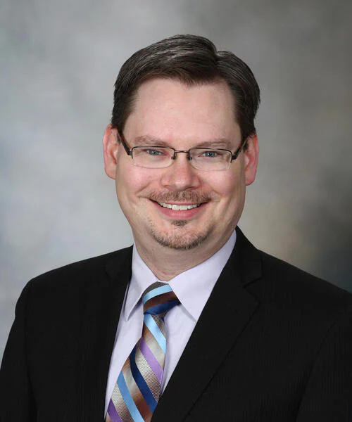
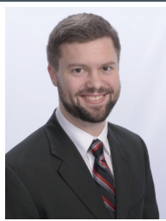
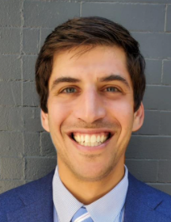
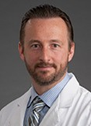
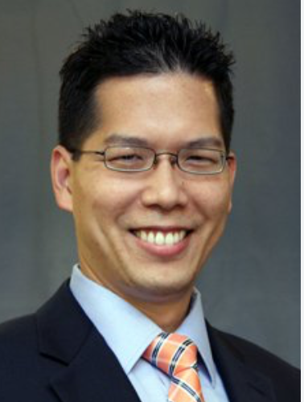
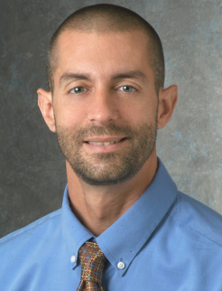
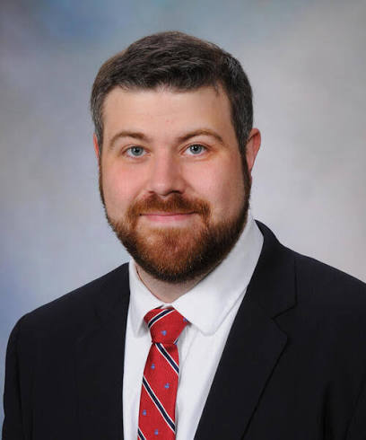
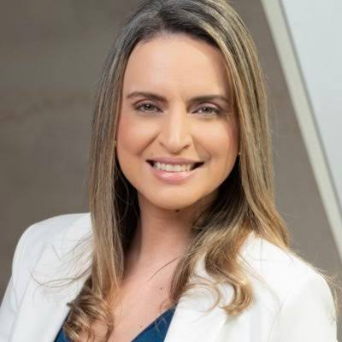
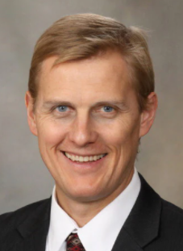
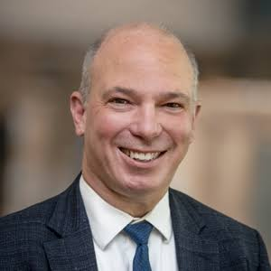
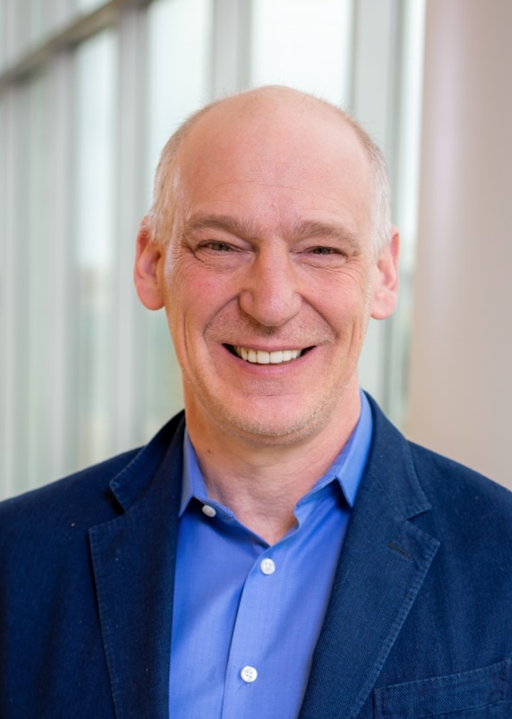
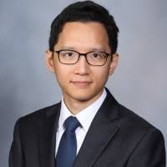
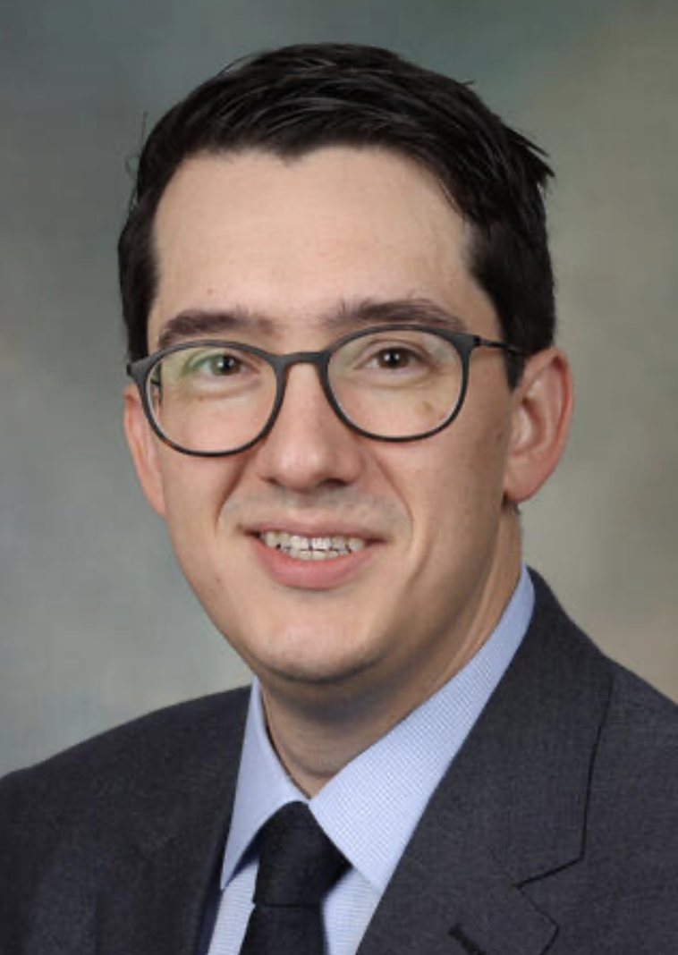
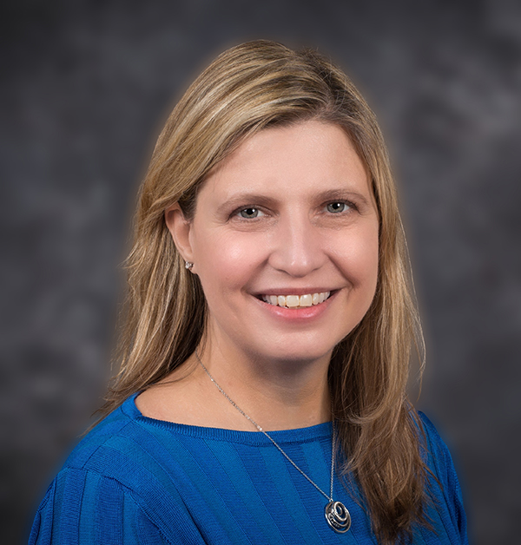
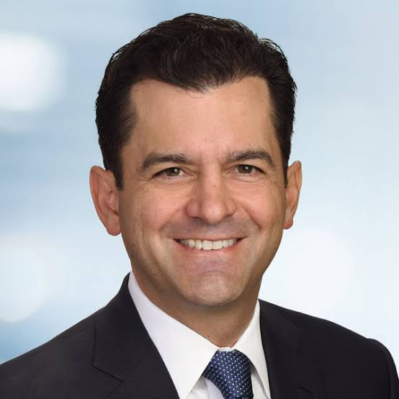
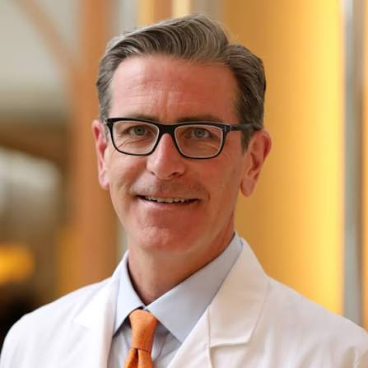
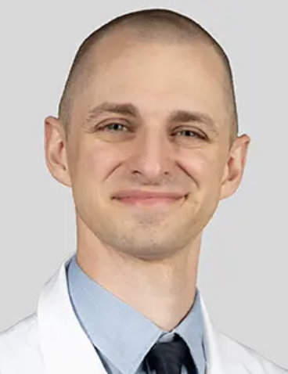
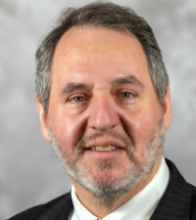
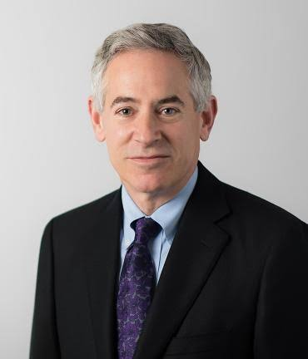
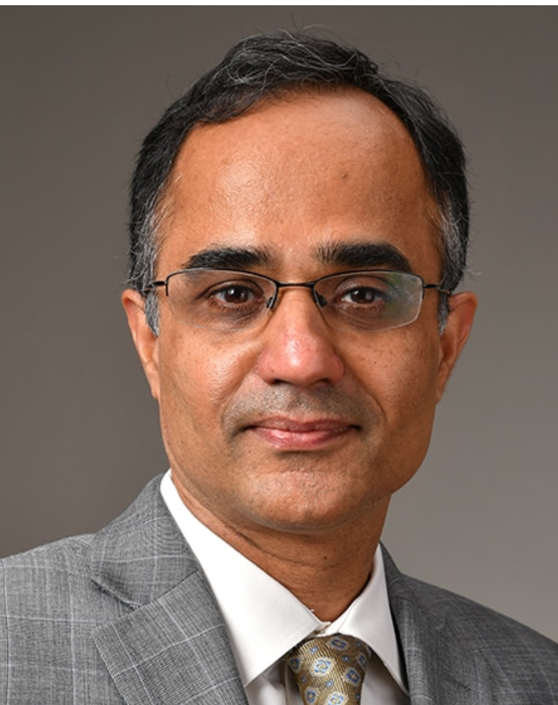
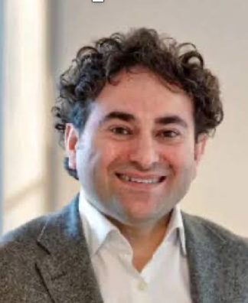
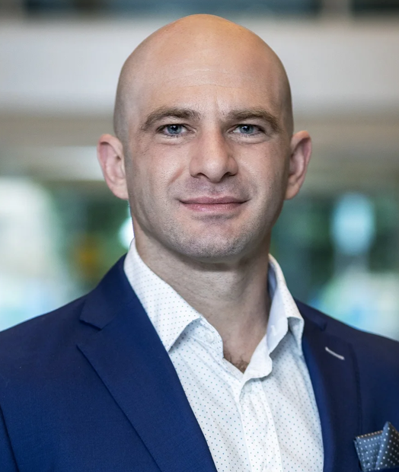
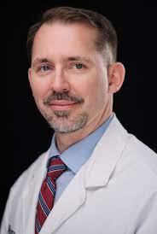
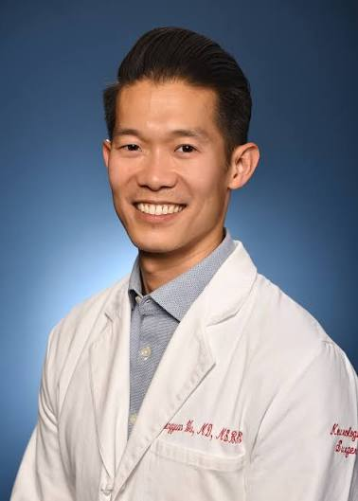
Course Faculty
Ellen Air
Rushna Ali
Sana Aslam
Alex Baumgartner
Ben Carroll
Jonathan Cavaleri
Rachel Davis
Peter Fecci
Fabio Grassia
Steve Harward II
Henry Ford Health
Mayo Clinic, Rochester, MN
University of Colorado Anschutz
University of Colorado Anschutz
Semmes-Murphy Clinic
UTHealth Houston
University of Colorado Anschutz
University of Colorado Anschutz
Denver Health
Duke University
Adam Hebb
Lora Kahn
Lesley Kaye
Drew Kern
Bryan Klassen
Michael Korsmo
Dan Kramer
Adrian Laxton
Brian Lee
Cameron McIntyre
Swedish Medical Center, Seattle
Ochsner Health
University of Colorado Anschutz
University of Colorado Anschutz
Mayo Clinic, Rochester, MN
University of Colorado Anschutz
University of Colorado Anschutz
Wake Forest University
University of Southern California
Duke University
Erik Middlebrooks
Vanessa Milanese
Kai Miller
Jeff Ojemann
Steven Ojemann
Sihyeong Park
Jonathon Parker
Julie Pilitsis
Francisco Ponce
John Sampson
Mayo Clinic, Jacksonville, FL
A Beneficencia Portuguesa, Brazil
Mayo Clinic, Rochester, MN
University of Washington
University of Colorado Anschutz
Mayo Clinic, Rochester, MN
Mayo Clinic, Phoenix, AZ
University of Arizona
Barrow Neurological Institute
University of Colorado Anschutz
David Satzer
Jason Schwalb
Philip Starr
Nitin Tandon
Yasin Temel
Eddie Tsvankin
Jon Willie
Chen Wu
University of Chicago
Indiana University
University of California, San Francisco
UTHealth Houston
Maastricht University
University of Colorado Anschutz
UT Austin
Thomas Jefferson University
Notes:
Ben carroll Semmes Murphy clinic at Utenn memphis
Won soek Chang Associate professor at Yonsei university, seoul, south korea
Adam Hebb kaiser permanente
Eddie tsvankin Colorado Brain And Spine Institute Denver

Slide 3
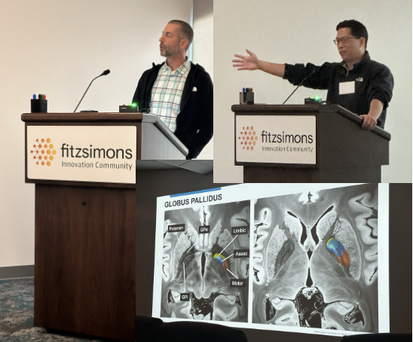
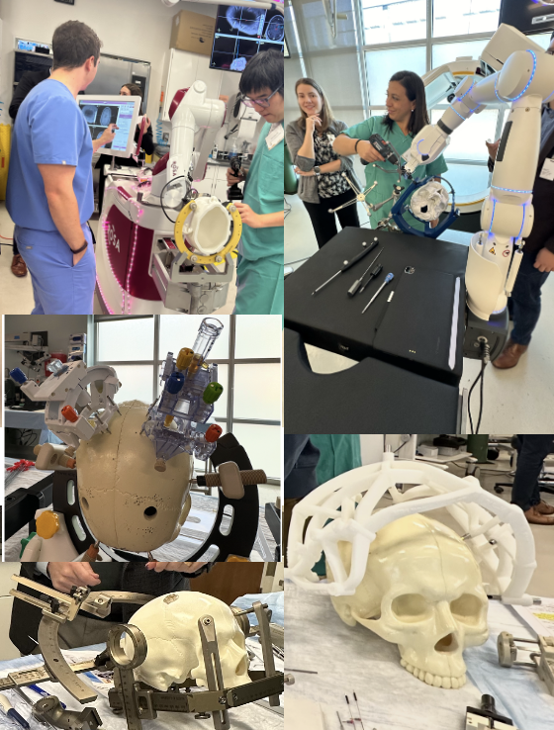
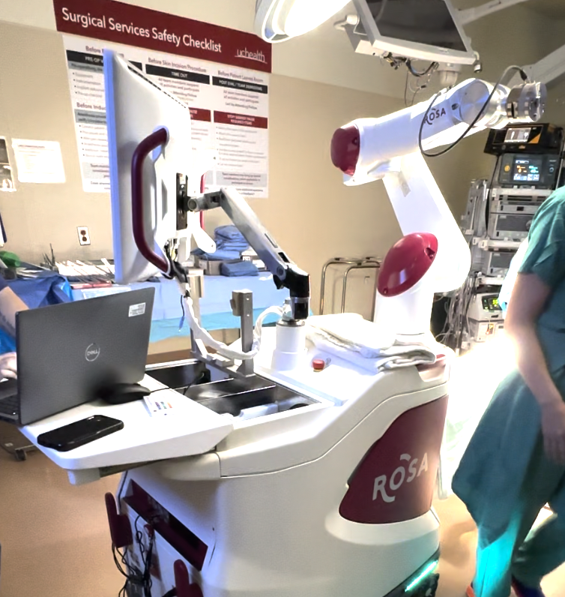
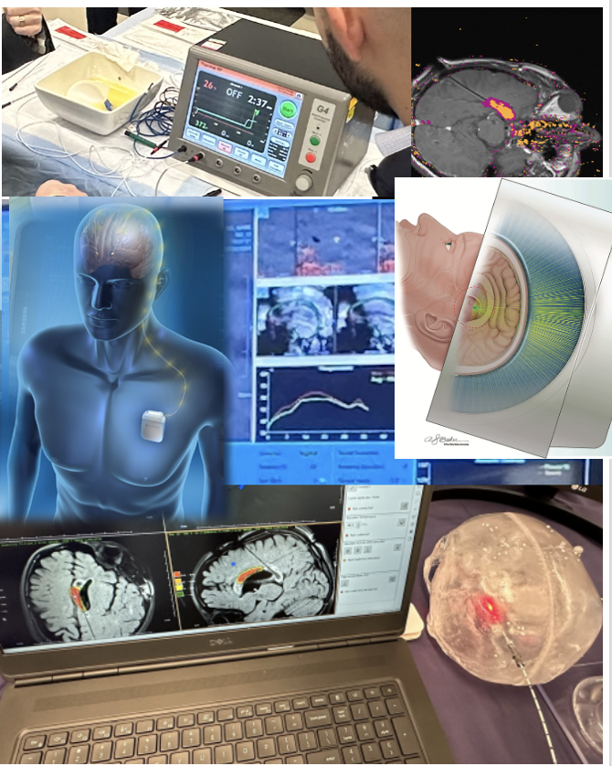
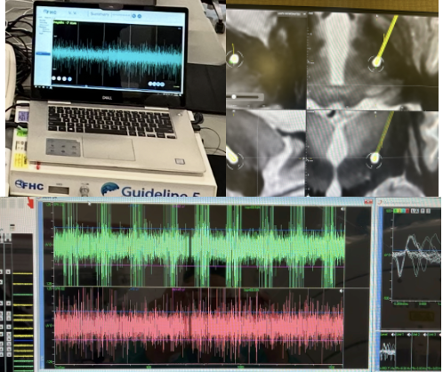
FRIDAY AM: DIDACTICS
SATURDAY: HANDS-ON
STEREOTACTIC PLATFORMS
SUNDAY: HANDS-ON
ENERGY DELIVERY
Laser, RF, Electrical, Ultrasound
FRIDAY PM: HANDS-ON
ANATOMY AND PHYSIOLOGY

Slide 4
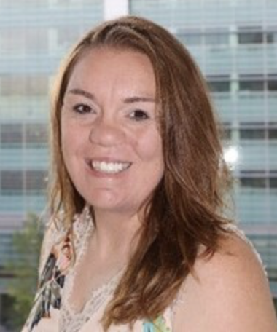
For more information or registration, please contact Jennifer Hasenbalg- Jennifer.Hasenbalg@CUAnschutz.edu
Jennifer Hasenbalg
Jennifer.Hasenbalg@CUAnschutz.edu

